Slide 1
Q9 2022 Client Presentation
Q9 2022 Client Presentation
Revenue sources — Black Hills vs benchmark regions

Slide 2
Dataset and revenue source variables
Dataset
This presentation uses the GivingTuesday Form 990-family analysis file for the Black Hills and benchmark-region nonprofit comparison.
• Tax year: 2022 only.
• Forms included: Form 990 (1,085 rows), Form 990-EZ (563 rows), and Form 990-PF (151 rows).
• Analysis universe: 1,799 organization-year records representing 1,797 unique EINs after requiring positive total revenue.
• Exclusions: hospitals, universities, and political organizations are excluded for client-peer comparability; excluded rows in the full selected-year frame: 25.
• Statistical tests compare organization-level 2022 raw dollar values, not regional aggregate totals or stacked-bar percentages.
Variable definitions
The analysis partitions revenue into earned program revenue, contribution-source categories, mixed/unclassified contributions, and other revenue. The detailed contribution-source categories are clean only for Form 990 filers.
Variable | Meaning
Total revenue | All reported revenue for the organization in tax year 2022.
Program service revenue | Mission-related earned revenue from program services; available for Form 990 and 990-EZ, while Form 990-PF lacks the same comparable field. Blank supported lines are treated as zero.
Total contributions | Total reported contributions, gifts, grants, and similar amounts across the 990-family forms. Blank supported lines are treated as zero.
Government grants received | Form 990 Part VIII Line 1e government grants; 990-EZ/PF are excluded for this subcomponent because they do not expose it cleanly.
Federated campaign contributions | Form 990 Part VIII Line 1a federated campaign support, such as United Way-style campaign allocations.
Related organization contributions | Form 990 Part VIII Line 1d contributions from related organizations or affiliates.
Membership dues | Form 990 Part VIII Line 1b membership dues; an individual-adjacent proxy, not pure individual giving.
Fundraising event contributions | Form 990 Part VIII Line 1c fundraising event contributions; individual-adjacent, not pure individual giving.
Mixed / unclassified contributions | Form 990 Line 1f plus all 990-EZ/PF contribution totals that cannot be decomposed into source subcategories.
Other revenue | Other revenue, calculated as total revenue minus program revenue and the detailed contribution-source components.
990-EZ and 990-PF do not expose the same contribution-source subcomponents as Form 990. For detailed subcomponent tests and median charts, those rows are excluded for the unavailable source rather than treated as zero. Their contribution totals are routed to mixed / unclassified contributions for the all-form revenue partition. Foundation grants cannot be cleanly isolated in this file.
Q9 2022 · 1

Slide 3
2022 revenue sources — overview (same metric as statistical slides)
This chart uses the same definition as Slides 3–12: for each revenue source, the bar height is the median dollar amount among organizations in that region that report a positive value for that source (zeros excluded). Each small panel is one source; the five bars are the five regions.
• Purpose: Orientation — see all sources and regions on one page before the source-by-source pairwise slides.
• Aligned with tests: Slides 3–12 show the same positive-only medians with Black Hills vs each benchmark; permutation p-values are on the following slides' bullets and tables.
• Not stacked: Medians for different sources are not added together (each source has its own reporter pool).
• Archived stacked views: Aggregate dollar totals, aggregate shares, and stacked positive-only medians (normalized mix and raw sum of medians) are in python/analysis/revenue_sources_black_hills/results/client_notebook_assets/. Stacked medians use the same positive-reporter definition but each segment is a different org subset, so normalized stacks show a relative profile only — not a budget that adds up.
How to read the charts and tests
Zero-excluded framing. Every revenue and contribution source slide below restricts the median and the permutation test to organizations that report a positive amount for that source. This trades the population-level prevalence story (how many organizations engage with the source at all) for the conditional dollar story (when an organization does engage, how big is the check). Reporting rates, reporter counts, and IQR are stored in client_2022_pairwise_presentation_summary.csv if needed.
Headline test. Pairwise tests use a two-sided permutation test on the median dollar difference between Black Hills positive reporters and each benchmark region's positive reporters (10,000 reshuffles, seed 321). The median gap is shown with a 95% percentile bootstrap CI on the source slides below.
How to read the charts. Each region is a single bar whose height equals the median dollar amount reported by organizations in that region — restricted to positive reporters, as described above. The chart shows region names only; slide bullets on the following pages report the median gap, 95% CI, and permutation p-value for each Black Hills vs benchmark comparison.
What changes vs an all-population test. For sources where Black Hills has the *highest* reporting rate but a *lower* dollar amount among reporters (government grants, federated campaigns), the direction of difference flips between the two framings. Both views can be true at once: more Black Hills organizations participate, but each participating organization brings in fewer dollars from that source. Use both numbers when telling the full story to the board.
Q9 2022 · 2

Slide 4
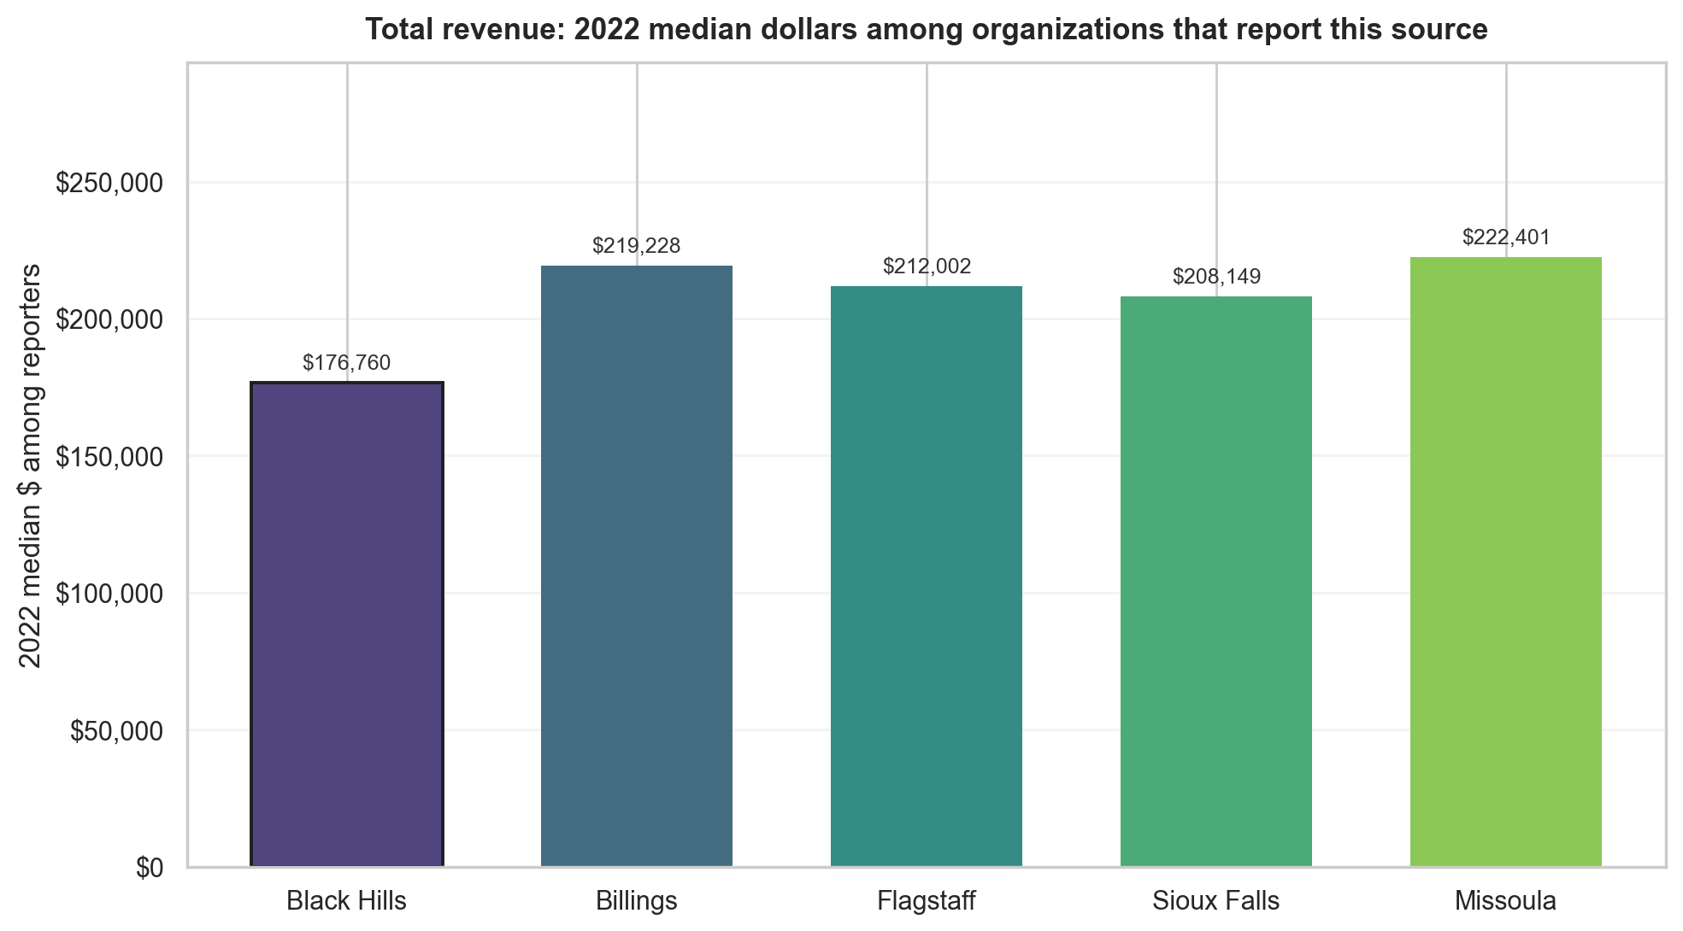
Total revenue
Pairwise comparison of conditional medians for organizations with a positive value for this source (zeros excluded). Headline test: two-sided permutation on the median difference.
Benchmark | Significance | BH median | Benchmark median | Median gap (95% CI) | p-value
Billings | Not significant | $176,760 | $219,228 | -$42,468 (95% CI -$125,394 to +$33,850) | p = 0.269
Flagstaff | Not significant | $176,760 | $212,002 | -$35,242 (95% CI -$149,323 to +$35,127) | p = 0.366
Sioux Falls | Not significant | $176,760 | $208,149 | -$31,390 (95% CI -$84,901 to +$26,666) | p = 0.246
Missoula | Not significant | $176,760 | $222,401 | -$45,642 (95% CI -$126,653 to +$32,158) | p = 0.242
Q9 2022 · 3

Slide 5
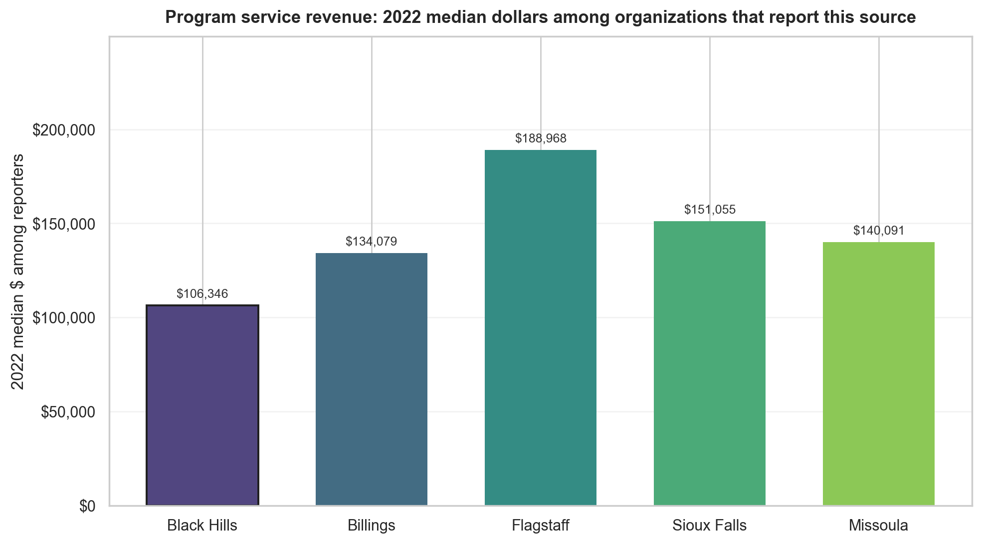
Program service revenue
Pairwise comparison of conditional medians for organizations with a positive value for this source (zeros excluded). Headline test: two-sided permutation on the median difference.
Benchmark | Significance | BH median | Benchmark median | Median gap (95% CI) | p-value
Billings | Not significant | $106,346 | $134,079 | -$27,733 (95% CI -$96,511 to +$25,161) | p = 0.292
Flagstaff | Significant | $106,346 | $188,968 | -$82,622 (95% CI -$188,223 to +$1,513) | p = 0.038
Sioux Falls | Not significant | $106,346 | $151,055 | -$44,709 (95% CI -$114,440 to +$6,707) | p = 0.089
Missoula | Not significant | $106,346 | $140,091 | -$33,745 (95% CI -$91,143 to +$18,223) | p = 0.175
Q9 2022 · 4

Slide 6
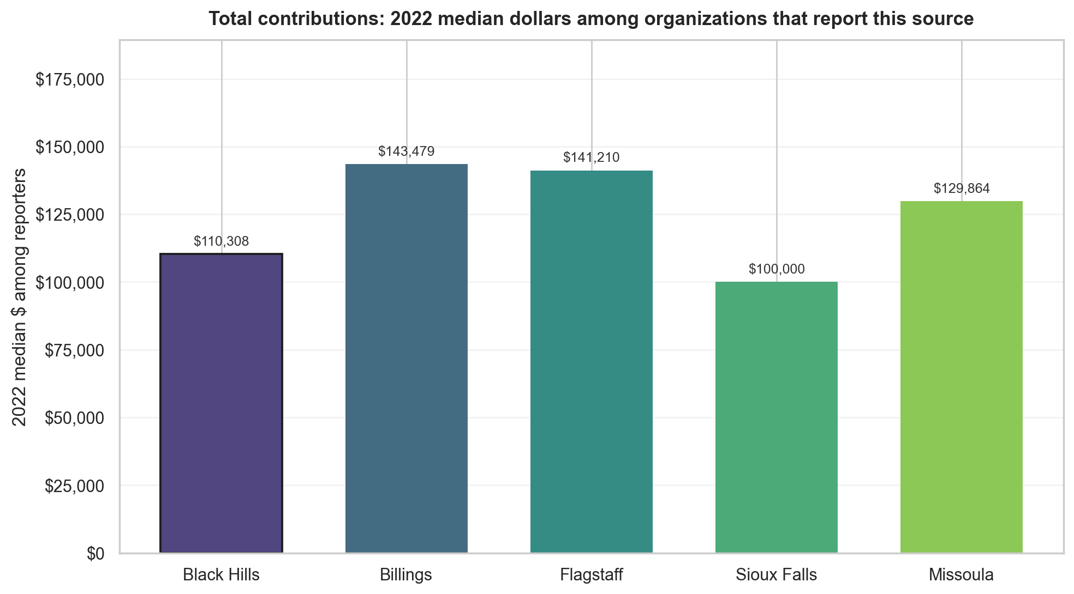
Total contributions
Pairwise comparison of conditional medians for organizations with a positive value for this source (zeros excluded). Headline test: two-sided permutation on the median difference.
Benchmark | Significance | BH median | Benchmark median | Median gap (95% CI) | p-value
Billings | Not significant | $110,308 | $143,479 | -$33,171 (95% CI -$85,280 to +$16,324) | p = 0.161
Flagstaff | Not significant | $110,308 | $141,210 | -$30,902 (95% CI -$95,512 to +$14,239) | p = 0.224
Sioux Falls | Not significant | $110,308 | $100,000 | +$10,308 (95% CI -$20,952 to +$41,476) | p = 0.448
Missoula | Not significant | $110,308 | $129,864 | -$19,556 (95% CI -$95,775 to +$26,776) | p = 0.309
Q9 2022 · 5

Slide 7
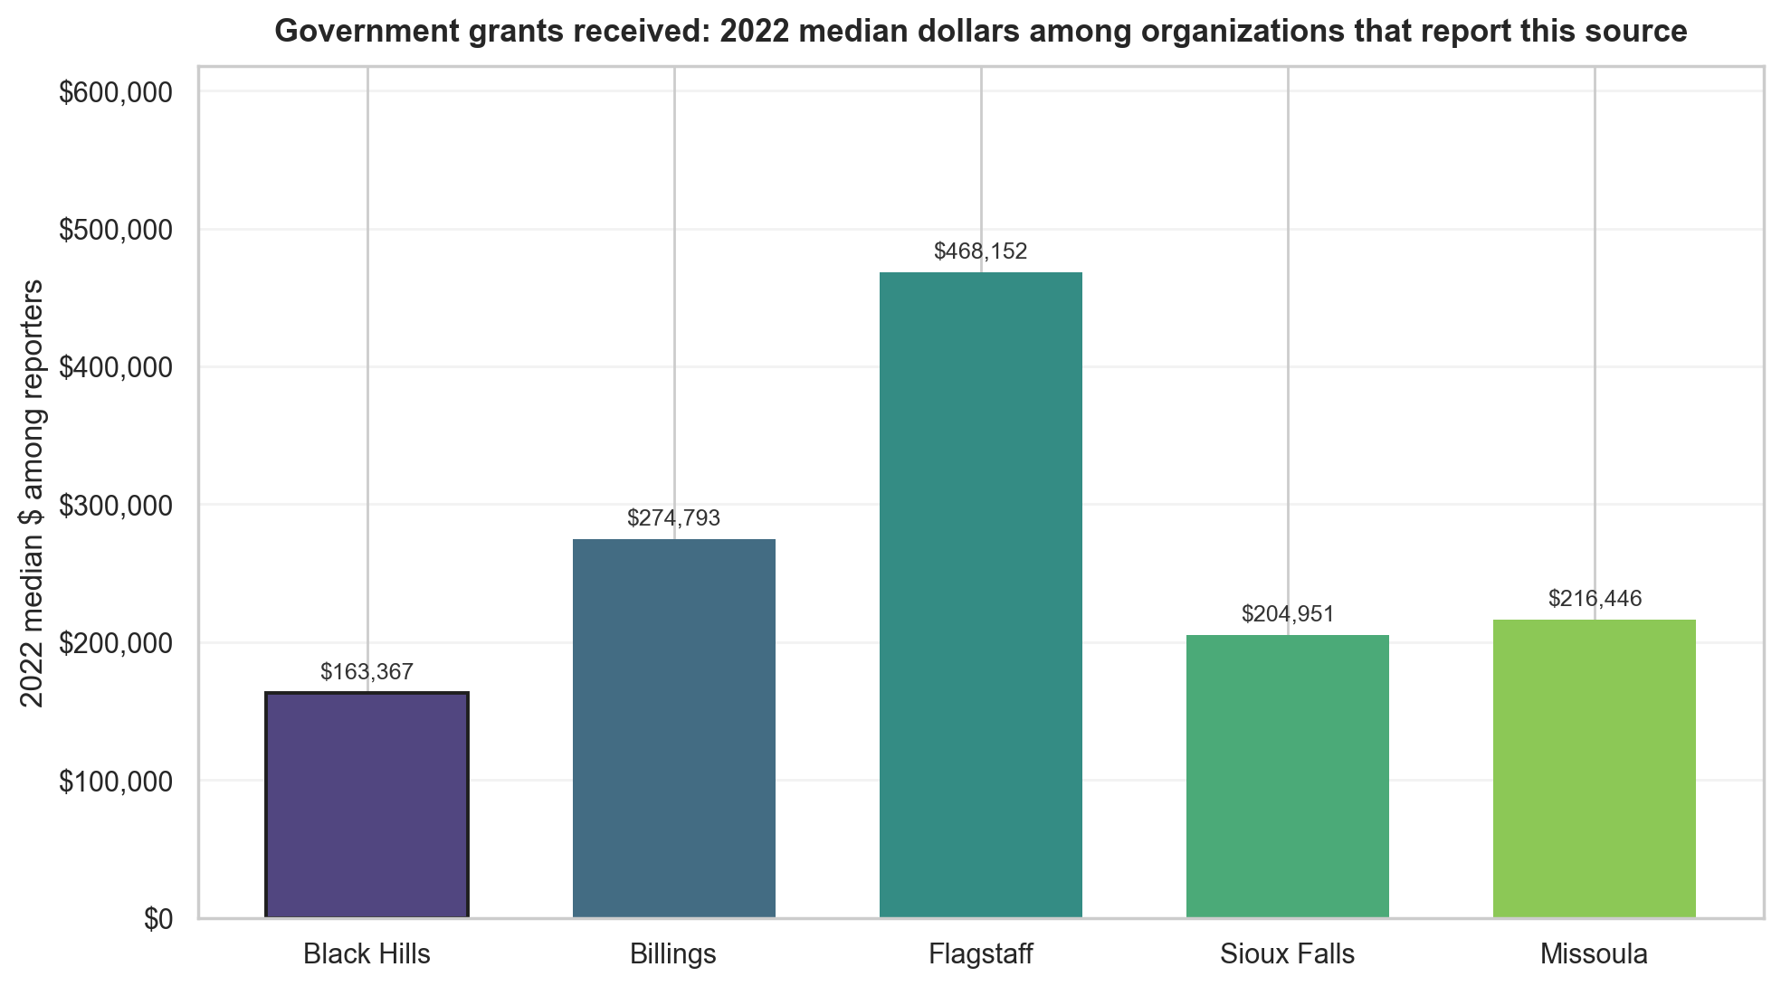
Government grants received
Pairwise comparison of conditional medians for organizations with a positive value for this source (zeros excluded). Headline test: two-sided permutation on the median difference.
Benchmark | Significance | BH median | Benchmark median | Median gap (95% CI) | p-value
Billings | Significant | $163,367 | $274,793 | -$111,426 (95% CI -$345,341 to +$7,163) | p = 0.043
Flagstaff | Significant | $163,367 | $468,152 | -$304,785 (95% CI -$817,302 to -$131,168) | p = 0.003
Sioux Falls | Not significant | $163,367 | $204,951 | -$41,584 (95% CI -$156,414 to +$89,266) | p = 0.507
Missoula | Not significant | $163,367 | $216,446 | -$53,078 (95% CI -$292,032 to +$26,850) | p = 0.197
Q9 2022 · 6

Slide 8
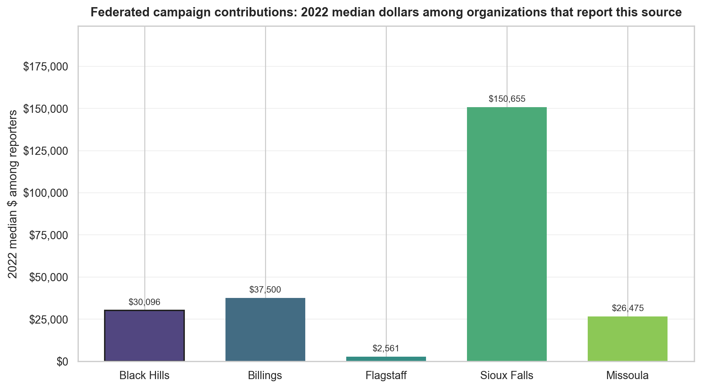
Federated campaign contributions
Pairwise comparison of conditional medians for organizations with a positive value for this source (zeros excluded). Headline test: two-sided permutation on the median difference.
Benchmark | Significance | BH median | Benchmark median | Median gap (95% CI) | p-value
Billings | Not significant | $30,096 | $37,500 | -$7,404 (95% CI -$41,337 to +$36,319) | p = 0.688
Flagstaff | Not significant | $30,096 | $2,561 | +$27,535 (95% CI -$50,214 to +$38,331) | p = 0.179
Sioux Falls | Significant | $30,096 | $150,655 | -$120,559 (95% CI -$251,704 to -$58,041) | p = 0.005
Missoula | Not significant | $30,096 | $26,475 | +$3,621 (95% CI -$374,904 to +$29,973) | p = 0.819
Q9 2022 · 7

Slide 9
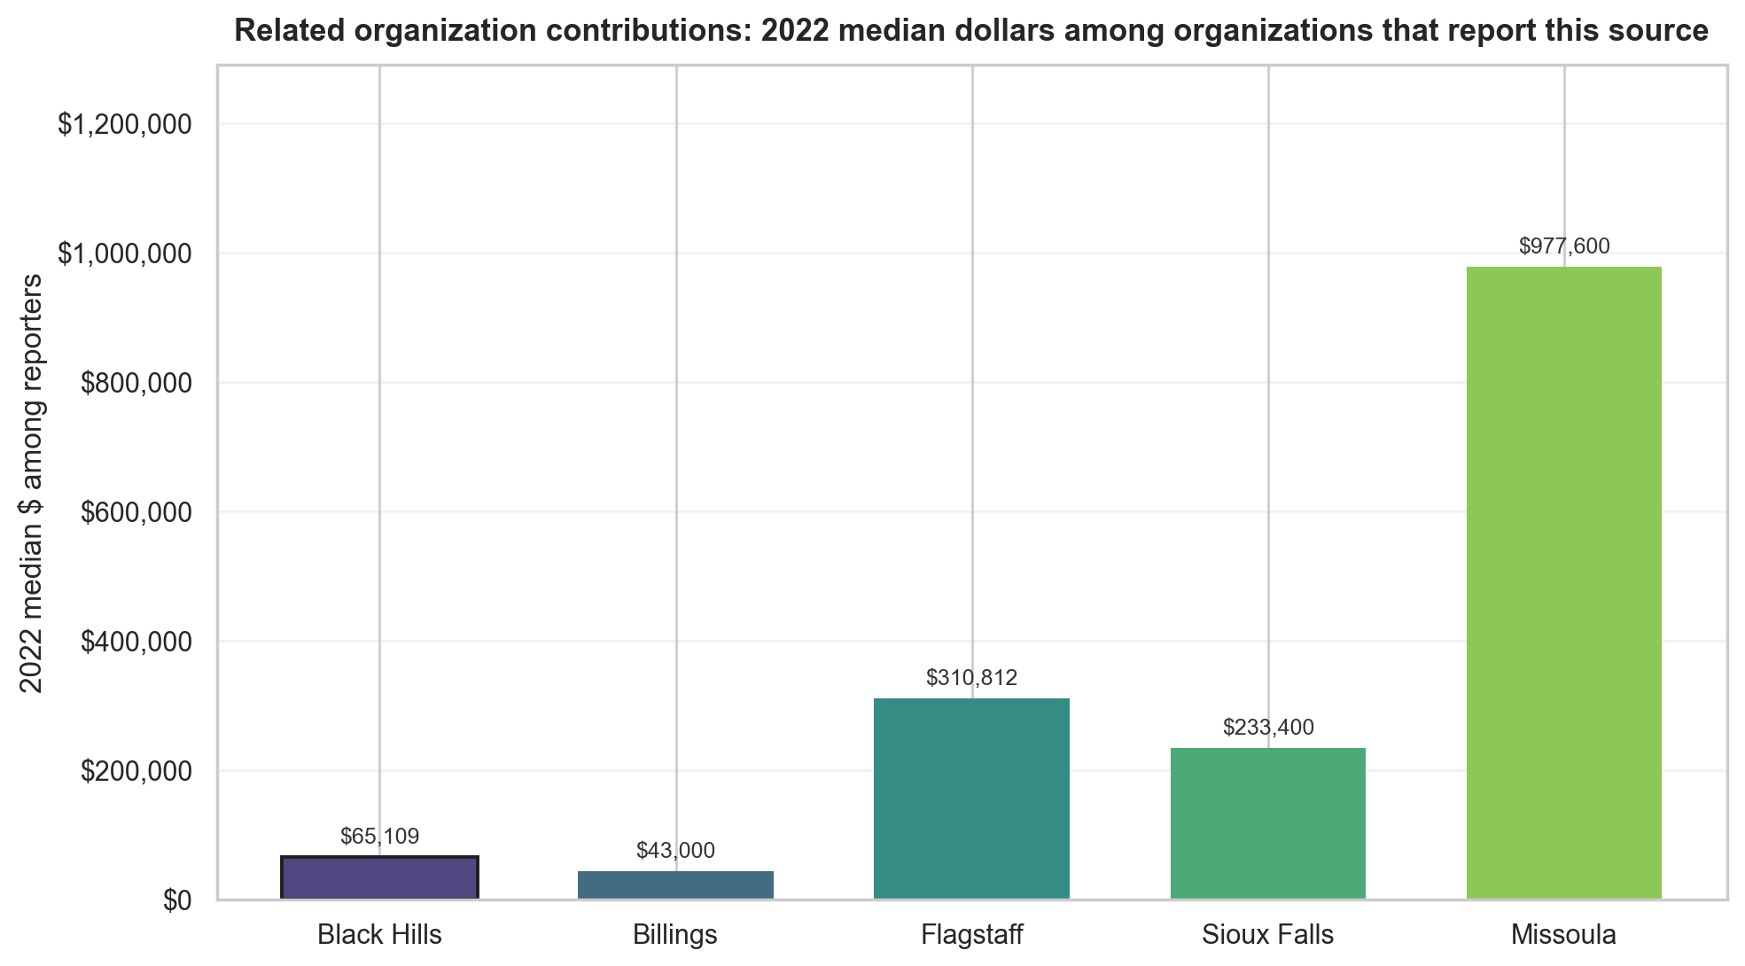
Related organization contributions
Pairwise comparison of conditional medians for organizations with a positive value for this source (zeros excluded). Headline test: two-sided permutation on the median difference.
Benchmark | Significance | BH median | Benchmark median | Median gap (95% CI) | p-value
Billings | Not significant | $65,109 | $43,000 | +$22,109 (95% CI -$205,000 to +$1,417,018) | p = 0.627
Flagstaff | Not significant | $65,109 | $310,812 | -$245,703 (95% CI -$573,240 to +$1,112,196) | p = 0.126
Sioux Falls | Not significant | $65,109 | $233,400 | -$168,291 (95% CI -$1,493,390 to +$1,137,398) | p = 0.203
Missoula | Not significant | $65,109 | $977,600 | -$912,491 (95% CI -$3,371,000 to +$150,595) | p = 0.173
Q9 2022 · 8

Slide 10
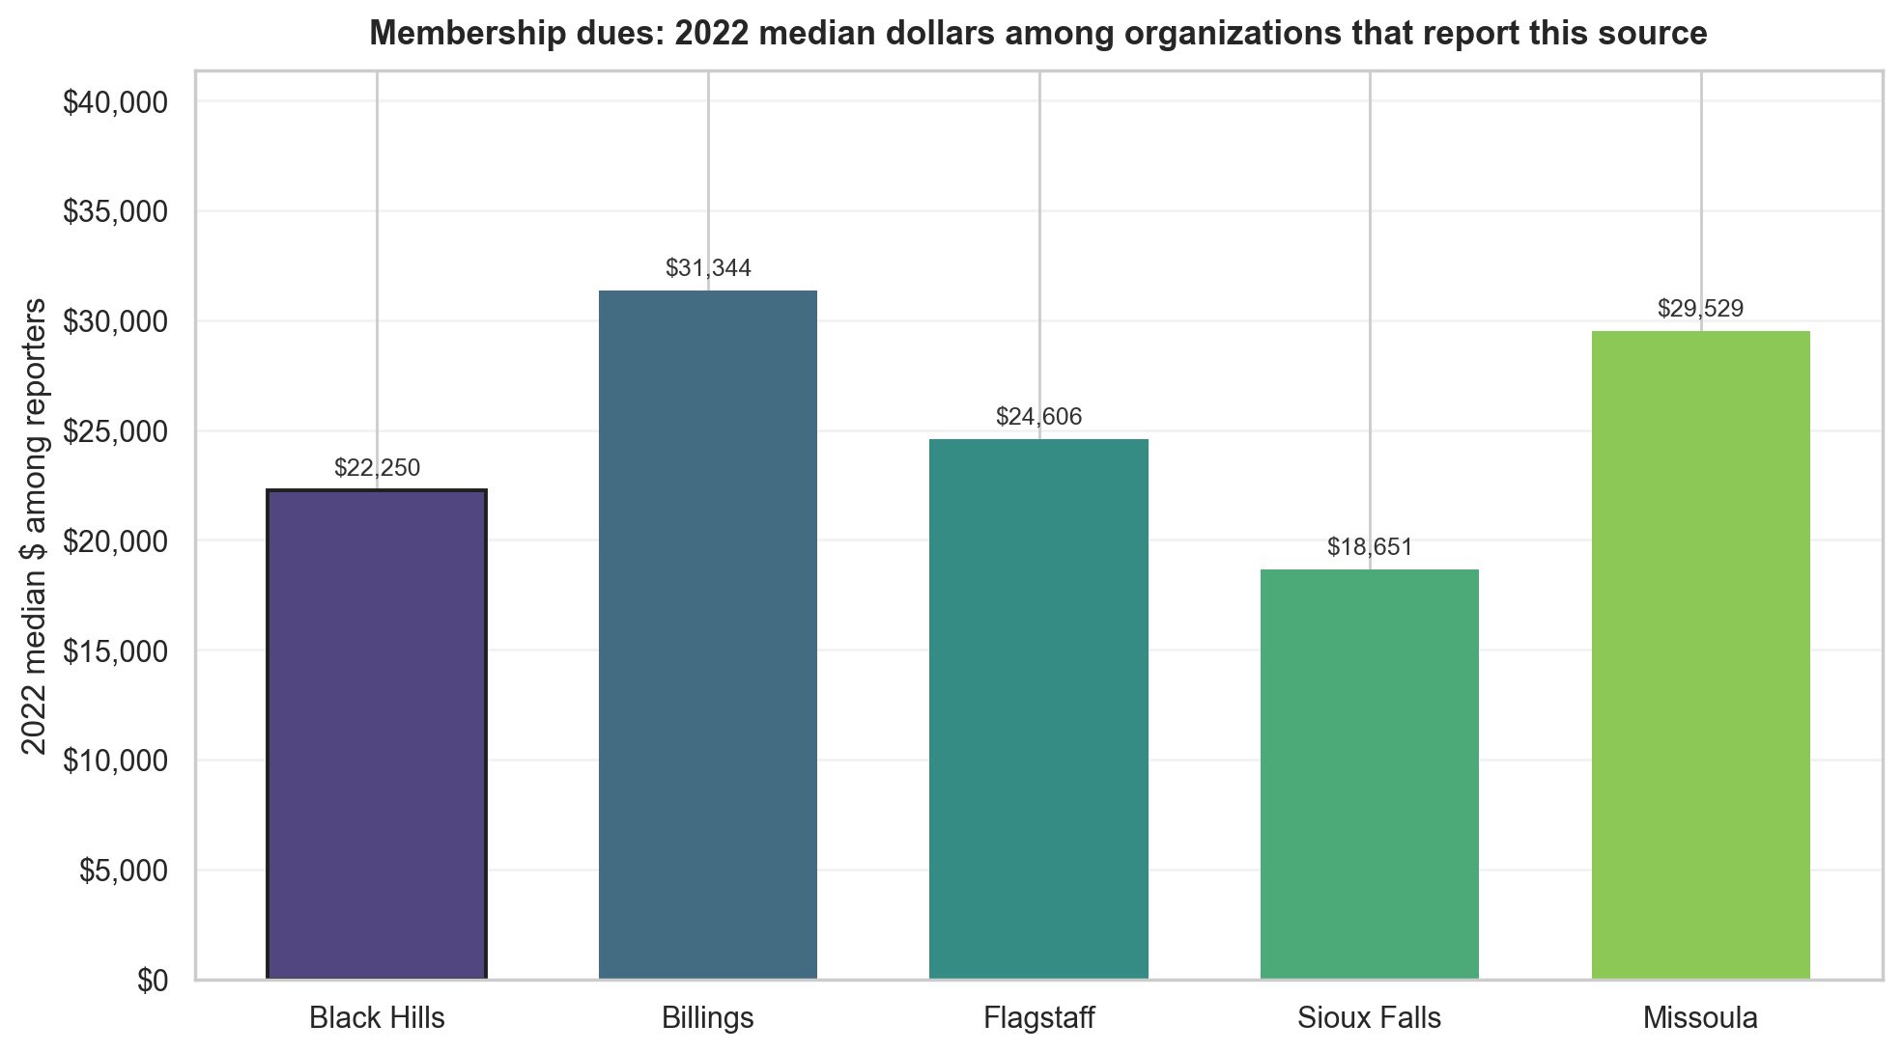
Membership dues
Pairwise comparison of conditional medians for organizations with a positive value for this source (zeros excluded). Headline test: two-sided permutation on the median difference.
Benchmark | Significance | BH median | Benchmark median | Median gap (95% CI) | p-value
Billings | Not significant | $22,250 | $31,344 | -$9,093 (95% CI -$51,928 to +$10,338) | p = 0.342
Flagstaff | Not significant | $22,250 | $24,606 | -$2,355 (95% CI -$167,924 to +$21,272) | p = 0.832
Sioux Falls | Not significant | $22,250 | $18,651 | +$3,600 (95% CI -$54,010 to +$23,295) | p = 0.540
Missoula | Not significant | $22,250 | $29,529 | -$7,278 (95% CI -$20,952 to +$13,858) | p = 0.601
Q9 2022 · 9

Slide 11
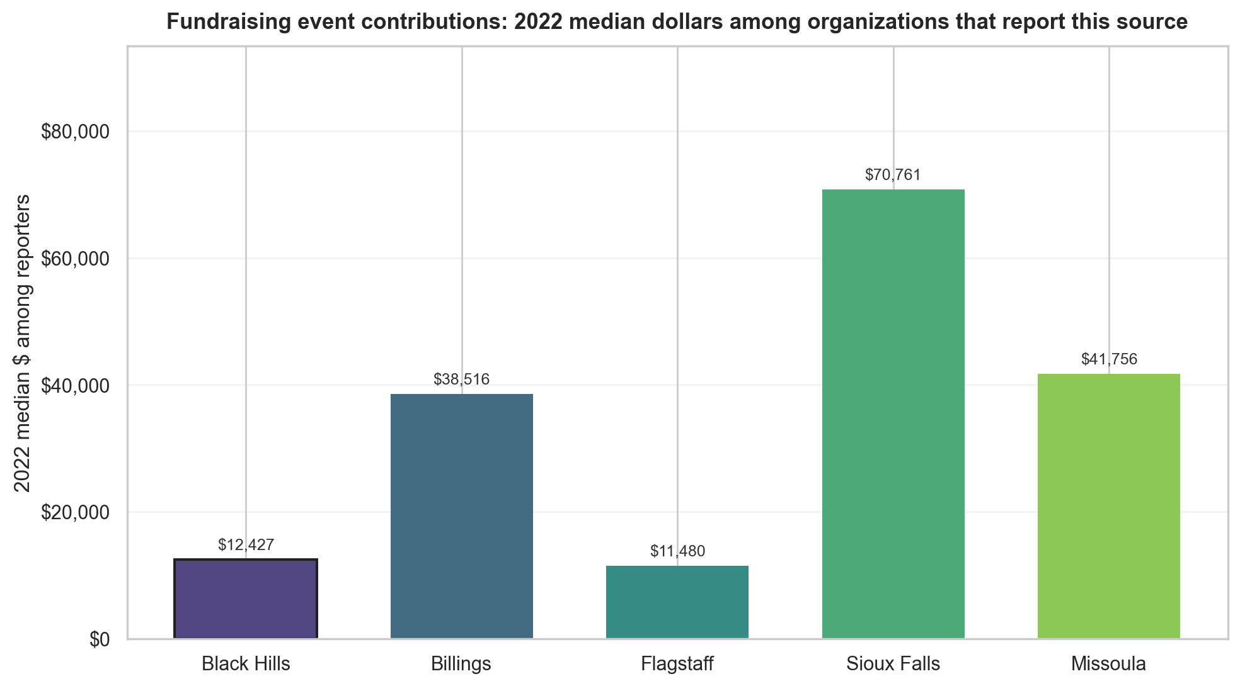
Fundraising event contributions
Pairwise comparison of conditional medians for organizations with a positive value for this source (zeros excluded). Headline test: two-sided permutation on the median difference.
Benchmark | Significance | BH median | Benchmark median | Median gap (95% CI) | p-value
Billings | Significant | $12,427 | $38,516 | -$26,088 (95% CI -$64,852 to -$6,639) | p = 0.009
Flagstaff | Not significant | $12,427 | $11,480 | +$947 (95% CI -$9,712 to +$13,322) | p = 0.849
Sioux Falls | Significant | $12,427 | $70,761 | -$58,334 (95% CI -$80,561 to -$31,388) | p < 0.001
Missoula | Significant | $12,427 | $41,756 | -$29,329 (95% CI -$72,681 to +$1,335) | p = 0.010
Q9 2022 · 10

Slide 12
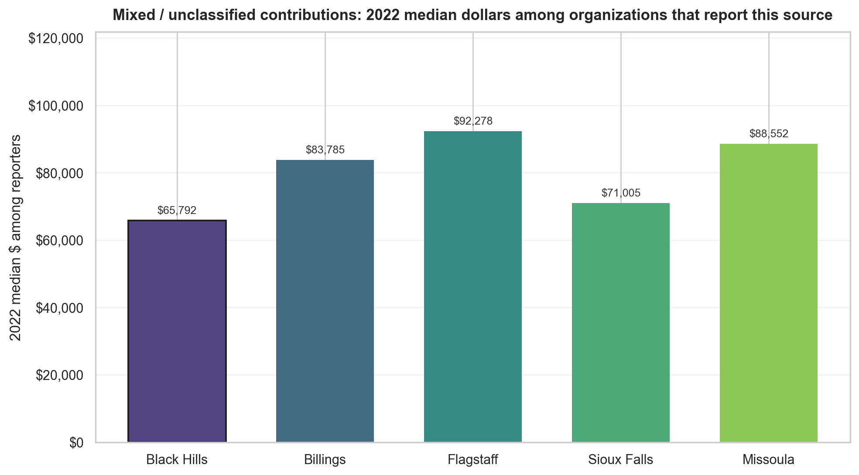
Mixed / unclassified contributions
Pairwise comparison of conditional medians for organizations with a positive value for this source (zeros excluded). Headline test: two-sided permutation on the median difference.
Benchmark | Significance | BH median | Benchmark median | Median gap (95% CI) | p-value
Billings | Not significant | $65,792 | $83,785 | -$17,992 (95% CI -$49,754 to +$8,827) | p = 0.157
Flagstaff | Significant | $65,792 | $92,278 | -$26,486 (95% CI -$50,596 to -$2,907) | p = 0.033
Sioux Falls | Not significant | $65,792 | $71,005 | -$5,212 (95% CI -$29,255 to +$15,095) | p = 0.619
Missoula | Not significant | $65,792 | $88,552 | -$22,760 (95% CI -$58,330 to +$11,256) | p = 0.099
Q9 2022 · 11

Slide 13
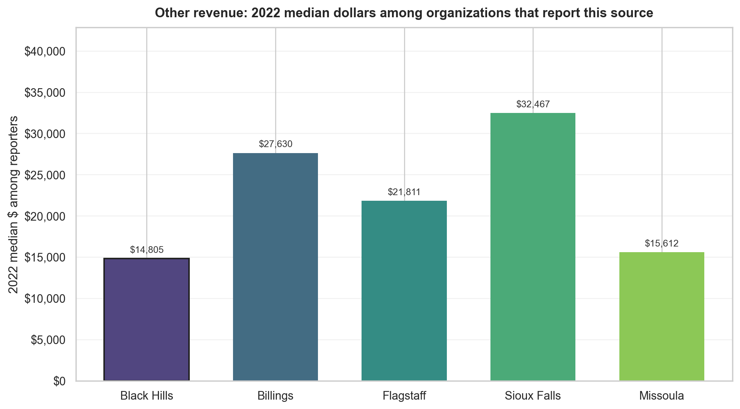
Other revenue
Pairwise comparison of conditional medians for organizations with a positive value for this source (zeros excluded). Headline test: two-sided permutation on the median difference.
Benchmark | Significance | BH median | Benchmark median | Median gap (95% CI) | p-value
Billings | Significant | $14,805 | $27,630 | -$12,825 (95% CI -$22,923 to -$1,324) | p = 0.010
Flagstaff | Not significant | $14,805 | $21,811 | -$7,006 (95% CI -$27,475 to +$6,558) | p = 0.292
Sioux Falls | Significant | $14,805 | $32,467 | -$17,662 (95% CI -$25,196 to -$6,938) | p = 0.001
Missoula | Not significant | $14,805 | $15,612 | -$807 (95% CI -$8,600 to +$7,563) | p = 0.697
Q9 2022 · 12

Slide 14
Sensitivity — including hospitals, universities, and political organizations
Excluded organizations & headline
Slides 3–12 use the primary analysis universe, which excludes 25 organization-year records flagged as hospitals, universities, or political organizations (25 unique EINs in 2022) for client-peer comparability. This slide reruns the same positive-reporter permutation-on-median pairwise tests on the full 2022 universe with those organizations included.
Excluded organization counts by region (2022 full universe before exclusion)
Region | Full-universe rows | Excluded special-org rows | Hospitals | Universities | Political
Black Hills | 423 | 1 | 0 | 1 | 0
Billings | 337 | 5 | 4 | 1 | 0
Flagstaff | 198 | 1 | 1 | 0 | 0
Sioux Falls | 581 | 16 | 9 | 7 | 0
Missoula | 285 | 2 | 1 | 0 | 1
Headline comparison (40 pairwise tests: 10 sources × 4 benchmarks)
• Significant at p < 0.05 when excluding special orgs (primary deck): 10
• Significant at p < 0.05 when including special orgs: 10
• Direction changes: 0
• Significance-status changes: 0
• No pairwise comparison flipped median direction between the two universes; where both versions are comparable, Black Hills vs benchmark stays on the same side of the median.
• No pairwise comparison crossed the p < 0.05 threshold when special organizations were added back.
Q9 2022 · 13 · Excluded organizations & headline

Slide 15
Sensitivity — including hospitals, universities, and political organizations
Excluded organizations & headline (continued)
• All 10 comparisons significant in the primary deck remain significant when hospitals, universities, and political organizations are included.
How to use this slide
• Treat the primary slides as the client-facing conclusion; this slide shows that the exclusion choice does not overturn that story.
• Most excluded organizations are in Sioux Falls (16 of 25 rows), so Sioux Falls–related p-values shift more than other regions even when significance does not change.
• The full comparison table is in client_2022_special_org_sensitivity_comparison.csv.
Q9 2022 · 13 · Excluded organizations & headline (continued)

Slide 16
Full answer — Is there a difference in revenue sources between Black Hills and benchmark regions?
Summary & methods
Short answer
Yes — for tax year 2022, Black Hills differs from at least one benchmark region on several revenue sources, but the difference is not uniform across all sources or all benchmarks. This deck tests one source at a time using organization-level dollars among organizations that report a positive amount for that source (zeros excluded). Statistical significance comes from a permutation test on the median difference between Black Hills and each benchmark region's positive reporters, with a 95% bootstrap confidence interval reported alongside; pairwise results appear on Slides 3–12 and in the table below.
What this presentation tested
• Question: Do Black Hills nonprofits differ from Billings, Flagstaff, Sioux Falls, and Missoula in how they draw revenue from each source?
• Year: 2022 only (see docs/Section3_Q9_Analysis.md for the full multi-year analysis and additional statistical framings).
• Unit: Organization-level reported dollars per source, not regional aggregate totals or stacked-bar percentages.
• Comparison: Black Hills vs each benchmark region separately (four pairwise tests per source).
• Statistic: Permutation test on the median difference among organizations with a positive value for that source (10,000 reshuffles); 95% percentile bootstrap CI on the same median gap (10,000 resamples). Slide bullets report medians for those reporters only.
• Significance rule: p < 0.05 on the pairwise permutation test (not FDR-adjusted on this slide).
Q9 2022 · 14 · Summary & methods

Slide 17
Full answer — Is there a difference in revenue sources between Black Hills and benchmark regions?
Significant results
Statistically significant pairwise differences (permutation p < 0.05, among positive reporters)
Revenue source | Benchmark region | Direction | Black Hills median | Benchmark median | Median gap (95% CI) | Permutation p
Federated campaign contributions | Sioux Falls | Black Hills lower among reporters | $30,096 | $150,655 | -$120,559 (95% CI -$251,704 to -$58,041) | 0.005
Fundraising event contributions | Billings | Black Hills lower among reporters | $12,427 | $38,516 | -$26,088 (95% CI -$64,852 to -$6,639) | 0.009
Fundraising event contributions | Missoula | Black Hills lower among reporters | $12,427 | $41,756 | -$29,329 (95% CI -$72,681 to +$1,335) | 0.010
Fundraising event contributions | Sioux Falls | Black Hills lower among reporters | $12,427 | $70,761 | -$58,334 (95% CI -$80,561 to -$31,388) | < 0.001
Government grants received | Billings | Black Hills lower among reporters | $163,367 | $274,793 | -$111,426 (95% CI -$345,341 to +$7,163) | 0.043
Government grants received | Flagstaff | Black Hills lower among reporters | $163,367 | $468,152 | -$304,785 (95% CI -$817,302 to -$131,168) | 0.003
Mixed / unclassified contributions | Flagstaff | Black Hills lower among reporters | $65,792 | $92,278 | -$26,486 (95% CI -$50,596 to -$2,907) | 0.033
Other revenue | Billings | Black Hills lower among reporters | $14,805 | $27,630 | -$12,825 (95% CI -$22,923 to -$1,324) | 0.010
Other revenue | Sioux Falls | Black Hills lower among reporters | $14,805 | $32,467 | -$17,662 (95% CI -$25,196 to -$6,938) | 0.001
Program service revenue | Flagstaff | Black Hills lower among reporters | $106,346 | $188,968 | -$82,622 (95% CI -$188,223 to +$1,513) | 0.038
Q9 2022 · 14 · Significant results

Slide 18
Full answer — Is there a difference in revenue sources between Black Hills and benchmark regions?
Board conclusions
No significant pairwise difference detected (permutation p ≥ 0.05, among positive reporters)
For these sources, none of the four Black Hills vs benchmark comparisons reached p < 0.05 under the conditional median permutation test:
• Total revenue: vs Billings, Flagstaff, Sioux Falls, Missoula
• Program service revenue: vs Billings, Sioux Falls, Missoula
• Total contributions: vs Billings, Flagstaff, Sioux Falls, Missoula
• Government grants received: vs Sioux Falls, Missoula
• Federated campaign contributions: vs Billings, Flagstaff, Missoula
• Related organization contributions: vs Billings, Flagstaff, Sioux Falls, Missoula
• Membership dues: vs Billings, Flagstaff, Sioux Falls, Missoula
• Fundraising event contributions: vs Flagstaff
• Mixed / unclassified contributions: vs Billings, Sioux Falls, Missoula
• Other revenue: vs Flagstaff, Missoula
How to state the conclusion to the board
1. Revenue-source patterns are not the same everywhere. Several 2022 pairwise comparisons show statistically significant differences in dollar amounts among organizations that actually use a given source.
2. Black Hills is often lower among reporters, not universally higher. Where this deck finds significance, the usual pattern is a lower median among Black Hills reporters than in the benchmark region being compared (for example program service revenue vs Flagstaff, government grants vs Flagstaff, fundraising events vs Billings and Sioux Falls, other revenue vs Billings and Sioux Falls).
Q9 2022 · 14 · Board conclusions

Slide 19
Full answer — Is there a difference in revenue sources between Black Hills and benchmark regions?
Board conclusions (continued)
3. Participation and dollars can tell different stories. Black Hills sometimes has more organizations reporting a source (higher nonzero rate) while still showing a lower median among reporters on that same source. See client_2022_pairwise_presentation_summary.csv for reporting rates; do not describe a significant median gap as proof of higher participation without checking the rate.
4. This deck does not replace the full Q9 report. The broader analysis in docs/Section3_Q9_Analysis.md covers additional tax years and alternative statistical framings. Use this presentation for 2022 pairwise, conditional-dollar comparisons.
One-sentence takeaway
Yes — in 2022, Black Hills differs from benchmark regions on multiple revenue sources (10 significant pairwise comparisons at permutation p < 0.05 on the median dollar gap among positive reporters), especially where median dollars among reporters are lower than in Billings, Flagstaff, or Sioux Falls; the pattern is source-specific and should be read together with reporting rates and the full 2022–2024 Q9 analysis.
Q9 2022 · 14 · Board conclusions (continued)

