Slide 1
Introduction to the Open Science Grid
OSG Software Carpentry Workshop
Indiana University-Purdue University Indianapolis
March 5th, 2015
Emelie Harstad <eharstad@unl.edu>, Mats Rynge <rynge@isi.edu>,
Bala Desinghu <balamurugan@uchicago.edu>, David Champion <dgc@uchicago.edu>, Suchandra Thapa <sthapa@ci.uchicago.edu>, Rob Quick <rquick@iu.edu>

Slide 2
The Open Science Grid
What is the Open Science Grid
Organization of OSG
Who uses OSG
Computation that is a good fit for OSG
OSG Connect (Easy on-ramp to OSG)
Joining a Project
HTCondor (OSG Job Scheduler)
Distributed Environment Modules

Slide 3
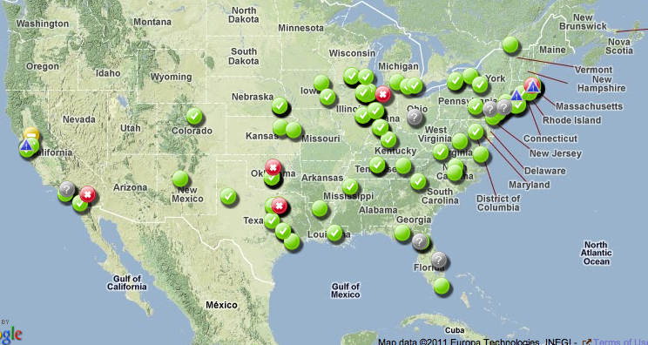
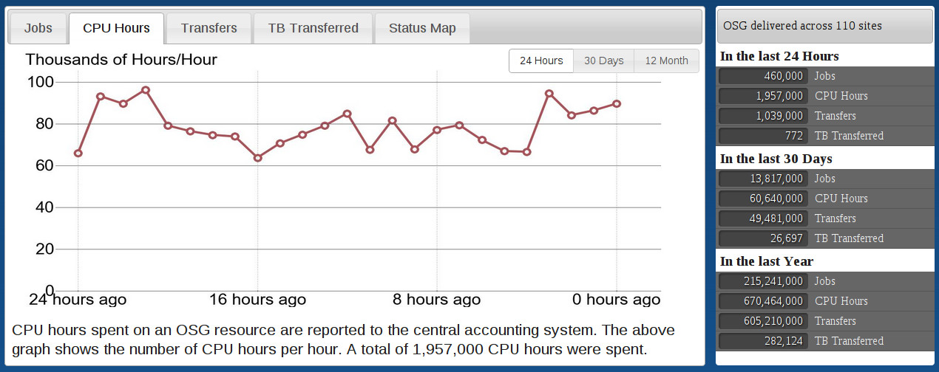
The Open Science Grid
A framework for large scale distributed resource sharing
addressing the technology, policy, and social requirements of sharing
OSG is a consortium of software, service and resource providers and researchers, from universities, national laboratories and computing centers across the U.S., who together build and operate the OSG project. The project is funded by the NSF and DOE, and provides staff for managing various aspects of the OSG.
Integrates computing and storage resources from over 120 sites in the U.S. and beyond.

Slide 4
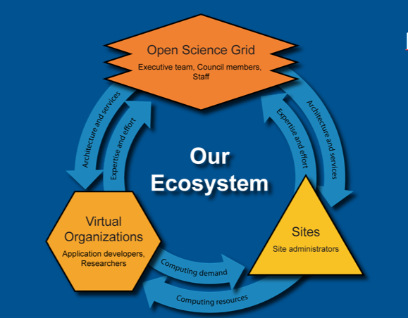
The Open Science Grid
Mission: The Open Science Grid aims to promote discovery and collaboration in data-intensive research by providing a computing facility and services that integrate distributed, reliable and shared resources to support computation at all scales.
Consortium & Project
Virtual Organizations
Sites
OSG organizes a set of sites
and user communities into
a cooperative computing
framework for science
http://www.opensciencegrid.org/

Slide 5
Virtual Organizations
The OSG environment is VO based.
Resource usage accounting
VOs can be science communities (e.g. ATLAS, CMS) or
Multi-disciplinary Campus based [e.g. U-Nebraska(HCC), U-Wisconsin(GLOW)]
Each OSG user is a member of a VO (examples: CMS, ATLAS).
Users can be members of multiple VOs
Site resources are owned by one or more VOs
The OSG VO provides access to US researchers who are not already affiliated with an existing community in OSG.
OSG VO is “Opportunistic” VO: users take advantage of unused cycles on resources owned by others.

Slide 6
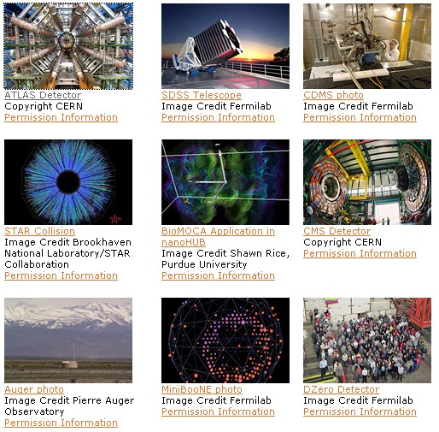
Who is Using the OSG?
Astrophysics
Biochemistry
Bioinformatics
Earthquake Engineering
Genetics
Gravitational-wave physics
Mathematics
Nanotechnology
Nuclear and particle physics
Text mining
And more…

Slide 7
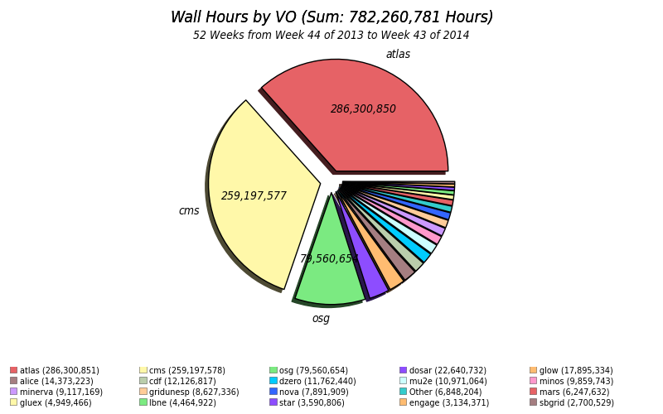
OSG Usage

Slide 8
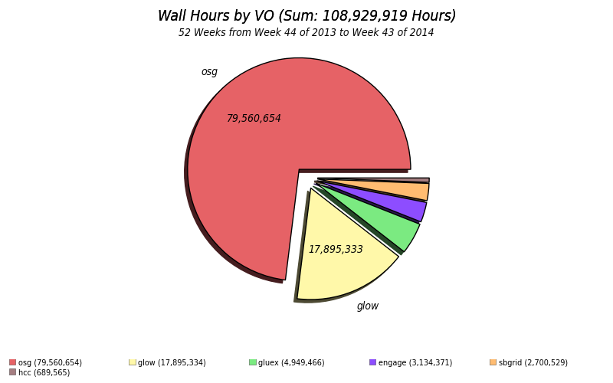
OSG Opportunistic Use

Slide 9
OSG Jobs
High Throughput Computing
Sustained computing over long periods of time. Usually serial codes, or low number of cores threaded/MPI.
vs. High Performance Computing
Great performance over relative short periods of time. Large scale MPI.
Distributed HTC
No shared file system
Users ship input files and (some) software packages with their jobs.
Opportunistic Use
Applications (esp. with long run times) can be preempted (or killed) by resource owner’s jobs.
Applications should be relatively short or support being restarted.

Slide 10
OSG Jobs
High Throughput Computing
Sustained computing over long periods of time. Usually serial codes, or low number of cores treaded/MPI.
vs. High Performance Computing
Great performance over relative short periods of time. Large scale MPI.
Distributed HTC
No shared file system
Users ship input files and (some) software packages with their jobs.
Opportunistic Use
Applications (esp. with long run times) can be preempted (or killed) by resource owner’s jobs.
Applications should be relatively short or support being restarted.

Slide 11
OSG Jobs
High Throughput Computing
Sustained computing over long periods of time. Usually serial codes, or low number of cores treaded/MPI.
vs. High Performance Computing
Great performance over relative short periods of time. Large scale MPI.
Distributed HTC
No shared file system
Users ship input files and (some) software packages with their jobs.
Opportunistic Use
Applications (esp. with long run times) can be preempted (or killed) by resource owner’s jobs.
Applications should be relatively short or support being restarted.

Slide 12
Properties of DHTC Jobs
Run-time: 1-12 hours
Single-threaded / non-proprietary software
Require <2 GB Ram
Statically compiled executables (transferred with jobs)
Input and Output files transferred with jobs, and reasonably sized: <10 GB per job (no shared file system on OSG)

Slide 13
Properties of DHTC Jobs
Run-time: 1-12 hours
Single-threaded / non-proprietary software
Require <2 GB Ram
Statically compiled executables (transferred with jobs)
Input and Output files transferred with jobs, and reasonably sized: <10 GB per job (no shared file system on OSG)
These are not hard limits!
Checkpointing (built-in to application) – for long jobs that are preempted
Limited support for larger memory jobs
“Partitionable” slots – for parallel applications using up to 8 cores
Distributed Environment Modules – a collection of pre-installed software packages, distributed by OASIS

Slide 14
OSG Connect
By joining OSG Connect, a user automatically becomes a member of OSG VO.
OSG Connect provides a virtual cluster that users can submit jobs to – this makes OSG look like a single resource (single Condor pool) to the user.
Authenticate through home institution (InCommon/CILogon)
NO X509 CERTIFICATES REQUIRED!
User support: (online: Connectbook and
connect-support@OPENSCIENCEGRID.org)

Slide 15
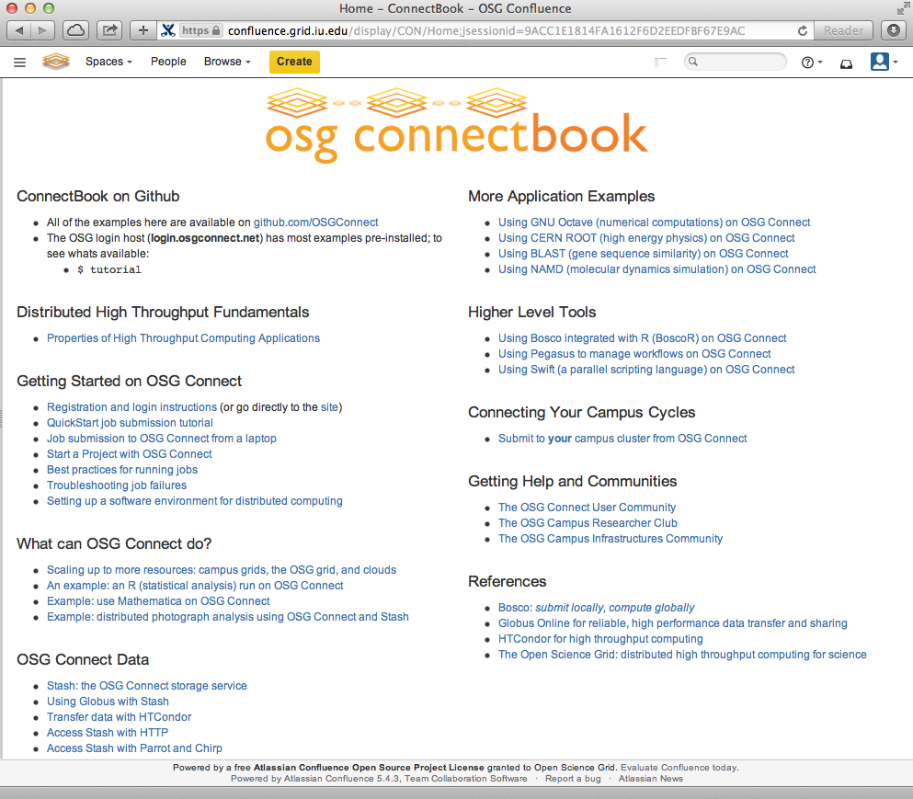
OSG Connect
Easy entry
No certificates
Comes with support !
<connect-support
@opensciencegrid.org>

Slide 16
Projects in OSG Connect
Projects in OSG are used for organizing groups and jobs, granting access to resources, usage accounting.
Every job submitted through OSG Connect must be associated with a project.
Principal Investigators or their delegates may create projects and manage project membership.
To apply for a new project: https://portal.osgconnect.net
Select: Connect -> Create a Project
OSG Connect administrator must approve the new project
To join a pre-existing project: https://portal.osgconnect.net
Select: Connect -> Join a Project

Slide 17
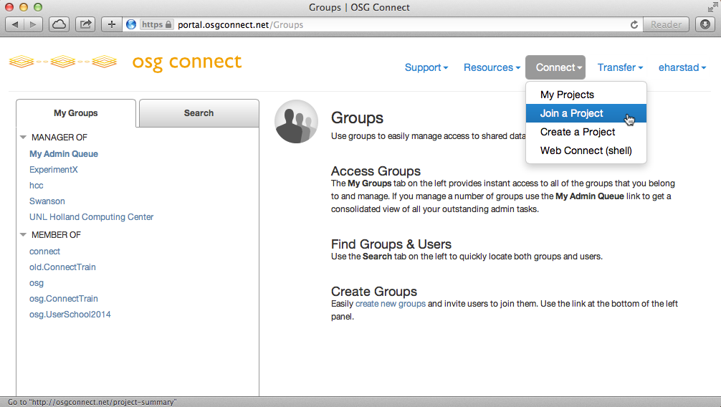
Projects in OSG Connect

Slide 18
HTCondor - OSG Job Scheduler
HTCondor is the OSG Job Scheduler
Matches jobs to available resources
Provides an overlay: Collection of compute nodes at different OSG sites appears as a single resource to users
Simplifies job submission: only one submission necessary to access nation-wide pool of resources
Made possible by flocking
Basic procedure:
Move all job files to the submit node (or create files directly on the node)
Log in to the submit node (ssh <username>@login.osgconnect.net)
Create a Condor submit script (contains information for the job scheduler)
Submit the job using the ‘condor_submit’ command.

Slide 19
Distributed Environment Modules
Popular (and some requested) software packages and libraries are made available via OASIS repository
Users don’t have to transfer software with their jobs
Modules address ease of use issues
Many users are already familiar with modules environment
Example: module load python/2.7
More information: here

