Slide 1


Slide 2


AGANTUK
WE ARE ALL A TEAM
SAIMANTI SOURAV BISWADEEP SUBHANKAR RITAYAN ISHAN(T.L)
👩 👦 👦 👦 👦 👦

Slide 3
PROBLEM STATEMENT
National Web Portal is used for designing Job oriented courses with the help of Human Resource data and desirable skill sets from industries.
Organization: govt. of Uttarakhand

Slide 4
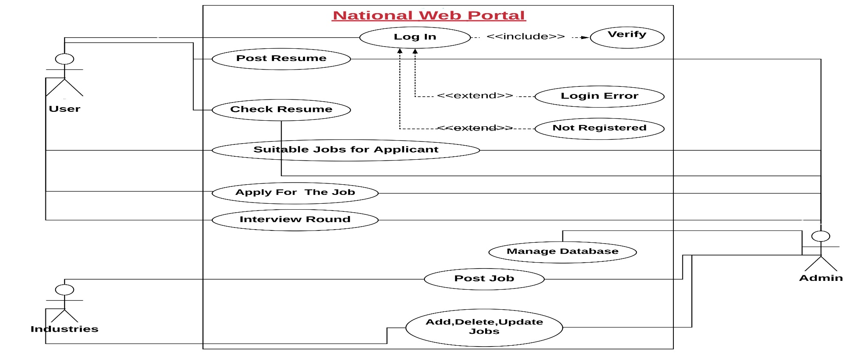
USE CASE DIAGRAM:

Slide 5
Possible challenges & Limitations:
Making The Portal User friendly
Using the parser efficiently and performance.
Reducing the time-complexity of the program.

Slide 6


