Slide 1
Lightning Talk: Ahmed Almohammed Support Vector Machines (SVM)

Slide 2
Contents
Content | Slide Number
What is SVM? | 3
Types of SVM | 6
Pros & Cons of SVM | 7
Applications of SVM | 9
Code in Action | 11
References | 13
End of Presentation | 14

Slide 3
DEFINITION
1
What are Support Vector Machines?

Slide 4
Supervised machine learning algorithm best suited for classification and can be used in regression problems. It simply creates a line that cuts the features (data points) into two categories.

Slide 5
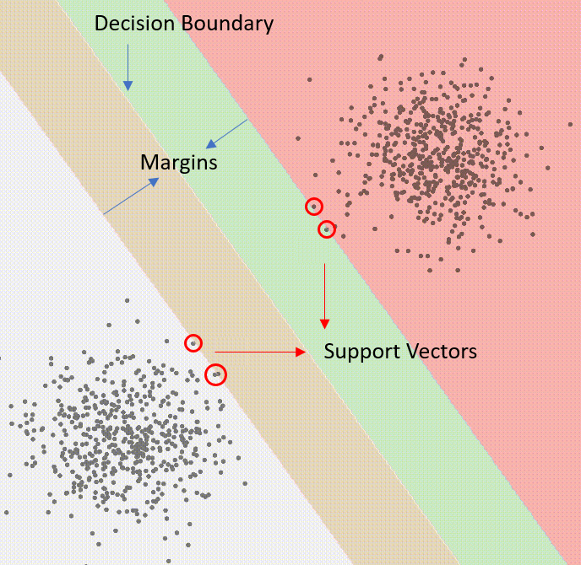

Slide 6
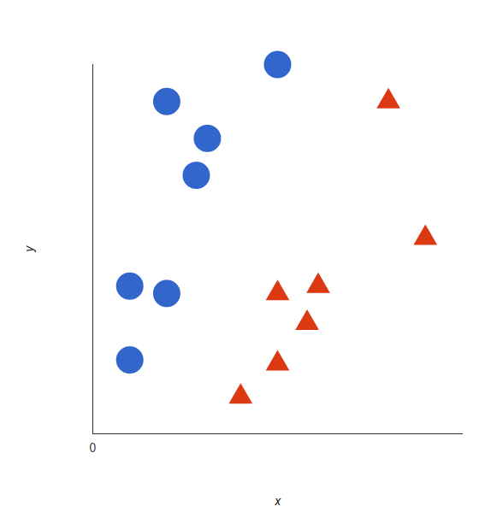
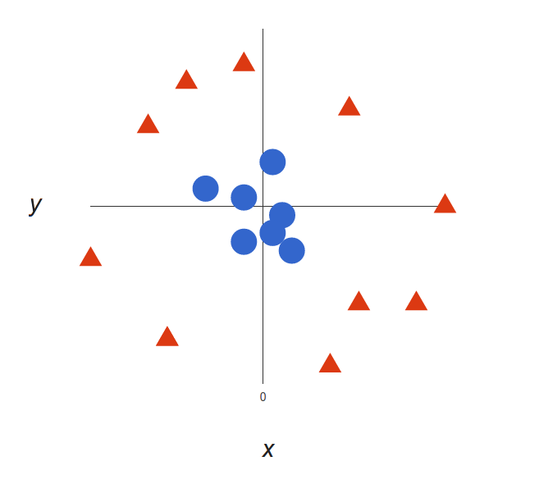
Types of SVM
Linear SVM (Simple)
Non-liner SVM (Kernel)

Slide 7
COMPARISON
2
Pros and Cons of using SVM

Slide 8
Pros and Cons of SVM
Pros
Cons
Fast Computations
High training time on large datasets
Performs well on small datasets
Does not provide probability estimates
Memory Efficient
Does not perform well on noisy dataset

Slide 9
APPLICATIONS
3
Some uses of SVM

Slide 10
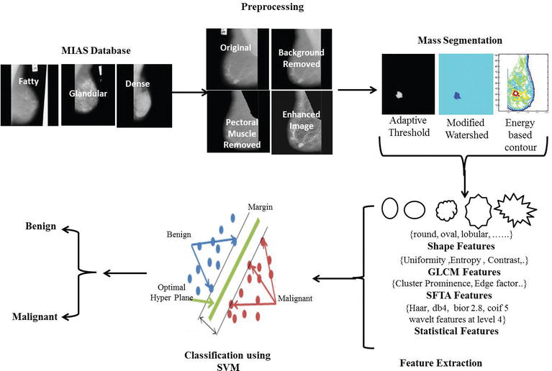
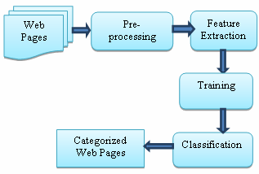
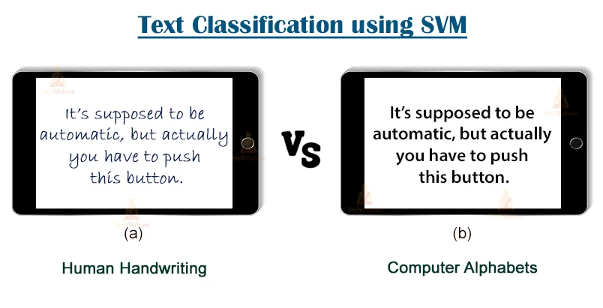
The Various Applications of SVM
Image Recognition
Text Classification
Web Pages Classification

Slide 11
SVM IN ACTION
4
Code snippet of applying SVM in Python

Slide 12
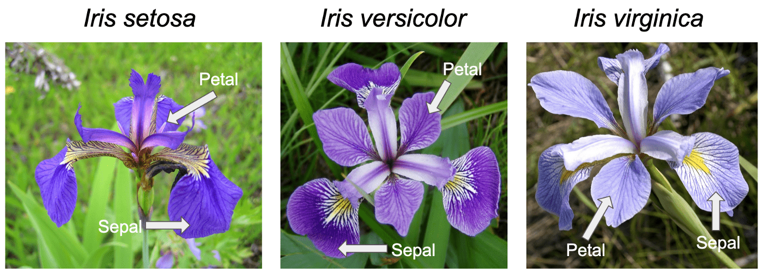


Slide 13
REFERENCES USED
https://www.freecodecamp.org/news/svm-machine-learning-tutorial-what-is-the-support-vector-machine-algorithm-explained-with-code-examples/
https://towardsdatascience.com/support-vector-machine-introduction-to-machine-learning-algorithms-934a444fca47
https://scikit-learn.org/stable/modules/svm.html
https://monkeylearn.com/blog/introduction-to-support-vector-machines-svm/
https://www.geeksforgeeks.org/support-vector-machine-algorithm/
https://scikit-learn.org/stable/modules/generated/sklearn.svm.SVC.html
https://www.elixirpublishers.com/articles/1362051287_55%20(2013)%2012825-12829.pdf

Slide 14
THANKS!
Any questions?

