Slide 1
Courses & TAs
Name: Ahmad Mazhar Mohamed
Section: IS-1
Web Project

Slide 2
Here We Go

Slide 3

Project Description
The first page of the website is the start page , it contains a simple design

Slide 4
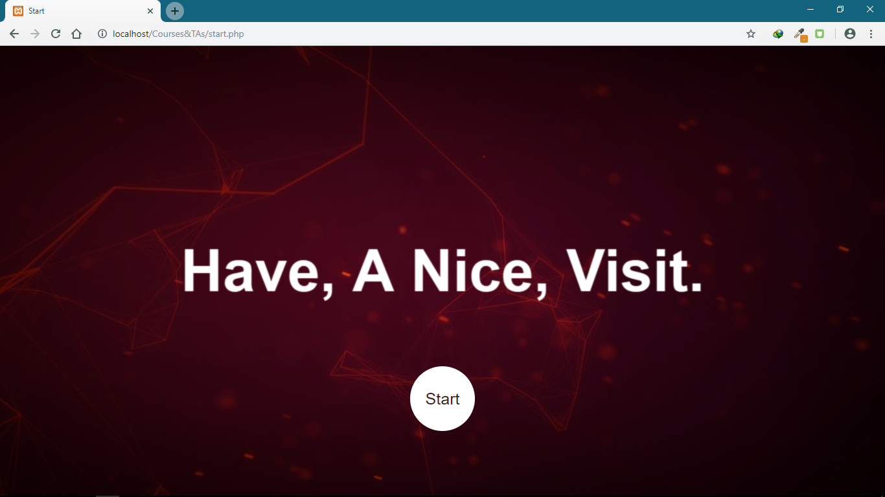
leading to (Start) button which in turn directs you to the home page

Slide 5
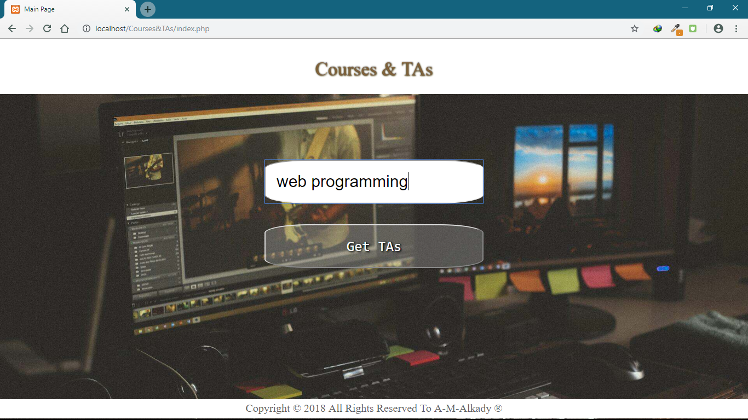
which contains a text box to type the name of the course you want and a submit button that leads you to the result page

Slide 6
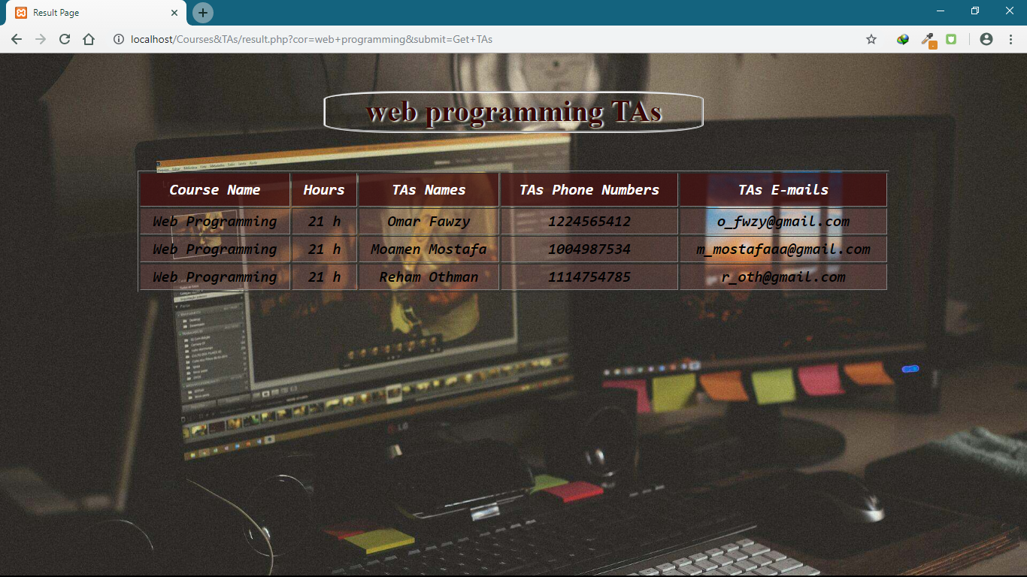
which contains the result of your search , it has a table consists of the basic information by which you can contact with the TA you prefer .

