Slide 1

Workshop 3
Any questions?

Slide 2
01
Agenda
1. Part 1 assessment results
Your assignment will be graded within 2 weeks of submission.
We’ll talk about common mistakes next week.
2. JSP, servlets, TomCat
We’ll talk about JSPs, servlets, and Apache TomCat then do a demo of GET and POST methods of servlets.

Slide 3



02
Java web development
You will build your application on Java Servlets and Java Server Pages (JSPs).
A low-level API that that is the building blocks for modern day Java web frameworks.
Modern Java frameworks abstract the role of servlets.

Slide 4

03
Servlets
A servlet is used to implement web applications and is simply a class which responds to an HTTP request.
Servlets provide a low-level API for receiving and responding to HTTP requests.
Servlets are the Java programs that runs on the Java-enabled web server or application server. They are used to handle the request obtained from the web server, process the request, produce the response, then send response back to the web server.

Slide 5
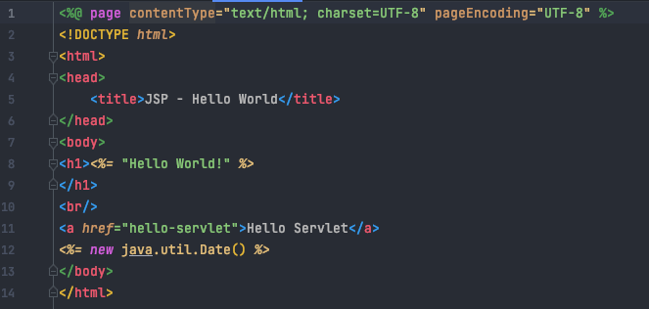
04
JSPs
What are JSPs?
Java Server Pages (JSP) is a server-side programming technology that enables the creation of a dynamic, platform-independent method for building Web-based applications.
JSPs vs. HTML
HTML cannot contain dynamic information.
JSPs vs. JavaScript
Server-side vs. client-side (JavaScript is not based on Java!).
JSPs vs. pure servlets
JSPs are used in conjunction with servlets.
JSP introduces Java into HTML.

Slide 6
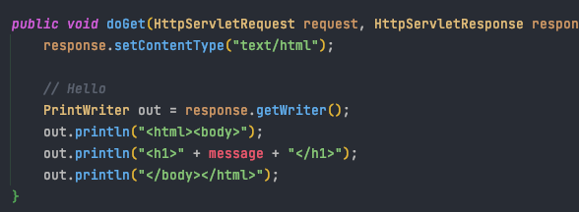
05
You don’t need to use JSPs with servlets…
But you should
This is tedious and doesn’t separate roles of back-end and front-end developers.

Slide 7
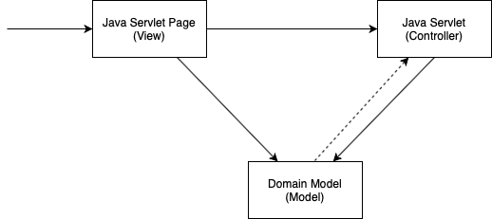
06
JSP + servlets + domain model = MVC pattern
Controller layer acts as an interface between View and Model. It receives requests from the View layer and processes them, including the necessary validations.
This layer represents the output of the application, usually some form of UI. The presentation layer is used to display the Model data fetched by the Controller.
This is the data layer which contains business logic of the system, and also represents the state of the application.

Slide 8
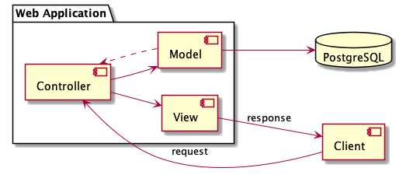
07
MVC pattern in your assignment

Slide 9
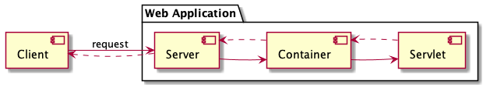
08
Apache TomCat
Acts as both a web server and container
Web servers are great at serving static pages (but cannot create dynamic pages).
This is the role servlets play - they can dynamically create pages to send as a response to the client.
Dynamic web pages didn’t exist before the request.
Servlets don't have main methods the server can call, so instead when the web server gets a request for a servlet, the server hands the request to the container in which the servlet is deployed.
The container gives the HTTP request to the servlet and calls the servlet's doGet() and doPost() methods.

Slide 10
09
Benefits of using TomCat as a container
Apache TomCat, as a container, handles several issues for you:
Communications support - The container creates an easy way for your server to talk to your servlets. The container knows the protocol to use to speak to the server, so you don't have to make use of an API in your servlets in order to speak to the server.
Lifecycle management - The container controls the life and death of your servlets. It loads classes, instantiates servlets, knows which servlet method to call, and handles garbage collection, so you don't have to worry as much about managing resources.
JSP support - The container translates JSP code into Java.

Slide 11
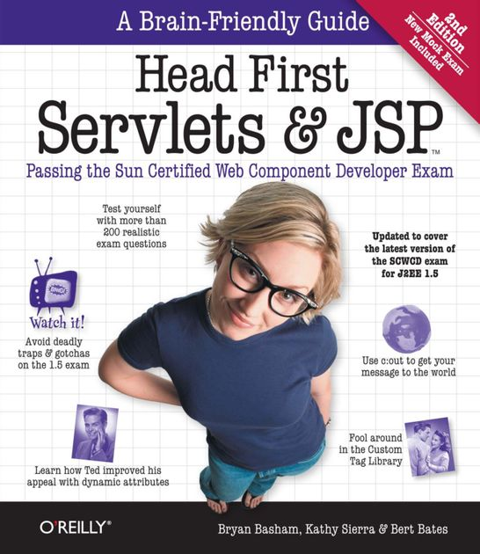
10
Extra resources
New resources are in the GitHub Resources repo!
Theory introduction to JSP and servlets:
https://github.com/SWEN900072021/Resources/blob/main/how_to/2021/jsp_servlets.md
Create your first JSPs and servlets:
https://github.com/SWEN900072021/Resources/blob/main/how_to/2021/first_web_app.md

Slide 12
Time for a demo

