Slide 1

Workshop 4
Any questions?

Slide 2

01
1. Part 1 assessment results
Your assignment will be graded within 2 weeks of submission.
Agenda
2. A note about authentication
Do not try to implement your own authentication – it’s the easiest way to introduce vulnerabilities into your application.
You will learn authentication frameworks in around a week.
3. New Java + PostgreSQL demo
Available in the Resources repo: https://github.com/SWEN900072021/Resources/blob/main/how_to/2021/java_postgresql.md
4. Common mistakes in part 1

Slide 3
02
GitHub tag in submissions
Create a tag and copy the URL into 2 places:
README file of your repository
Checklist you submit to LMS

Slide 4
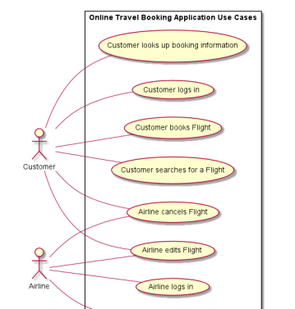
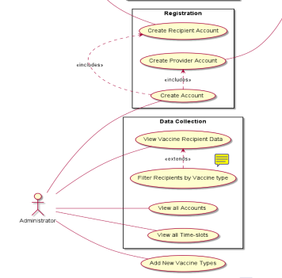


03
Group all use cases under one application heading
Otherwise, it appears like they’re different applications/systems.

Slide 5
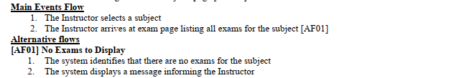
04
Don’t arbitrarily divide use cases
Use cases should define a goal of the actor.
One use case could ‘searches for flight’ with alternate flows based on how they specify the search criteria.
It makes your use cases less clear if you were to break these down into 2 use cases, for example: 1. User searches for flight, and 2. User filters search results for flights

Slide 6
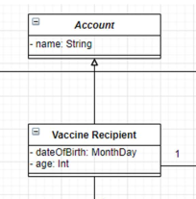
05
Use of generic classes:
Don’t make a generic class which is only inherited from one other class.
Also: Domain models also don’t require attribute types (nor methods).
This overcomplicates the domain model and makes it less clear (and will make implementation harder for very little gain).

Slide 7
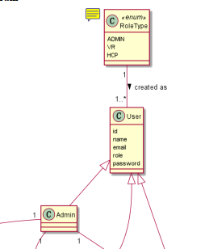
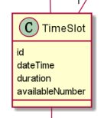
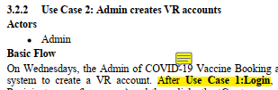
06
Representing database IDs in the domain model
Not using preconditions for use cases
Duplicating enums and classes

Slide 8
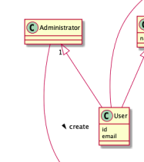
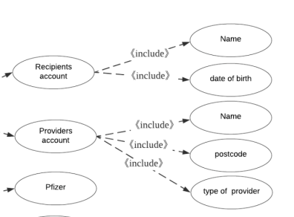
07
Using attributes in the use cases diagram
Wrong directional arrows for inheritance, etc.

Slide 9
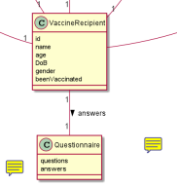
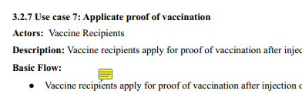
08
Common mistakes – Vaccine Booking
1-to-1 relationship between questionnaire and recipient
Allowing Health Care Providers to create their own account
Diverging from specifications
Limits your application’s extensibility and precludes recipients from filling out the questionnaire again in future.
Presents a safety threat to the application.

Slide 10
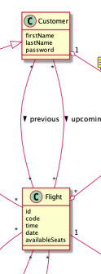
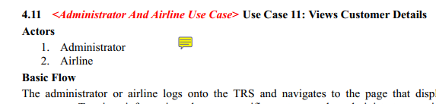
09
Common mistakes – Flight Booking
Not having a ‘Passenger” class
Allowing airlines to view all customer details
Specifications state a customer can purchase tickets for 1 or more other people.
Should only be able to view a flight’s manifest.

Slide 11
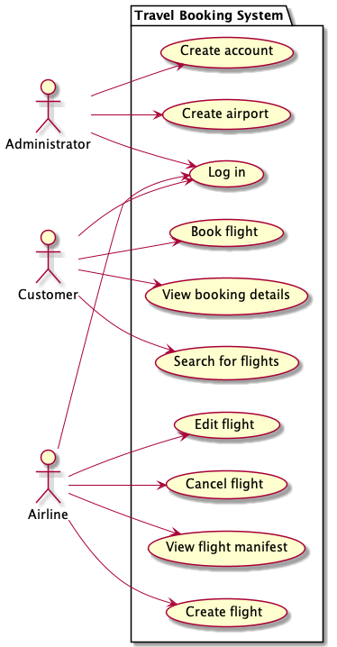
10
Travel booking use cases
These are the minimum use cases expected for parts 2 and 3. You can develop more than these (we will not mark you down if you extend the specs but don’t fully implement the extended specs).
You will lose marks if you don’t implement all of these use cases.

Slide 12
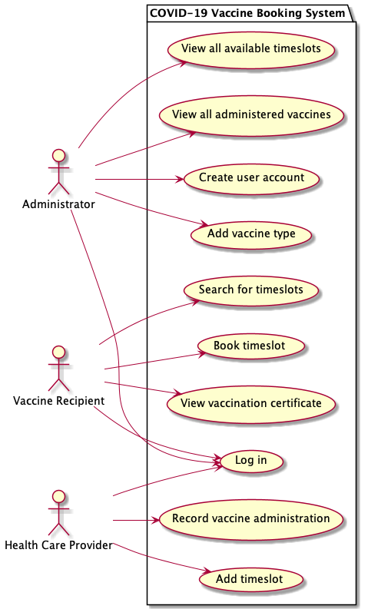
11
Vaccination booking use cases
These are the minimum use cases expected for parts 2 and 3. You can develop more than these (we will not mark you down if you extend the specs but don’t fully implement the extended specs).
You will lose marks if you don’t implement all of these use cases.

Slide 13
Time for breakout rooms

