Slide 1
SWEN90009 Software Requirements Analysis
Do/Be/Feel + Goal Model
2022 - Semester 1
Tutorial Week 4
Copyright University of Melbourne 2017

Slide 2

Prior to tutorial, you need to have:
Researched your industry partner’s current system and the “system-to-be” the client wants.
Identified potential project stakeholders.
Understood what the system-to-be tries to achieve (i.e. goals - more on this later)

Slide 3
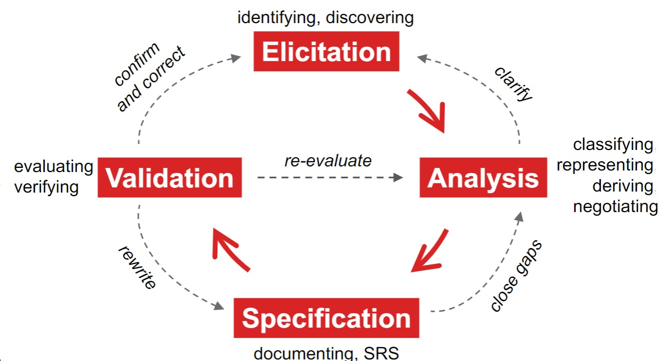
Recap
requirements engineering phases
Elicitation: client meeting
Invite
Confirm
Agenda
Identify Stakeholder (a busy VIP ☹ )
Set interview
Anticipate problem narrative
Record
Summarize
Validate
Define the stakeholder’s User Goals
Scope of system-to-be
Notes:
Elicitation can establish user goals, (the outcomes that users want to achieve).
The system scope should be defined.

Slide 4

This Week: Analysis
Establish a shared understanding
Clarify IT Solution scope
Analysis: Find goals
do-be-feel-who lists
Motivational Model (if time permits)
Do: What should the software do? (Functional goals)
Be: How should it be done? (Quality goals)
Feel: What are the emotional (or social) goals/considerations?
Who: Identify the users of the system? (Roles)
Notes:
Define either the scope of the system-to-be or the time and cost constraints.
Establish a shared understanding among the stakeholders.
User goals are descriptions of outcomes that users want to achieve.
User goals guide developers to consider the functions of a system.
Decompose goals into tasks/functions of the system
We want as few tasks as needed.
Deals with conflict and adds clarity, priority
Specifying goals leads to asking "why", "how" and "how else".

Slide 5

Team Discussion
Analysis: Find goals
Describe the main goal of project. (1 sentence or paragraph)
Decompose goals into smaller tasks
Quality goals represent how: (time & date calendar widget)
Emotional goals represent motivation: (feel in control of system)
Identify the end users of the system.
Identify the benefits for the stakeholders.
Identify when & how the stakeholders will use the system tasks.
Notes:
Establish what the user wants, prioritize, choose triple constraints
User goals: desired hi level outcomes of system, decomposed into tasks
Goals focus teams and reduce conflict

Slide 6
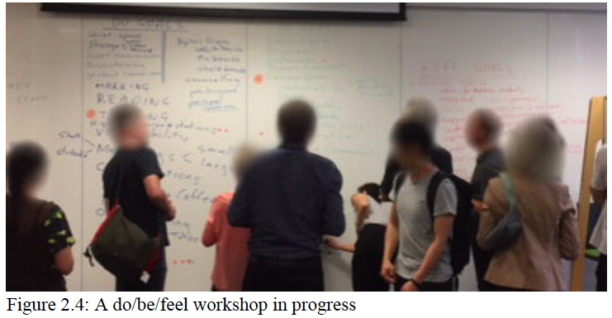
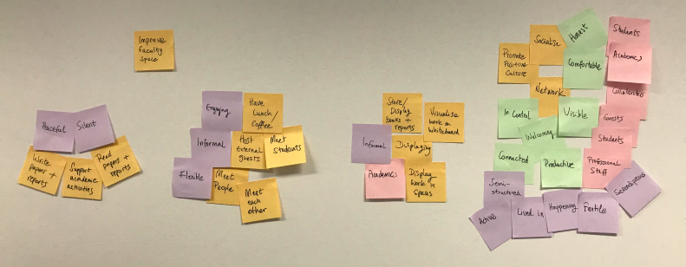
Analysis Team Work
Teamwork process
Multicolored pens on whiteboard
(or breakout room shared screen)
Sticky notes on whiteboard
(or Trello board)
Notes:
Capturing diverse ideas from a group of people.
Collaborative, lightweight and adaptive
Roles: Facilitator & Scribe

Slide 7
Analysis Team Work
Analysis: do-be-feel-who lists
Identify the stakeholders of your project
Create your who/do/be/feel list according to this template
Who | Do | Be | Feel | Concerns (optional)

Slide 8
Tips for the Do/Be/Feel lists
NO ROWS! Work with columns only. For example, after you are done with the Who, you are done with that column. Start working on the Do independently – NOT based on the stakeholders.
Do/Be/Feel should be a brainstorm activity at the start.
Don’t be too critical at the start. At the start, just documents ideas, then discuss later to polish it.

Slide 9
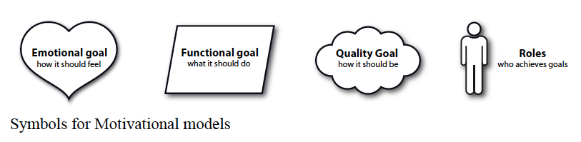
Analysis Team Work
Create Goal Model
Review Lists
Cluster Elements
Create Do Element Hierarchy
Notes:
Construction phase
Construct a goal model: review of the lists, clustering the do lost elements, structuring into a hierarchy, and then reviewing the resultant motivational model with key stakeholders.

Slide 10
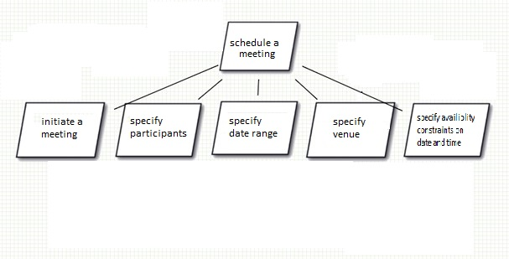
Analysis Team Work
Goal Model
specify availability
constraints on
date-time
Notes:
Example

Slide 11
Analysis Team Work
Create Motivational Model
Review Lists
Cluster Elements
Create Do Element Hierarchy
Attach Be, Feel, Who Elements
Review with Stakeholders
Notes:
Construction phase
Construct a motivational model: review of the lists generated, clustering the elements in the lists,
attaching the elements from the remaining lists (be, feel, and who) to the do hierarchy,
and then reviewing the resultant motivational model with key stakeholders.

Slide 12
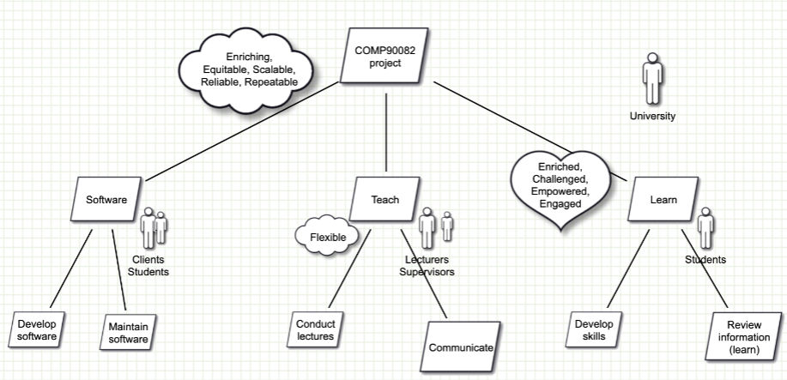
Analysis Team Work
Example from lecture. Remember, this example has room for improvements!
Notes:
This example from the lecture is NOT perfect. But it does illustrate where certain shapes should go.
Biggest problem mentioned in the lecture: the head leaf (COMP90082 project) is SUPER vague.

Slide 13

Thank you!
Notes:
.

Slide 14

Questions?
Notes:
.

