Slide 1
SWEN90009 Software Requirements Analysis
Requirements Elicitation
2022 - Semester 1
Tutorial Week 3
Copyright University of Melbourne 2017

Slide 2

Prior to tutorial, you need to have:
Researched your industry partner’s current process and the “system-to-be” the client wants.
(At least) Started planning your first interview with your industry partner

Slide 3
Agenda
Communication with Industry Partner
Initial interview with Industry Partner
Sprint 1 Deliverables

Slide 4
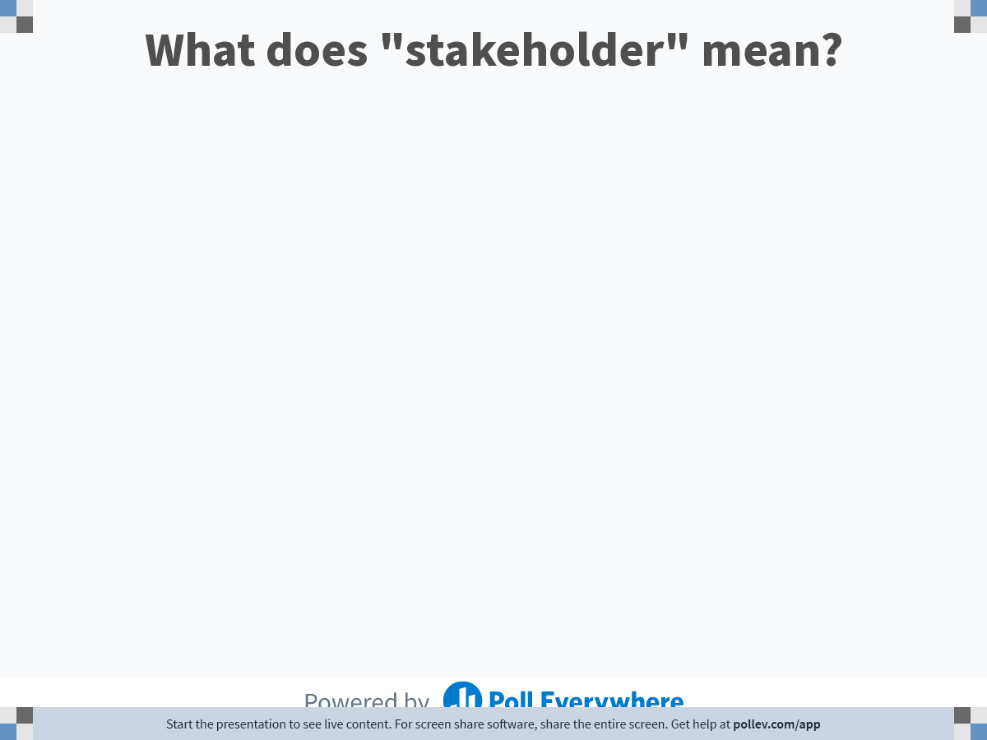
Notes:
Poll Title: Do not modify the notes in this section to avoid tampering with the Poll Everywhere activity. More info at polleverywhere.com/support What does "stakeholder" mean? https://www.polleverywhere.com/free_text_polls/rDoBBsyl8LzknsCwJJmSs

Slide 5
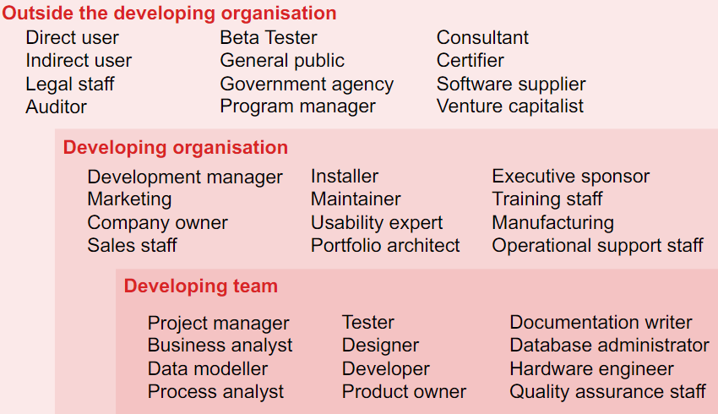
Stakeholder: individual, group, or organization that is actively involved in a project, is affected by its process or outcome, or can influence its process or outcome.
Some examples of potential stakeholders
Reference: Software Requirements by Karl Wiegers and Joy Beatty. 3rdEdition, 672 pp. Microsoft Press, 2013. ISBN-13: 978-0-7356-7966-5

Slide 6
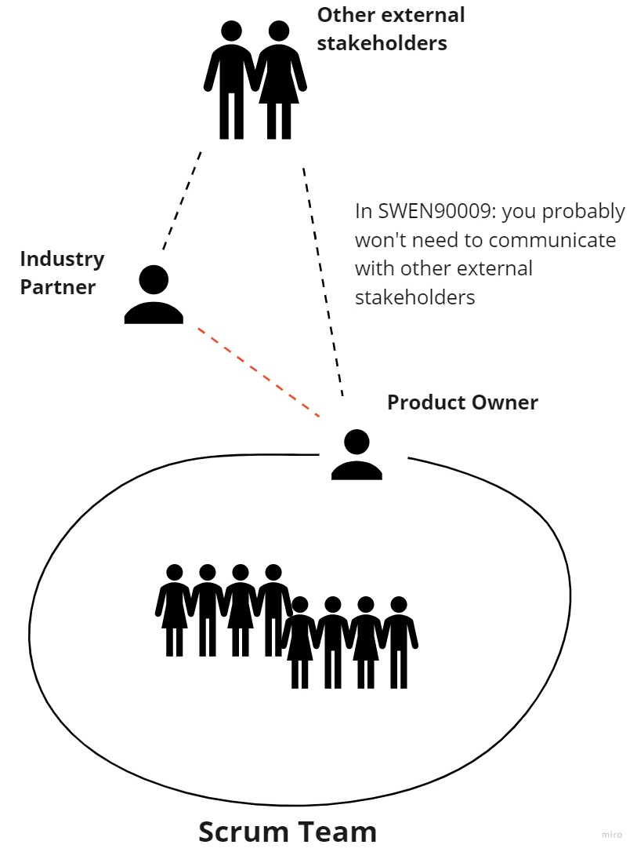

Slide 7
Product Owner:
Ensures that team delivers the most value to their client
Has a strong understanding of the project which will be used to priorities user stories/features in upcoming sprints
Works with stakeholders (in SWEN90009 - industry partner) to ensure most values are delivered
Is the communication channel from the team to the client, not everyone should be messaging the client

Slide 8
Client Communication
If you are the client, how would you like the development team to communicate with you?

Slide 9
Client Communication
Be respectful
Be organised
Plan meetings early
Be professional
Send meeting invites
Have an agenda for meeting, and send it to client beforehand
Send meeting notes afterwards
Clarify if you have questions
Involve the client in important decisions

Slide 10
SWEN90009 Teams Working Together
How should project teams work together?
The initial interview – you can share meeting notes. You can ask the other teams if you missed anything.
If you encounter a project specific issue – ask the client together, and share the response.
Same client, different interpretations/approaches.

Slide 11
Which stage is your team at?
Just started research? (Hopefully not ☺)
Finished research and ready to prepare for interview?
Finished interview and ready to reflect?
Completed Sprint 1 Deliverable already?

Slide 12
In this workshop, research…
or evaluate the value of your research
Review the interview guides first.
https://www.thisisservicedesigndoing.com/methods/contextual-interview
https://www.thisisservicedesigndoing.com/methods/in-depth-interview
https://www.designkit.org/methods Human-centered design
Know what to do before, during and after the client interview.
Refer to: https://cis-projects.github.io/project_based_course_notes/topics/client_communications.html

Slide 13
In this workshop, prepare for client interview
or share retrospective of how interview preparations worked out
- Assign one team member to the facilitator role and note taker role.
- All team members should participate and have an observer role.
- Prepare a small/flexible meeting agenda and validate it with your supervisor.
- Document your elicitation technique on Confluence.
- When done, send Zoom calendar invites.
Notes:
If interview is done already, share retrospective of how

Slide 14
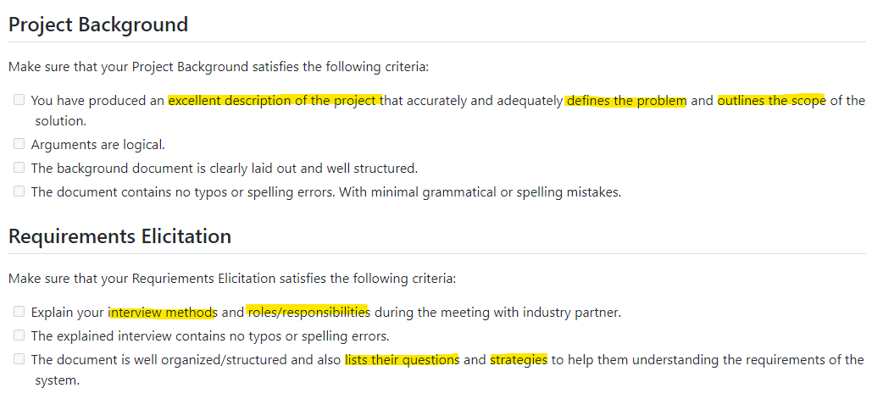
Sprint 1 Deliverables

Slide 15
Conduct client interview
- Ask for permission to record
- Introduce context and motivation
- Ask prepared questions from agenda – the easy ones first
- Validate your stakeholders, including the end users
- Identify the current processes and scenarios
- Identify where process improvements which could be made
- Identify your project’s goals, scope and challenges
- Be open-minded to new ideas/suggestions

Slide 16
After client interview
1. Review your meeting minutes
2. Share the meeting minutes with your client
3. Discuss what went well, what didn't work, how to improve next time
4. Seek the observer’s thoughts about the interactions
5. Clarify your project goal, stakeholders, expected user experience.
6. Create scenarios on how each stakeholder will use the system.
7. Work collaboratively updating meeting minutes and everything on Confluence (Project Overview + Requirements Elicitation)
8. Update GitHub with client facing documents, Sprint1 release tag

Slide 17

The End
Thank you!
Notes:
.

