Slide 1
Hybrid Workshop
All students – join Zoom
Hearing echo: make sure you are muted ☺
Before team activity: I will speak into Zoom – like a virtual meeting
Students on Zoom:
Method 1: post in chat
Method 2: ask someone in-person to help you (let’s help one another!)
Method 3: Raise hand (reaction on Zoom)
Headphones might be needed for listeners

Slide 2
SWEN90009 Software Requirements Analysis
User Stories
2022 - Semester 1
Tutorial Week 6
Copyright University of Melbourne 2017

Slide 3

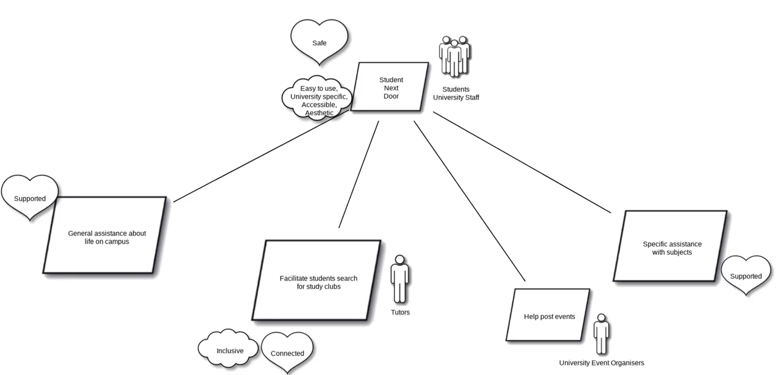
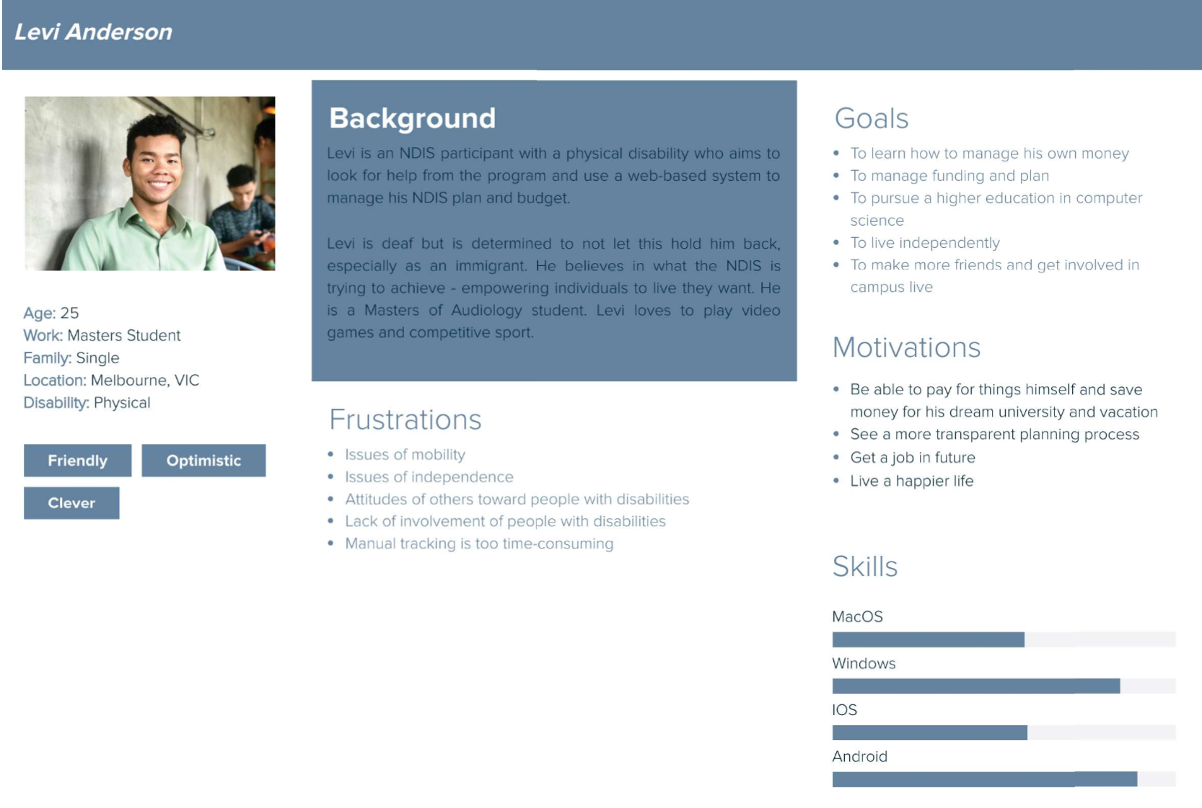
Recap
Week 3: Requirements Elicitation
Week 4: Motivational Model
Week 5: Personas

Slide 4

Today’s Aim
Discuss User Stories with your team
- Consider why do we create User Stories
- Consider what makes a good User Story
Write one User Story
Update Confluence

Slide 5
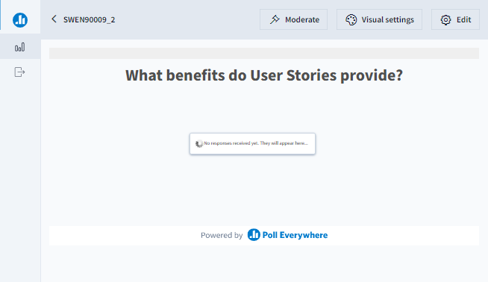
Poll discussion

Slide 6
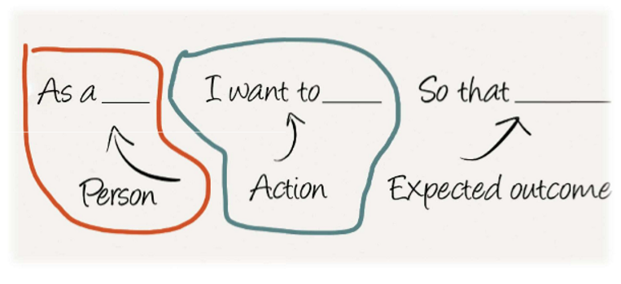
Discuss
What benefits do User Stories provide?
Colton Carner (2021)
Notes:
Here, be careful with “Action” – that should be about the user goal, NOT the UI
NOT “I want to have a button to click”,
YES “I want to find my size easily”

Slide 7
Benefits of User Stories
Contain technical details about how the implementation will be done
Allows for prioritization of certain features over others
Written in language that can be understood by client or users, making for easier validation and for prioritization by product owner
Extensive documentation that we can do upfront and hopefully never need to change later
Written in a manner that keeps the users at the front of a developer's mind, especially when tied to a persona
Use formal mathematical notation to ensure absolute correctness
Ties together information from goal model, personas, and paper prototype into units which can be implemented
❌
✔
✔
❌
✔
❌
✔
Colton Carner (2021)
Notes:
1. False. User stories are written from the perspective of end users/customers who are potentially non-technical. Therefore we should not have any technical details there.
2. True. User stories allow us to prioritise features/user goals
3. True. User stories are written from the perspective of end users/customers who are potentially non-technical.
4. False. User Stories are negotiable. They are NOT contracts, but invitation to conversations. They could be changed.
5. True. User stories are written from the perspective of end users/customers who are potentially non-technical.
6. False. Absolutely no formal mathematical notation. Goal is also NOT to ensure absolute correctness.
7. True.

Slide 8
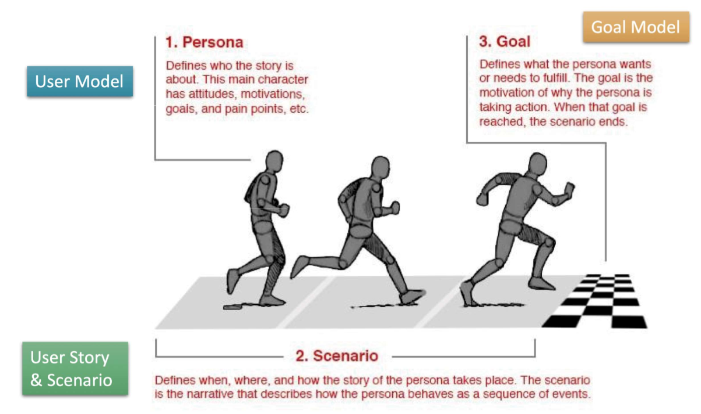

Slide 9
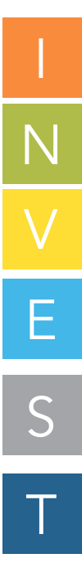
GOOD User Story
Stories are independent & self contained so order of implementation can change
ndependent
egotiable
aluable
stimable
mall
estable
Stories are feature placeholders. Don’t invest TOO much effort into them
to enable change.
Stories provide measurable business value to the client/product owner
Stories have concrete description for a developer to allow rough to estimation in storypoints and priorities.
Epic (big) Stories are hard to estimate. Detailed (small) Stories measure ‘progress’. The storypoints completed/velocity.
Confirm with client when a Story feature is considered done (Acceptance Testing)
Notes:
Notes Reference: https://agileforall.com/new-to-agile-invest-in-good-user-stories/
https://medium.com/agile-outside-the-box/back-to-basics-writing-and-splitting-user-stories-8903a931499c
Independent: Story should be as independent (in terms of order) as possible, so that we can have true prioritization (based on business value) of each and every story. Order dependency might make you implement a less-valuable user story first.
Negotiable: A story is NOT a contract. It is an “invitation to a conversation”. User story can be changed.
Valuable: Story should have value. If it has no value to the users in user story (“As a”), why would we want to implement this?
Estimable: A story should be clear enough to do an initial estimate. This is important for the prioritization – a highly valuable user story, but also very lengthy, might not have the highest priority. This can also help you break down user stories that are too large.
Small: In this subject, user stories should really be 1 week max in length
Testable: Every user story needs to be testable in order to be “done”.

Slide 10

User Story Completion
Acceptance Tests validate User Stories (week 8)

Slide 11
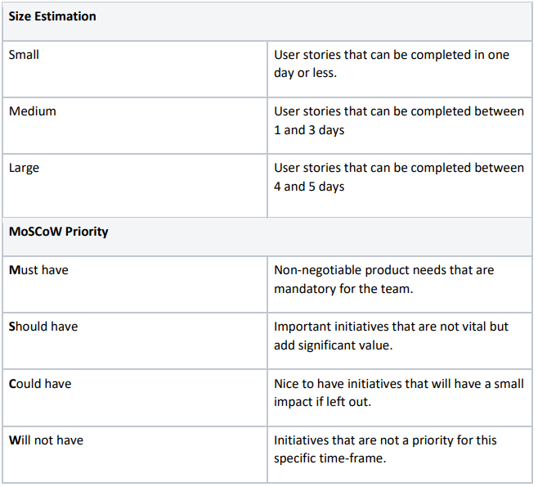
Project Work – Write User Story
1. Have a Stand Up team meeting to organizes each team member to write one user story during this workshop (use the lecture template).
2. Consider your goal model and personas. Write your user story, add StoryPoint estimation and justify estimation
a. Have a look at your leaf nodes on Goal Model. Write a User Story based on that.
b. Estimate your User Story. If it will probably take longer than 1 week to complete, break it down into sub-tasks (i.e. user stories with smaller size)
c. All user stories and sub-tasks should be documented on Confluence for team in the next semester
Notes:
Not all backlog items should be captured in Goal Model. Goal Model is an abstraction.
When to update your Goal Model: you realise your user stories are not connected to the epic. Or sub-tasks are not connected to user stories.
Goal Model: Top-down;
Requirements/Sprint planning: Bottom-up

Slide 12
Project Work - Confluence
3. Upload each User Story to Confluence
4. Discuss with team (Zoom breakout rooms for those online).
5. Use the MoSCoW technique to classify/prioritize your team’s user stories.
Reference: https://www.agilebusiness.org/page/ProjectFramework_10_MoSCoWPrioritisation
6. Feedback. Each student should review at least one user story from each member and provide Confluence comments.
Notes:
Priority: Make sure that you clarify the priority with the client.

Slide 13
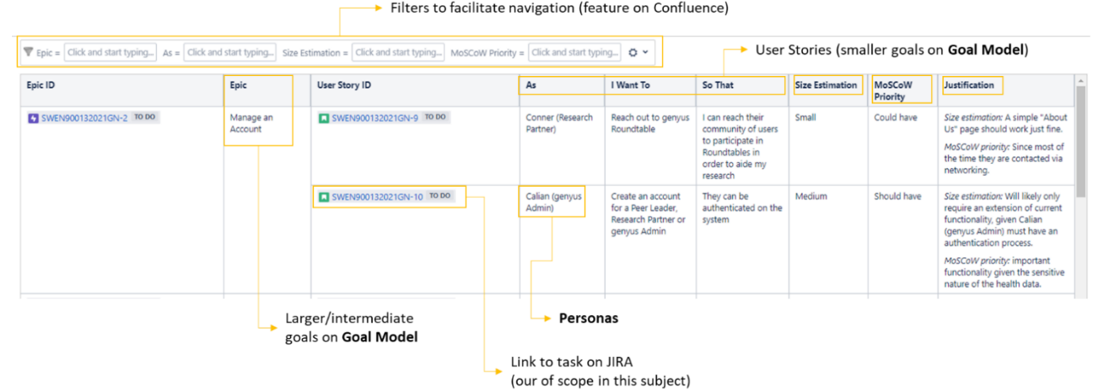
Project Work – quality review
7. Review/rework your own user stories after receiving feedback.
8. Create one well-organized, easy to read, shared Confluence page to document all of the team’s final, high-quality user stories.
Confluence Space (2019) https://confluence.cis.unimelb.edu.au:8443/display/ESPS/User+Stories

Slide 14

The End
Thank you!
Notes:
.

