Slide 1
SWEN90009 Software Requirements Analysis
Acceptance Test
2022 - Semester 1
Tutorial Week 8
Copyright University of Melbourne 2017

Slide 2

Today’s Aim
Discuss Acceptance Criteria & Tests.
Consider why do we write these.
- What value do Acceptance Criteria have?
- What value do Acceptance Tests have?
Work on Acceptance Criteria

Slide 3


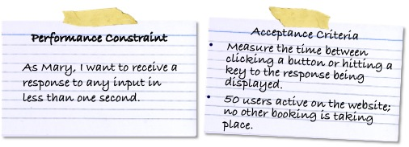
Revision of Week 7
Feature User Story
As a <User Role>,
I want <Goal>,
so that <Benefit>.
Acceptance Criteria:
define what needs to be done before User Story is 100% “Done”

Slide 4
Answers?
Quiz
1. Clarify the User Story prior to development, eg edge cases.
2. Provide a “definition of Done” for User Story
3. Provide an example of the UI look & feel
4. Ensure the product increment has well understood high quality
5. Product Owner/ Client writes them quickly without input from the development team.
6. Product Owner/Client understands the “Done” definition
✔
✔
❌
✔
❌
✔
Notes:
1 and 2: If anything was unclear in your user story, well – it will be clarified in the Acceptance Criteria. If user story was vague – then Acceptance Criteria is more specific. Because if we are not being specific, how do we know “yes this user story is done, we can move on to the next one”.
5 & 6: On a connected note: everyone should know when “user story is done”. That means your development team need to be involved.
UI: NOT the purpose of Acceptance Criteria. I would say this is more for the High fidelity prototype

Slide 5
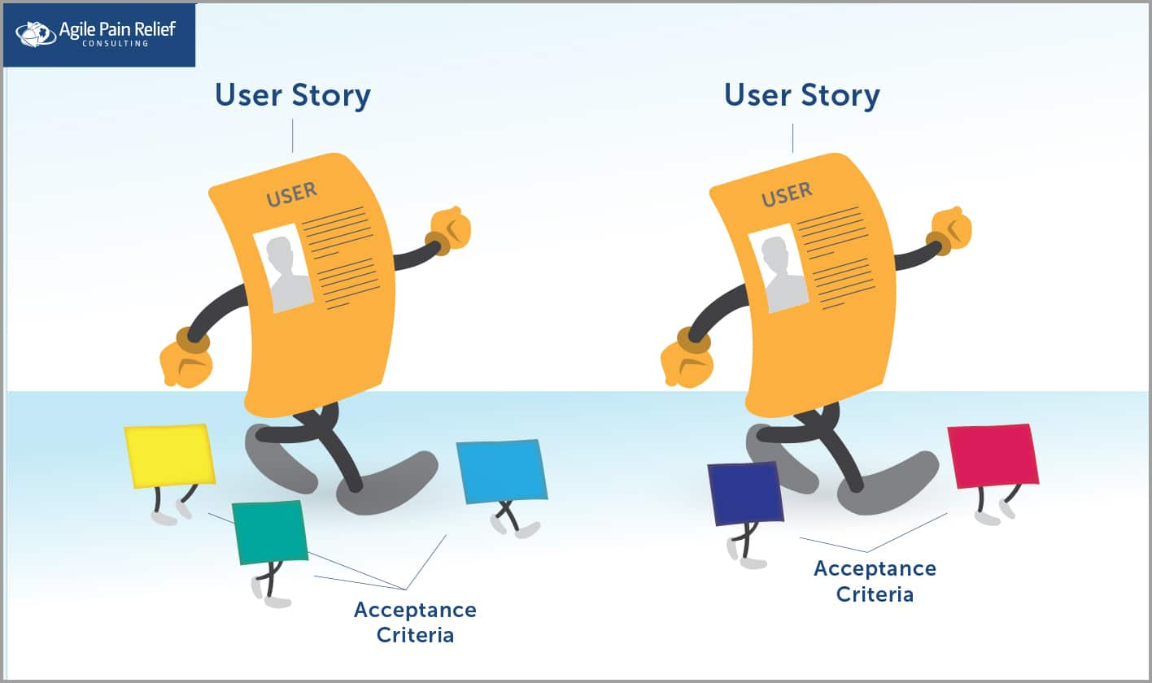
The value of Acceptance Criteria
What value do Acceptance Criteria have?
Src: https://agilepainrelief.com/blog/definition-of-done-user-stories-acceptance-criteria.html

Slide 6
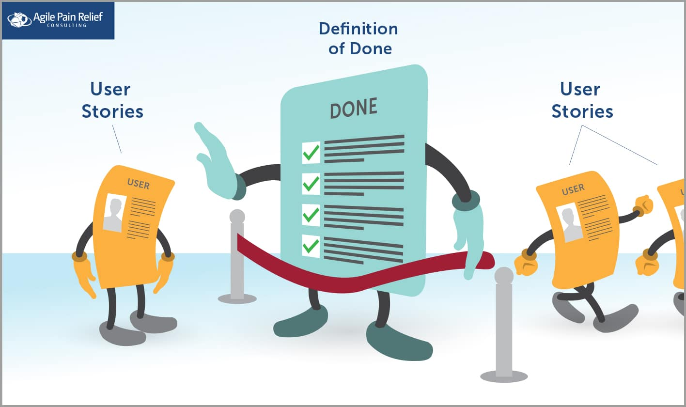
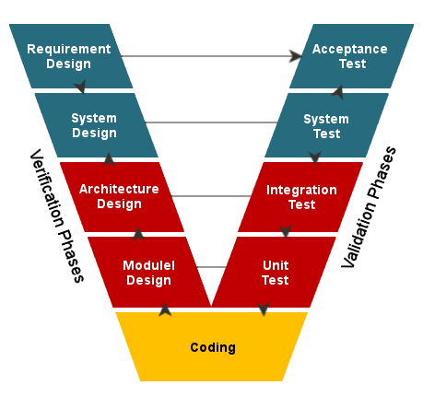
Definition of Done
Value of ‘Definition of Done’ is both:
An overview of what User Story must complete for before it is marked as complete, eg:
Code was peer reviewed
End-User documentation updated
Tested on Mobile Devices
…
Specific Acceptance Criteria each User Story must demonstrate before it is marked as complete
Src: https://agilepainrelief.com/blog/definition-of-done-user-stories-acceptance-criteria.html

Slide 7
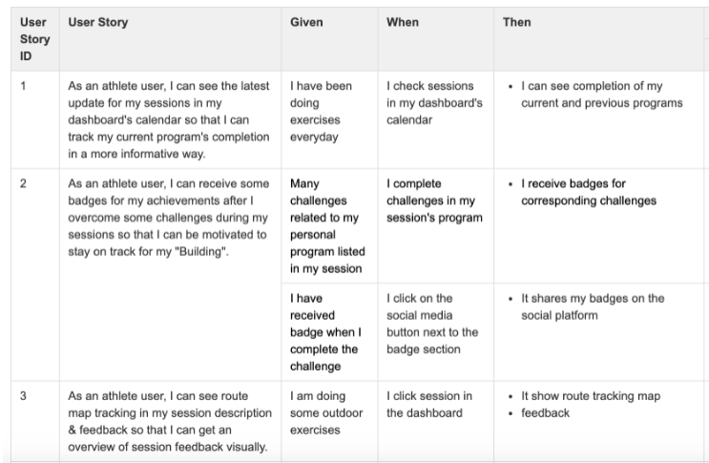
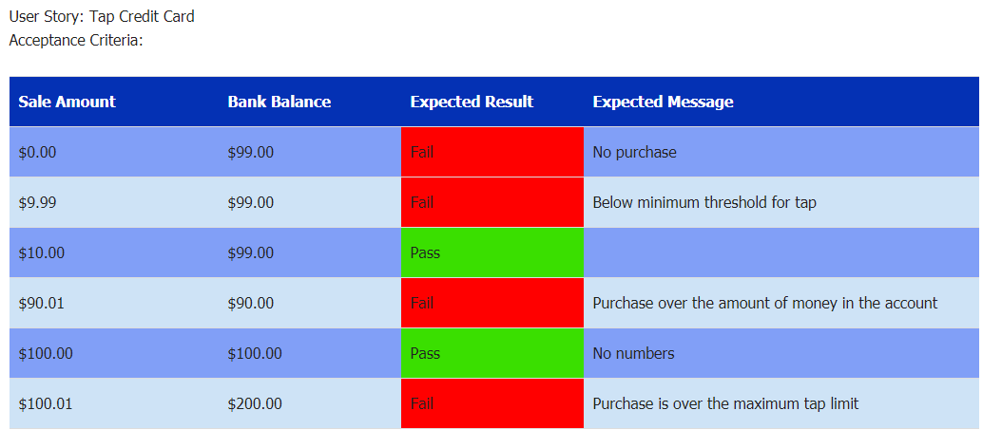
Forms of Acceptance Criteria
The many ways to document Acceptance Criteria
textual format: Given[condition], When [something happens], Then [result]
Table outlining possible inputs and outputs
Formal and automated ‘Behaviour Driven Development’ (compared to TDD, BDD is done by the whole team / product owner), eg Cucumber [next slide]

Slide 8
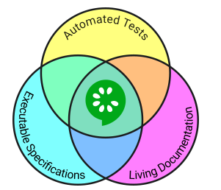
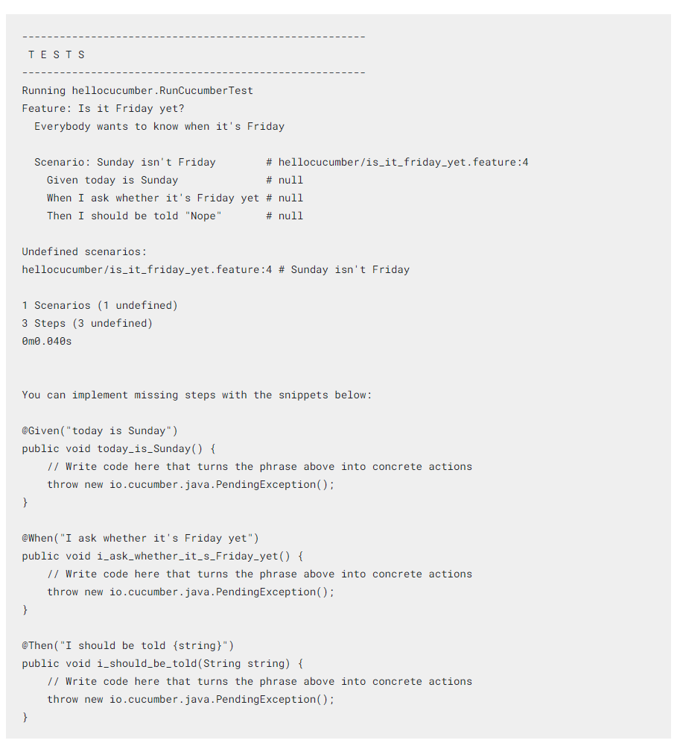
Cucumber Example

Slide 9
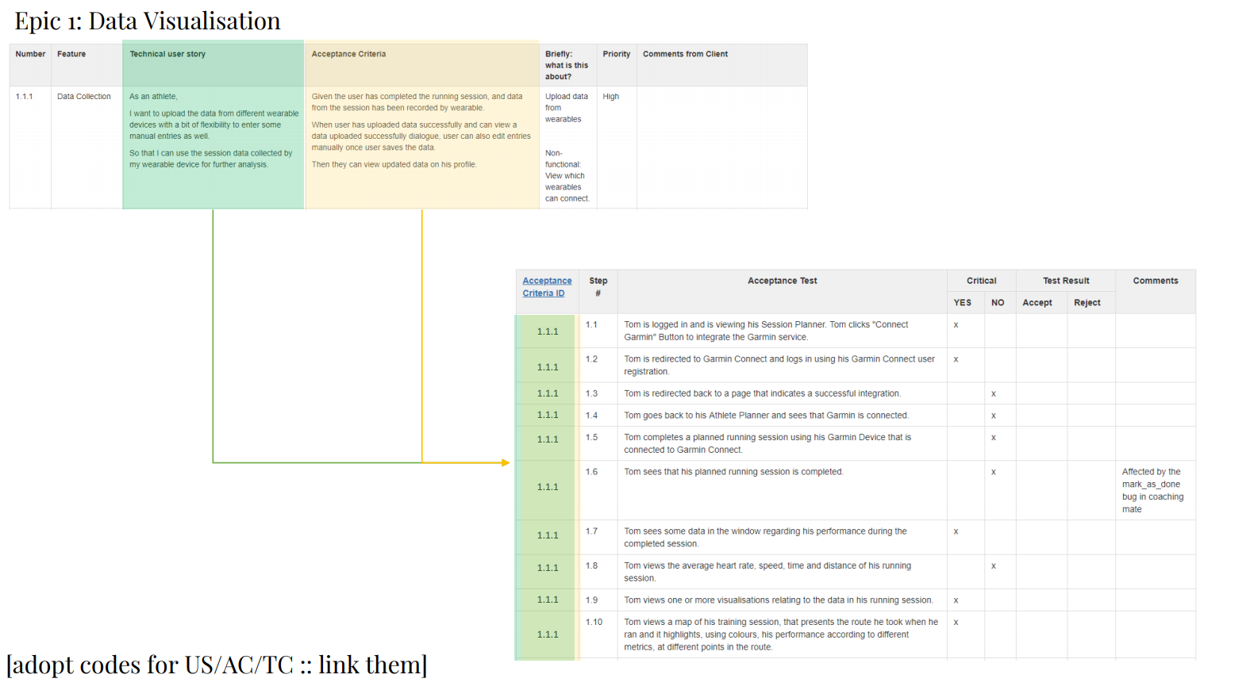
Acceptance Criteria vs Tests
One Criteria can have many Tests.
Tests are executable STEPS
Test functions, not ‘usability’.
Notes:
Take an Acceptance Criteria: how it should be tested – write an Acceptance Test
Test should be repeatable/reproducible

Slide 10
Acceptance Criteria
Capture Acceptance Criteria for User Stories
Textural format
Design test early: Test Driven Development
Given <precondition or assumption> and/or <additional precondition>
When <perform an action> and/or <perform an additional action>
Then <this outcome will result> and/or <an additional outcome>

Slide 11
Acceptance Test
For each Acceptance Criteria write Acceptance Test(s)
Consider typical scenarios, (happy path)
Consider boundary and fail scenarios
Choose any UAT template, (consider the lecture examples)
Give expected input data
Document expected output
Ask the client to confirm the scenario is working as expected
Does the prototype support the business user scenario?

Slide 12
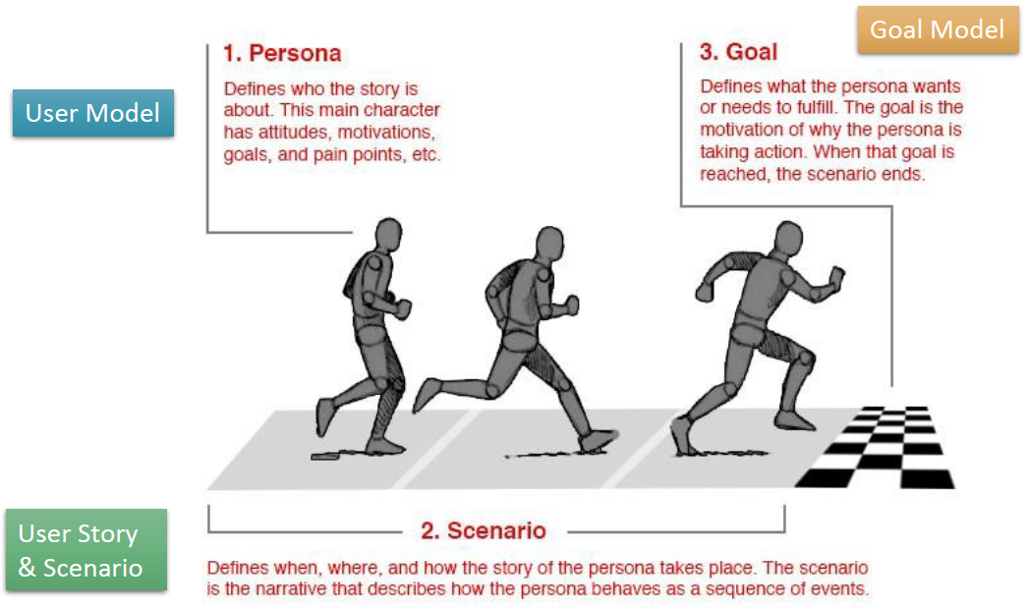
Different forms of specifications
Source: Note page 9 of Elaboration (Personas), & page 17 of Specification (User Stories and Scenarios)
by Dr Winn Chow

Slide 13
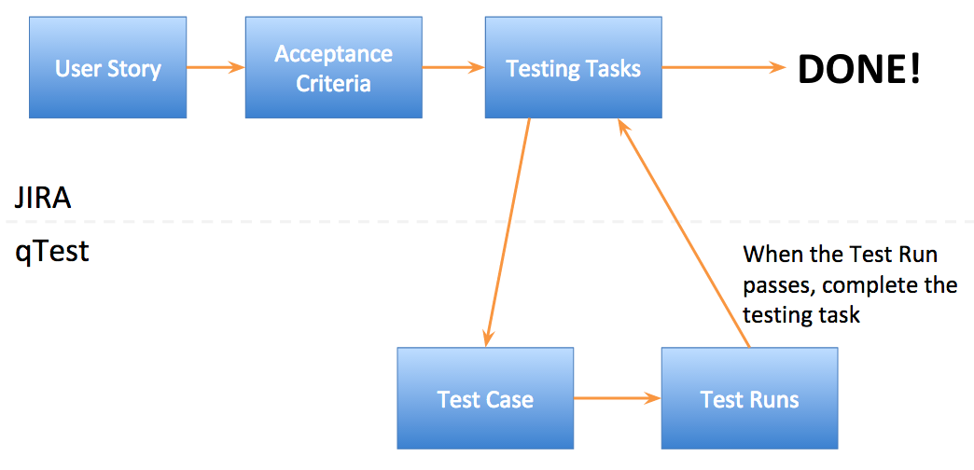

Test Workflow

Slide 14
Tasks to do – from GitHub
Acceptance Criteria tasks to be performed:
1. Your team chooses one or two high priority user stories.
2. During workshop, each student chooses one of the user stories and writes its Acceptance Criteria.
3. Following the lecture template:
“Given [condition], When [something happens], Then [result]”
5. Share your Acceptance Criteria with your team.
6. Each student reviews another team member’s Acceptance Criteria.
7. Provide feedback.
8. Review/rework your own Acceptance Criteria after receiving feedback.
Acceptance Test tasks to be performed:
1. For each student’s reviewed Acceptance Criteria, write one Acceptance Test.
2. Share your Acceptance Test with your team.
3. Each student reviews another team member’s Acceptance Test.
4. Provide feedback.
5. Review/rework your own Acceptance Test after receiving feedback.
Confluence tasks to be performed:
Upload the final, improved version of your Acceptance Criteria and Acceptance Test.

Slide 15
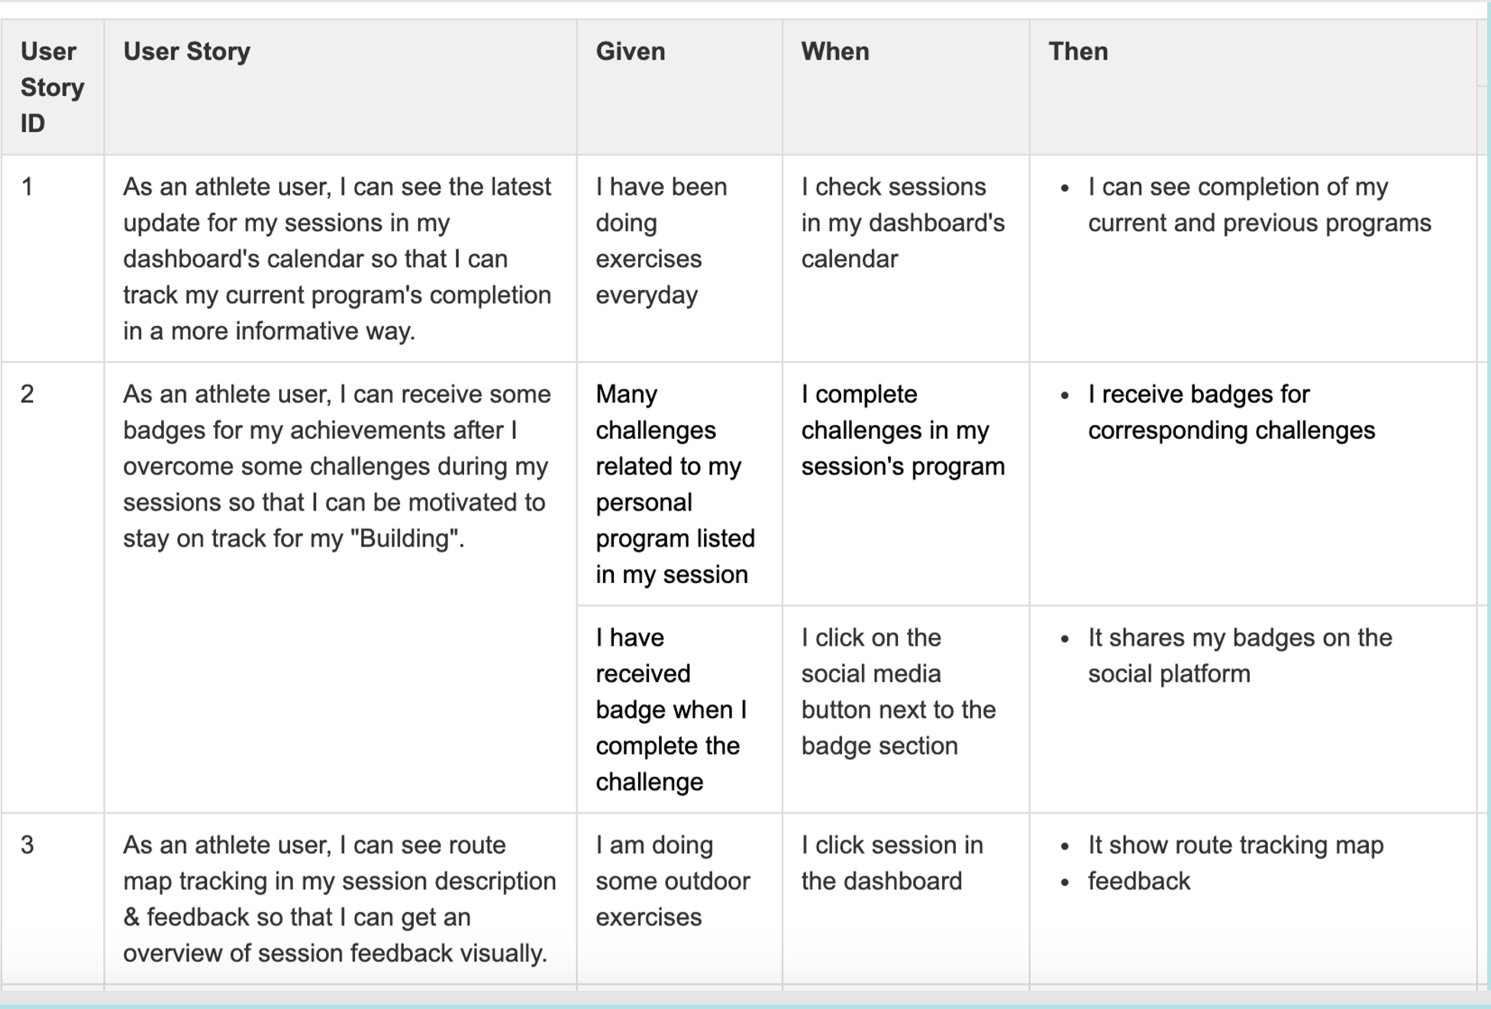
Formalize in GitHub
Confluence tasks to be performed:
Create one Confluence page to document all shared Acceptance Criteria and Acceptance Tests.
Create a table on this Confluence page which clearly link:
the User Story codes to the Acceptance Criteria, and
the Acceptance Criteria to the Acceptance Tests.
Upload the final improved version of your Acceptance Criteria and Acceptance Test.

Slide 16
Acceptance Criteria

Slide 17

The End
Thank you!
Notes:
.

