Slide 1


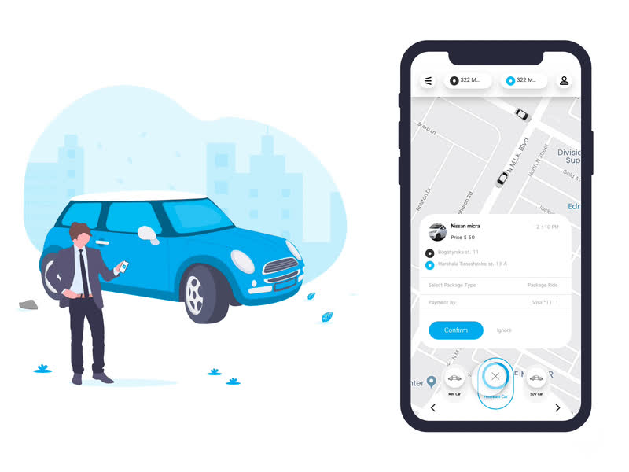



Cross Platform Application Development
S2-23_SESAPZG585
Carzoo📱
Mobile Application
Group - 1
Sushanth
2021HS70024
Anjali Mishra
2021HS70010
Shruti Dhanuka
2021HS70006
Preeti M Baddi
2021HS70017

Slide 2

The Carzoo app is designed to streamline car service management, providing functionalities for car owners, service center managers, mechanics, and service agents.
The app supports periodic car servicing, locating nearby mechanics for breakdown services, and managing important car-related documents.

Slide 3



Tech stack used:
Frontend: React native
Tool: Expo Go
Backend: Express.js
Database: MongoDB
Deployment platform: BTP(Backend service)
External services:
Amazon S3 bucket
SendGrid for production email
MailTrap for testing email
Google Map service

Slide 4
Features:
Periodic Service Booking:
Car owners can choose service plans (Standard, Comprehensive, Basic) and schedule service appointments.
Service orders are managed by service center managers and assigned to service agents for execution.
Nearby Mechanics:
Displays mechanics near the car owner's current location for breakdown services.
Mechanics can update their location through their profiles.

Slide 5
Features:
Document Management
Manages documents related to insurance and emissions.
Sends email alerts before document expiry.
Admin feature
Manage service order
Manage agents and

Slide 6
User roles:
Car Owner: Books services, finds nearby mechanics, manages documents.
Service Center Manager: Manages service orders, assigns service agents.
Mechanic: Updates location, receives and responds to service requests.
Service Agent: Handles assigned orders, updates service status.

