Slide 1
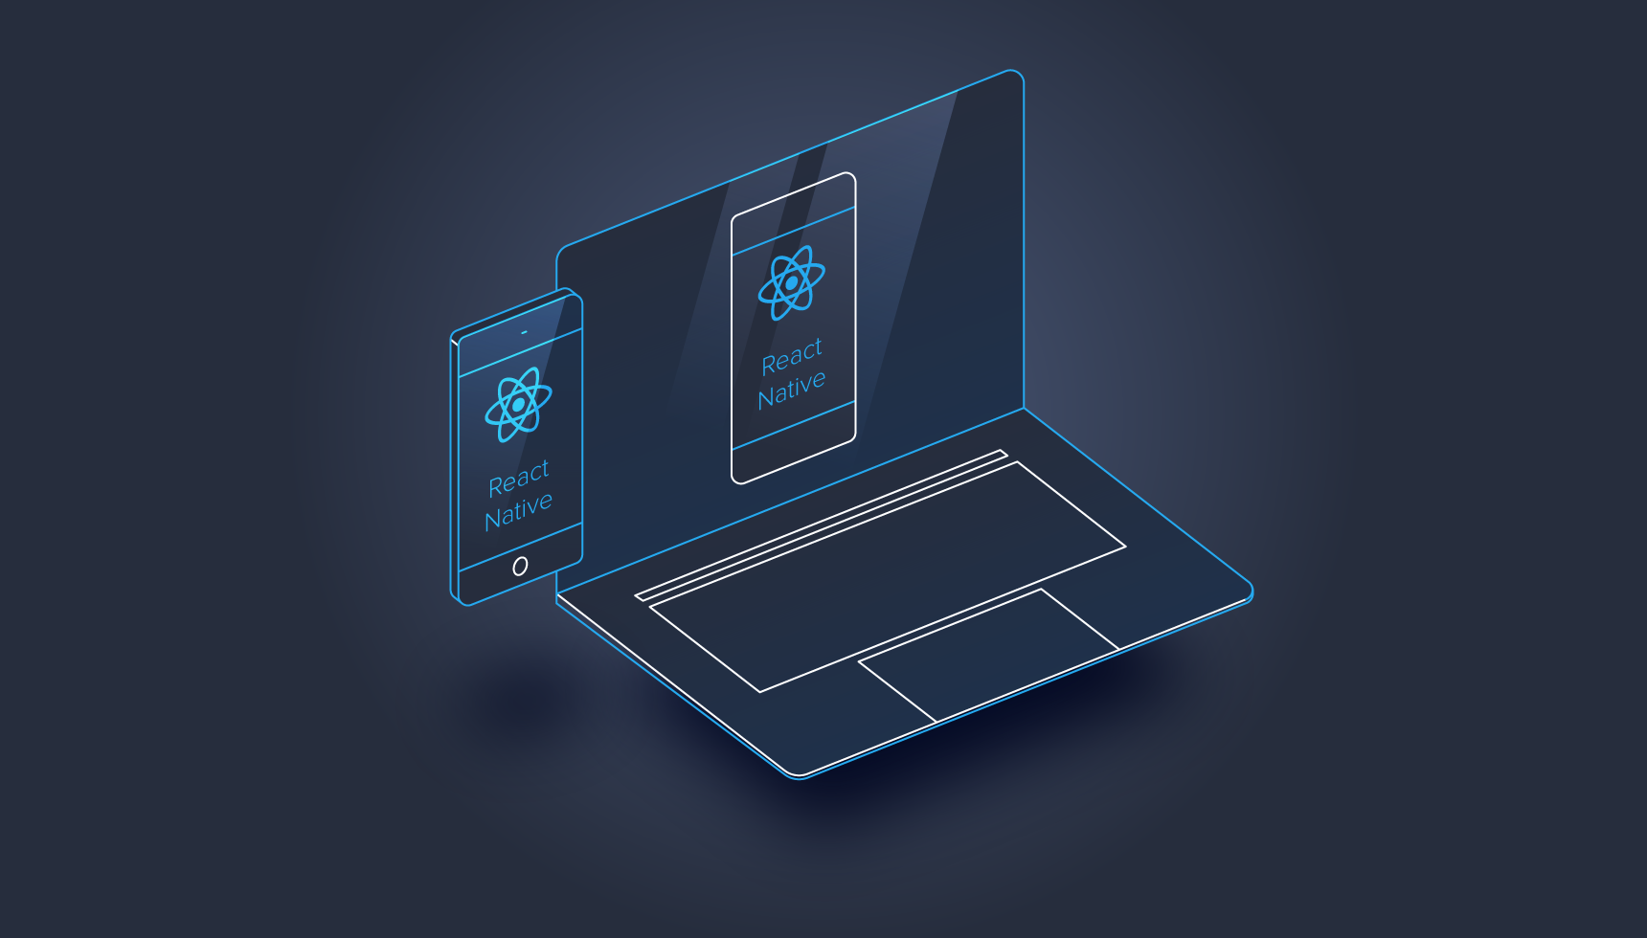
Project Inked
( A tattoo discovery platform )
Samrat Mukherjee
Shuvadip Ghosh

Slide 2
PROJECT OVERVIEW
A tattoo artist/parlor discovery platform
Available in 3 platforms: Web, IOS, Android
This app is currently under development.
Web Features
Customer registration
Customer authentication
Customer dashboard
Artist page
App Features (Currently static data, backend is yet to be implemented)
A custom native slide component for welcome page (published as NPM package)
Login Page / Registration
Customer Dashboard

Slide 3
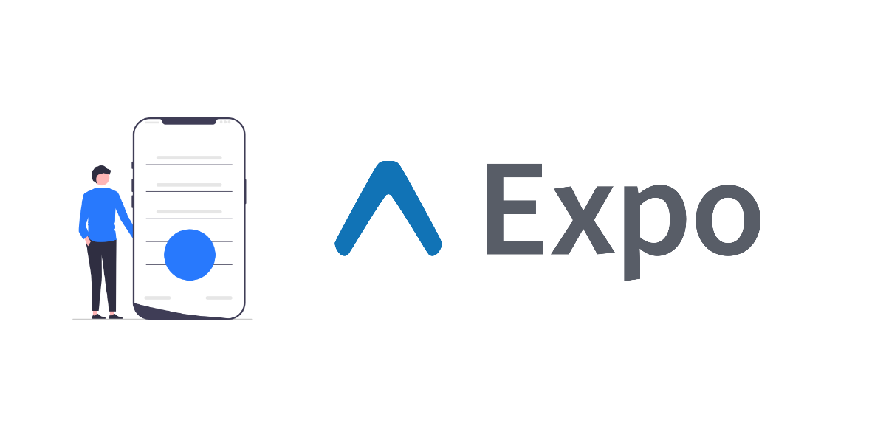


Key Concepts
What is React?
React, is an open-source JavaScript library used for building user interfaces.
Developed and maintained by Facebook, React has become one of the most popular libraries for front-end development.
2. What is React Native?
React Native is an open-source framework developed by Facebook for building mobile applications using JavaScript and React.
It allows developers to create natively rendered mobile apps for both iOS and Android platforms from a single codebase.

Slide 4
Native components
Native components are directly rendered using the native UI components of the mobile operating systems (iOS and Android).
These components bridge the gap between the React Native code and the native platform code, ensuring that the app looks and performs like a traditional native app.
Examples:
View: The most fundamental component for building UI, akin to a div in web development.
Text: Used for displaying text.
Image: For displaying images.
Touchable Opacity: Component for handling touch events with different feedback styles.

Slide 5
Expo
Expo is an open source platform that simplifies the development process by providing a set of tools and services that handle much of the complexity associated with React Native development.
Key Features of Expo:
Managed Workflow:
Expo offers a managed workflow where many of the setup and configuration tasks are handled for you.
Expo SDK:
A comprehensive library of pre-built components and APIs for accessing native device features such as the camera, location services, sensors, and more.
Expo Go:
A client app available on iOS and Android that allows developers to run and test their apps on a real device or emulator without needing to build a standalone app.

Slide 6
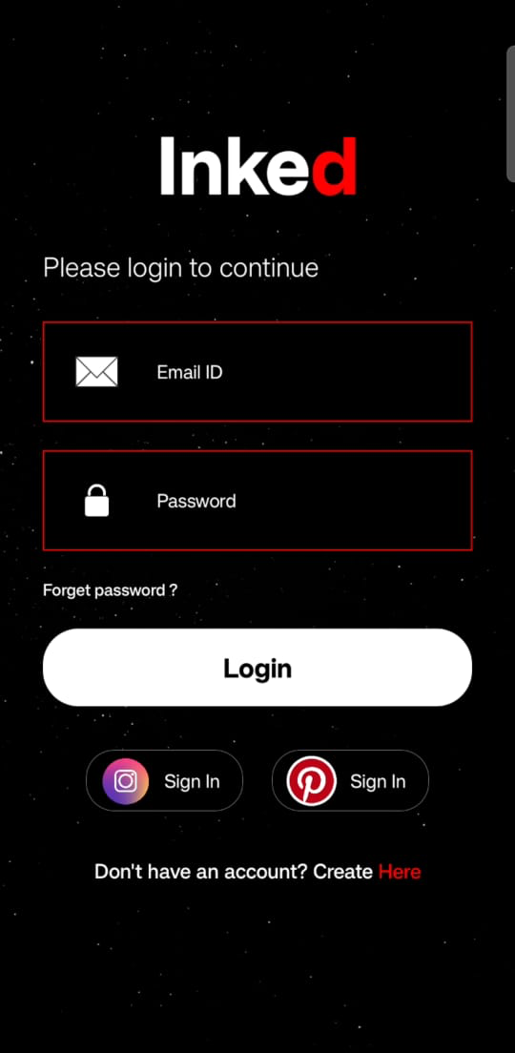
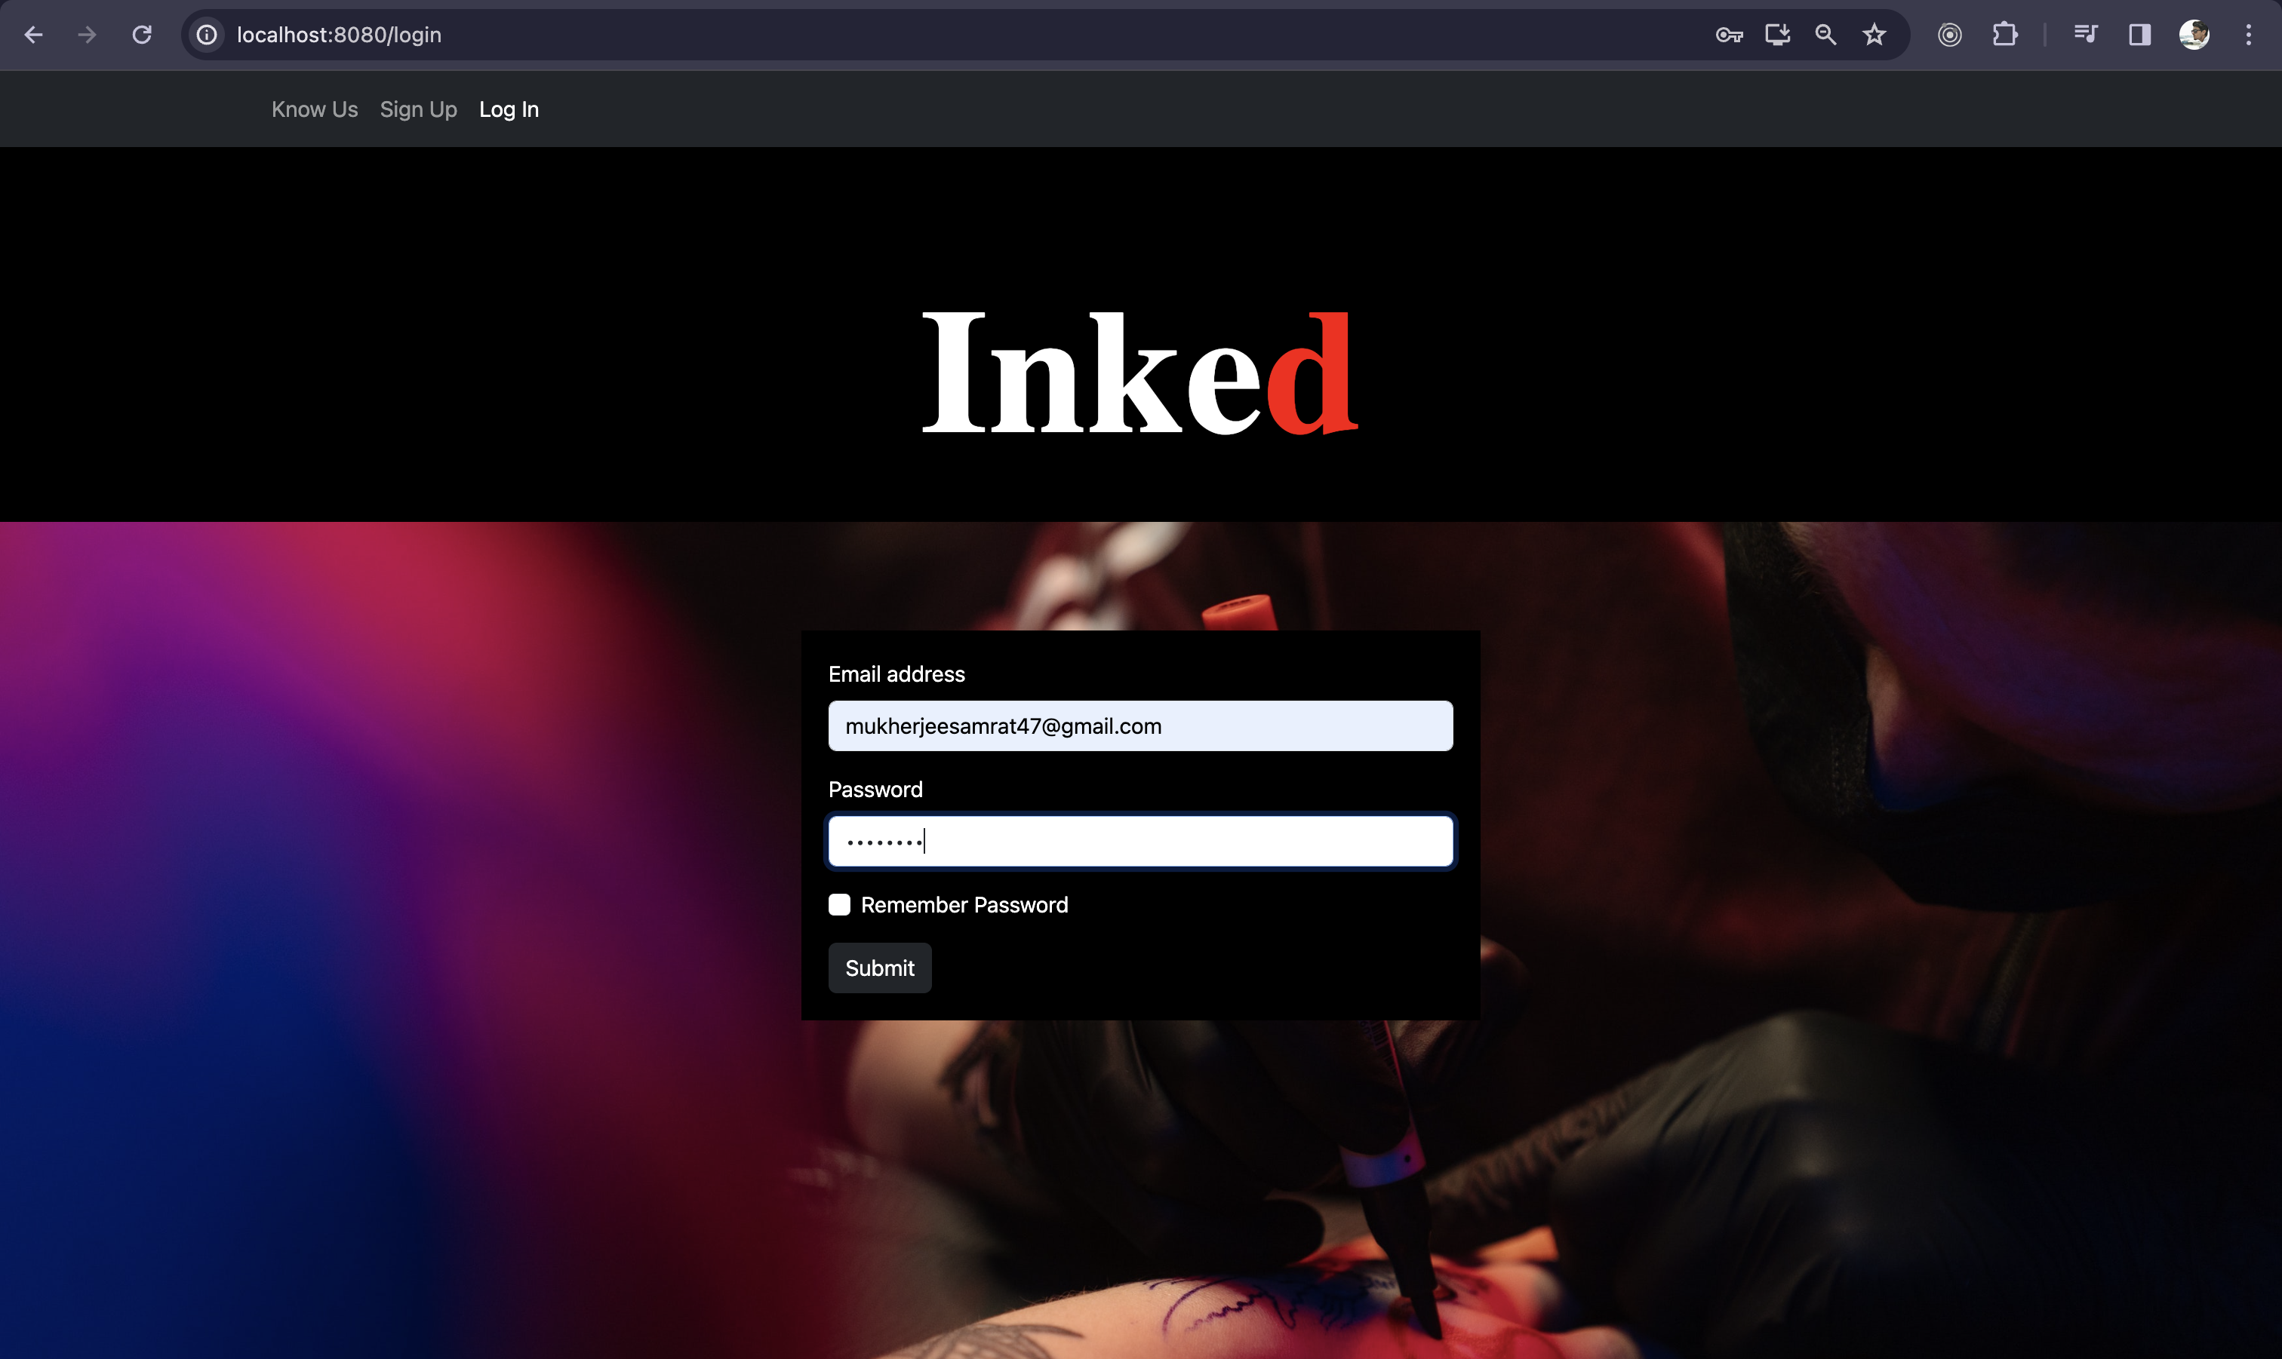
Showcase
1. MERN stack web application
(https://github.com/thekingiscold/react-native-inked)
2. React Native app using custom native components
(https://github.com/thekingiscold/inked-core)

Slide 7
DEMO

