Slide 1

Cross Platform Application Development
Team:
Pranjal Bankawat- 2021HS70020
Mahima M Nayak- 2021HS70028

Slide 2
Content
Application Name: RentWheels
Proposal
Project Description
Value Proposition
Market Analysis
Monetization Strategy
Development RoadMap

Slide 3
Project Description
Rent Wheels App:
The Rent Wheels app is a comprehensive solution designed to provide a seamless, intuitive experience for users seeking to rent cars across different platforms, including iOS, Android, and the web.
Whether you need a car for a short trip around town or a long journey across the country, the app allows you to quickly and easily find the right vehicle to suit your needs.

Slide 4
Value Proposition
Convenient Booking: Seamlessly find and book a car across platforms with intuitive search and filters.
Diverse Selection: Access a wide range of vehicles tailored to your preferences and needs.
Secure Payments: Enjoy peace of mind with encrypted, reliable payment options.
Personalized Experience: Manage bookings, rewards, and preferences in one easy-to-use app.
Exceptional Support: Receive prompt customer service through chat, email, or phone support.

Slide 5
Market Analyasis
Growing Demand: Increasing need for flexible transportation solutions drives the car rental market.
Rising Urbanization: Urban centers' expansion fuels demand for short-term car rentals.
Travel and Tourism Growth: A rise in travel and tourism boosts rental car requirements.
Tech Integration: Advanced technology improves booking convenience and customer experience.
Sustainability Focus: Eco-friendly and electric car options gain popularity among customers.
Intense Competition: Numerous players in the market lead to competitive pricing and innovation.
Evolving Consumer Preferences: Shifting preferences towards mobility solutions like car sharing and subscriptions.

Slide 6
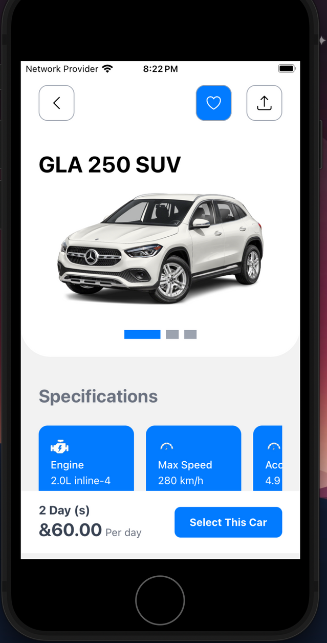
Features
1.Smart Search and Filters:
Utilize advanced search algorithms and filters to quickly find the perfect car based on location, dates, preferences, and budget.
2. Flexible Booking Options:
Offer flexible booking options including one-way rentals, multi-day rentals, and extended rentals to accommodate diverse travel needs.
3.Real-Time Availability Updates:
Provide real-time updates on car availability, ensuring users can make informed decisions and secure their desired vehicle promptly.
4.Secure and Convenient Payment Gateway:
Integrate a secure payment gateway that supports multiple payment methods, allowing users to complete transactions conveniently and confidently.
5.User-friendly Booking Management:
Empower users to manage their bookings effortlessly through a user-friendly interface, enabling modifications, cancellations, and viewing of booking history.

Slide 7
THANK YOU!!!

