Slide 1
Workflow 5
Jan 11, 2019
Green Team

Slide 2
Module 1, 2, 3: ICEES
1a) Define a Cohort of Asthma patients (COHORT:22)
1b) Sub-divide this Cohort by (using N X N, feature_association2?)
EstResidentialDensity (urban/rural)
TotalEDInpatientVisits (high/low)
1c) Retain Statistics/DataProvenance for these subgroups of the Cohort
2) Extract, form the Module 1 cohort information, the exposures (chemical & environmental) for each sub-group
3) Identify unique clusters of exposures within the cohort… I do not yet understand a working definition of “unique clusters of exposures”
Rural & High ED Visits
Urban & High ED Visits
Rural & Low ED Visits
Urban & Low ED Visits

Slide 3
Rural & High ED Visits
Urban & High ED Visits
Rural & Low ED Visits
Urban & Low ED Visits
Module 4: New Tools/Analysis? (possibly Gamma?)
Rank and Score clusters identified in Modules 2/3 while maintaining the delineation between each of the four subgroups

Slide 4
Module 5: Gamma
Identify Proteins/Genes associated with the clusters from Modules 2-4
Module 6: Gamma
Identify Pathways associated with the proteins/genes identified in Module 5
Module 7: Gamma
Identify Phenotypes associated with the Pathways identified in Module 6
Module 8: Gamma?
Enrich, rank, & score Phenotypes from Module 7

Slide 5
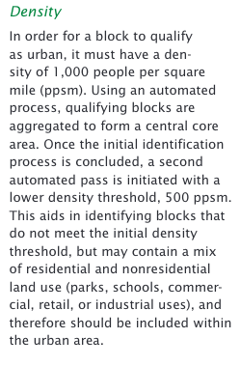
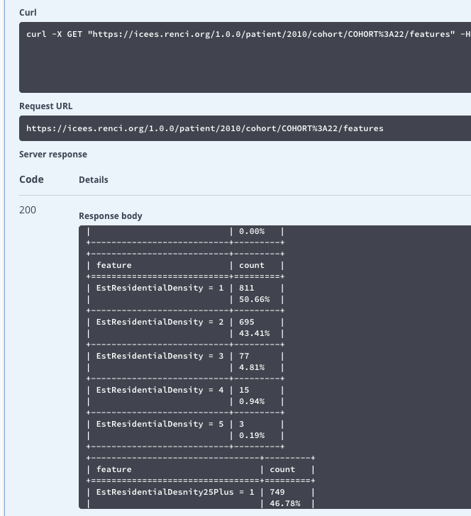
Defining URBAN vs. RURAL
When the /features endpoint is called,
This is the information pertinent to ‘EstResidentialDensity’ returned, below.
QUESTION:
What is the binning method such that we can choose an appropriate # for the cutoff between urban/rural (said another way, what do these bin values signify in terms of actual population density)?
https://www2.census.gov/geo/pdfs/reference/ua/Defining_Rural.pdf

