Slide 1
BLE SIT Introduction
Chunhao Jiang, CSPD
Nov, 2023

Slide 2
Agenda
Introduction
BLE Stack
BLE work flow
Example of Advertising and Scanning
Trouble Shooting
Notes:
这是说

Slide 3
Introduction
FreeRTOS
Task and scheduling
Create
Priority -> asynchronous problem
vTaskDelay
Message queue
BLE
Central and peripheral
Command and event
Spac v5.4

Slide 4
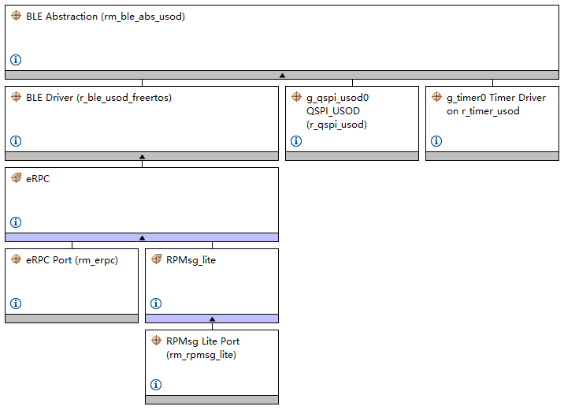
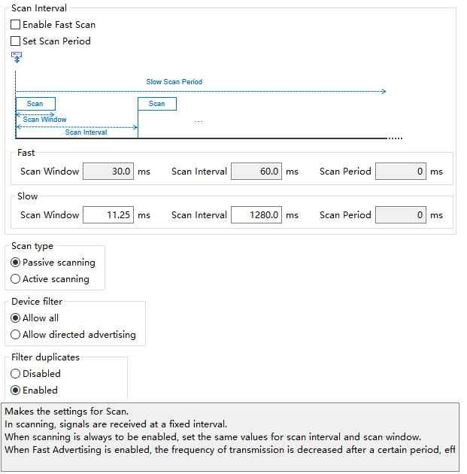
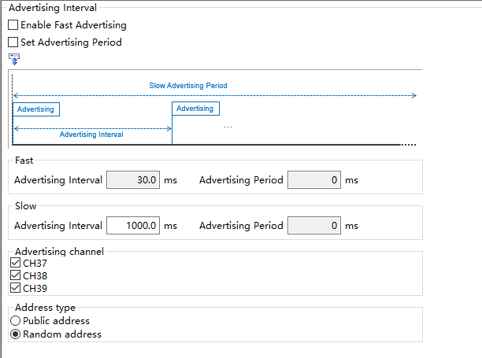
BLE Stack

Slide 5
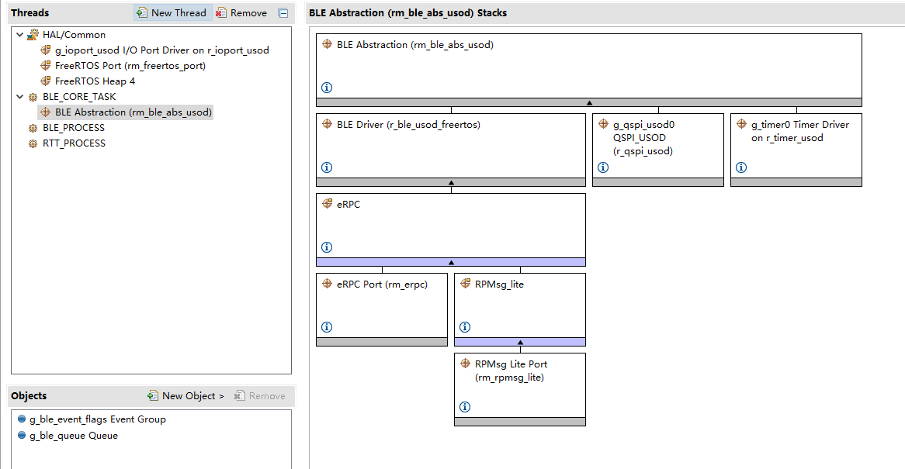
BLE Stack

Slide 6
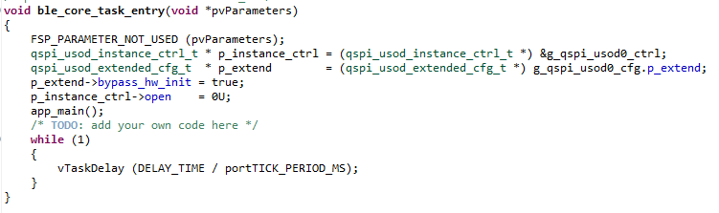
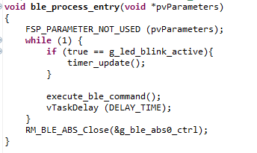
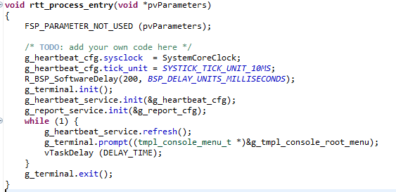
BLE Work Flow

Slide 7
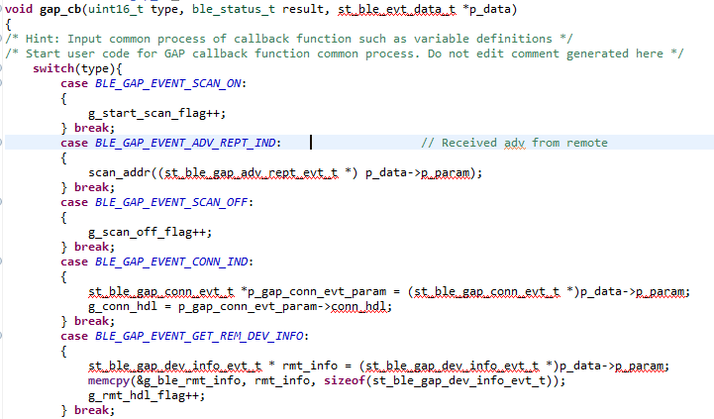
BLE Work Flow
What does app_main() do?
Initialize BLE
Initialize GATT Database
Initialize GATT server
Initialize GATT client
Initialize GATT Discovery Library
Initialize GATT Service client API
Process BLE Event in a loop(R_BLE_Exec)

Slide 8
BLE Work Flow
ble_core_task
ble_process_task
ble_core_task
ble_process_task
event
command
event
command
set flag
command
event
event
command
command
set flag
event
event
command
command
set flag
event
event
command
command
event
set flag

Slide 9
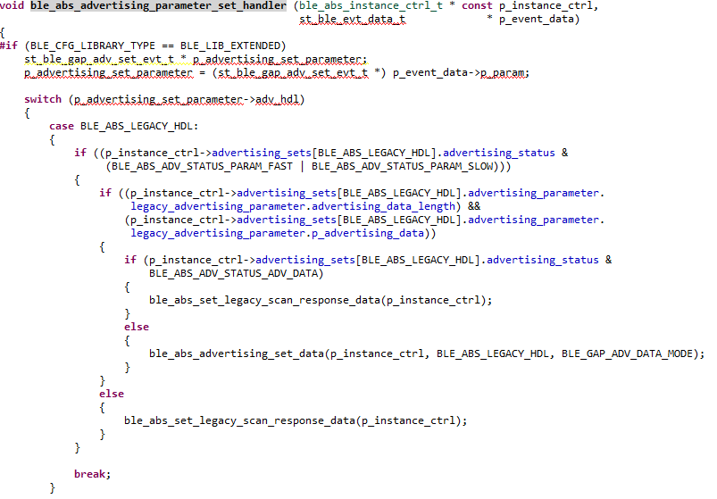
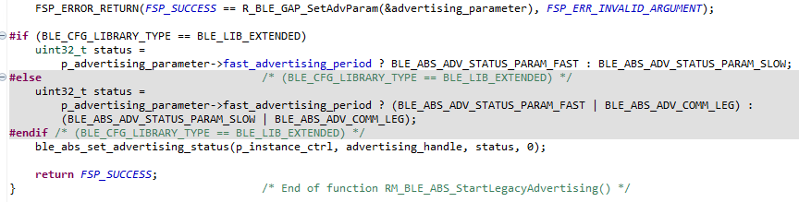

BLE Work Flow
Why set the priority of ble_core_task as lowest?
RM_BLE_ABS_StartLegacyAdvertising

Slide 10
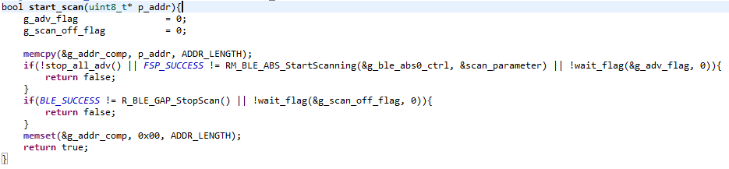
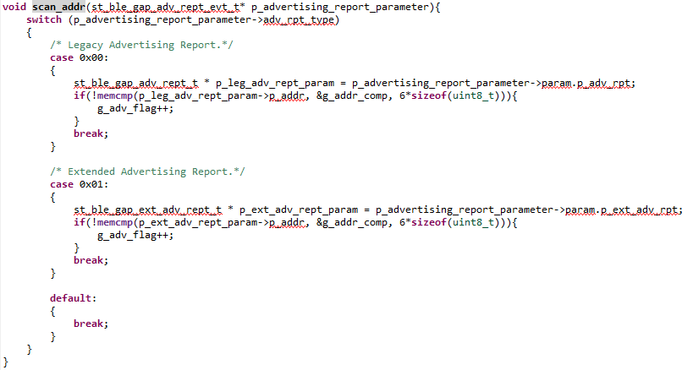

Example of BLE Scan

Slide 11

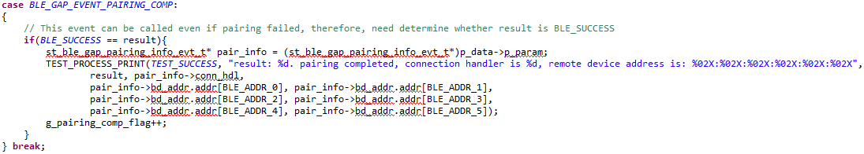
Trouble Shooting
Can’t trigger event
Notice the result of command
Find the event in whole project
Whether resend by a callback?
Sniffer
Can’t scanned
Check whether scan interval or advertising interval is large
Can’t pairing
Check result of callback
Check address of remote device
Stop adv before scan

Slide 12
Thank you for listening!

