Slide 1
SWP391 • LIBRARY MANAGEMENT SYSTEM
Phase 3 makes the
release defendable
Staging • Live SQL • Performance • User testing • Delivery evidence
19 July 2026

Slide 2
Phase 3 adds confidence—not new business scope
12
features complete
4
role audiences
FE01–FE12 retain the accepted Phase 2 contracts.
Guest, Member, Librarian, and Admin stay server-authorized.
100%
FR traceability
4 layers
validation required
Every implemented feature maps source rules to code evidence.
Automated, spec, safety, and acceptance evidence all remain mandatory.
Source: Phase 2 exit validation; Phase 3 design and plan.
2

Slide 3
Every deployed boundary is observable
GitHub Actions → quality gate → backend/frontend deploy → staging smoke
React
Express API
SQL Server
Azure Static Web Apps
Azure App Service
Azure SQL
HTML + responsive UI
CORS + protected 401
public catalog query
Frontend: lemon-wave-04db51100.7.azurestaticapps.net
API: app-library-api-staging-nhat714.azurewebsites.net
Source: phase3-staging-evidence-2026-07-19.md
3

Slide 4
Release readiness is measured, not declared
Coverage remains above 80% • deployment utilities 8/8 • browser E2E 4/4
916
151
100%
backend tests
frontend tests
FR traceability
53 suites passed
route and UI contracts passed
12 of 12 feature packages complete
Source: local baseline verification and Phase 2 exit evidence.
4

Slide 5
The SQL-aware smoke test closed the real staging gap
DETECT
DIAGNOSE
PROVE
Health looked green
Schema drift was concrete
The fix is repeatable
/health returned 200, but the first SQL-backed catalog check returned 500.
Books.RowVersion was missing; the legacy ISBN index then blocked the migration.
Five migrations ran twice; 20 tables validated; six-check smoke passed.
Source: Azure staging diagnosis, FE05 migration RED-GREEN, and six-check smoke.
5

Slide 6
Code-splitting cuts initial JavaScript by 67.9%
The first page no longer downloads every operational screen.
57
66.95 ms
route-level chunks
login p95 • bcrypt cost 10
Session validation p95: 1.45 ms
Source: phase3-performance-report-2026-07-19.md. Local deterministic timing; Azure SQL/network excluded.
6

Slide 7
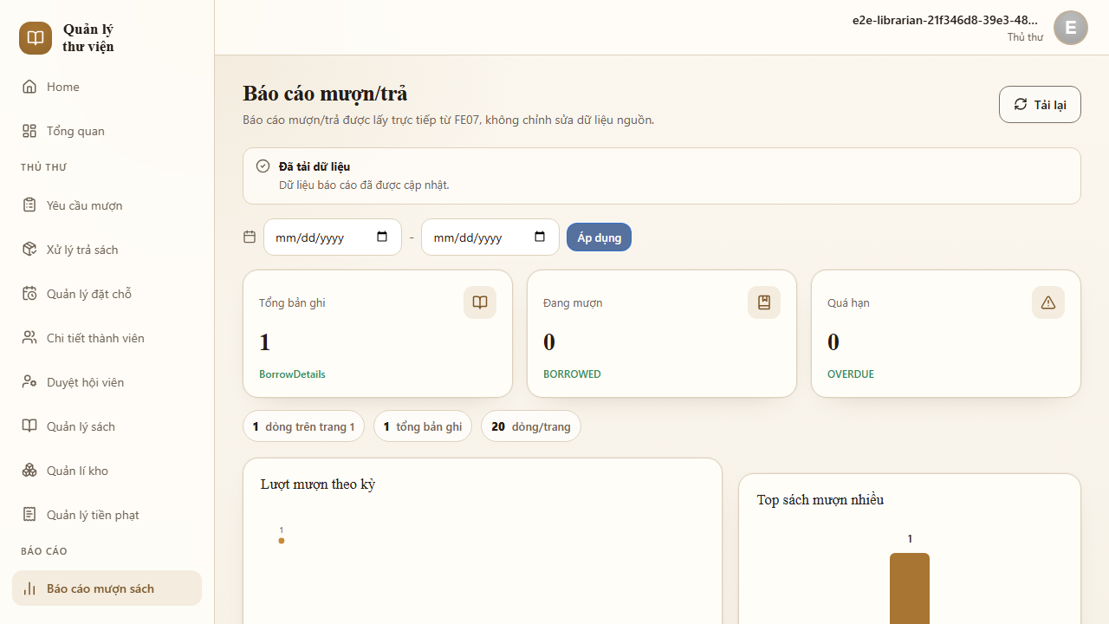
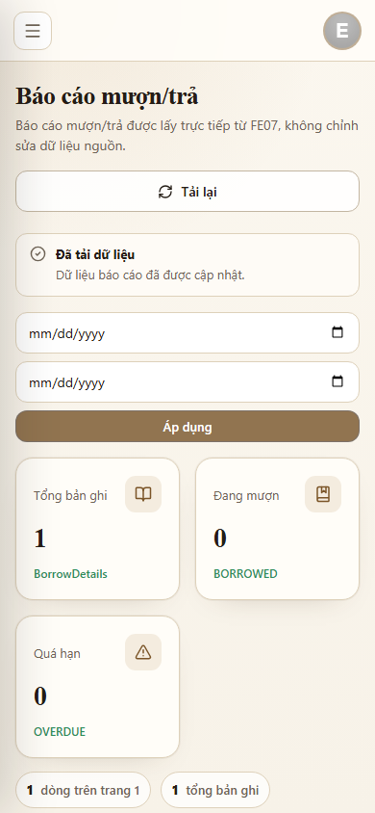
The golden path still works after delivery polish
4/4 browser flows • 24.4 s
Source: phase3-user-testing-record-2026-07-19.md
7

Slide 8
What is proven—and what is deliberately not claimed
Explicit boundaries keep the final report credible.
Evidence area | Status | Release meaning
Public frontend / API / SQL | PASS | Observed by the six-check staging smoke
CORS + anonymous auth | PASS | Exact origin allowed; /auth/me returns 401
Authenticated Azure golden path | NOT OBSERVED | No safe live Member/Librarian credential used
Real SMTP inbox delivery | NOT OBSERVED | Provider settings do not prove delivery
Durable avatar storage | LIMITATION | App Service filesystem is not production-durable
Production SLA | OUT OF SCOPE | Student-credit staging only
Source: Phase 3 staging and user-testing evidence.
8

Slide 9
The defense demo follows one repeatable five-minute path
1
2
3
4
5
6
Login
Borrow
Approve
Return
Pay fine
Report
Fallback evidence: six-check staging smoke • test:system • verified screenshots
Source: system-integration-demo-runbook.md
9

Slide 10
RELEASE DECISION
Phase 3 is ready
for integration
Merge the branch, require CI, then rerun the six-check staging deployment.
Keep authenticated Azure acceptance and real SMTP delivery open until they are actually observed.

