Slide 1
PPA Usage

Slide 2
PPA Main purpose
The basic idea of PPA is taking full advantage of the powerful hardware module PPE and try to minimize CPU load.
PPA can accelerate:
L3 ( IP Level ) --- Routing mode
  Unicast TCP/UDP
  Multicast packet
L2 ( MAC/bridge level) -- Bridge Mode
  Unicast packet
  Multicast packet
Note:
  For Routing and basic bridging acceleration --- Almost automatic learning
  For Vlan related bridging – Need manually set rules
Notes:
Linear Lookup Engine – running parallel to search for matched entries (ATM Cell / Ethernet Header / TCP/IP header).

Slide 3
PPA components
PPA package could be roughly divided into three parts:
  PPA Stack Adaption and Protocol Interface Layer
    Protocol Stack Adaption Layer: OS depentent, like ppa_get_pkt_src_ip(PPA_BUF *)
    Protocol Interface Layer – Hook into protocol stack
    like: Try to be OS independent
      Routing/NAT: ppa_hook_session_add_fn
      Bridge: ppa_hook_bridge_entry_add_fn
      VLAN: vlan_dev_get_vid
      Multicast: ppa_hook_mc_entry_modify_fn
  PPE Driver
    Net Interface for OS: like atm driver
    Interface to operate various PPE firmware or hardware
  PPE FW

Slide 4
PPA Architecture
Protocol Stack
Routing
NAT
VLAN
...
QoS
PPA Protocol Stack Interface (Upper Layer)
PPA adaptation to Protocol stack
PPE Hardware/Firmware Interface (Lower Layer)
Chip 1 (TP-E)
Chip 2
...
Chip n
PPE HW/FW

Slide 5
PPA Main Hooks
Unicast routing hooks:
  ppa_hook_session_add_fn: Try to add a routing session
  ppa_hook_session_del_fn: Try to delete a routing session
  ppa_hook_inactivity_status_fn: Check a session’s activity
Multicast hooks:
  ppa_hook_mc_group_update_fn
Bridging hooks:
  ppa_hook_bridge_entry_add_fn:Try to add a mac entry
  ppa_hook_bridge_entry_delete_fn: Try to delete a entry
  ppa_hook_bridge_entry_hit_time_fn:Check this entry’s activity
Direct Path hooks ( refer to next page )

Slide 6
PPA DirectPath Functions
Hook Functions – Extra ETH Port driver call these functions to communicate with DirectPath.
ppa_hook_directpath_register_dev_fn – register/unregister Extra ETH Port driver, such as USB ETH, WLAN.
ppa_hook_directpath_send_fn – send packet to DirectPath for acceleration.
ppa_hook_directpath_rx_stop_fn – stop receiving packet from DirectPath.
ppa_hook_directpath_rx_restart_fn – restart receiving packet from DirectPath.
Callback Functions – DirectPath use these callback Functions to communicate with Extra ETH Port driver.
rx_fn – DirectPath send packet to Extra ETH Port driver.
stop_tx_fn – DirectPath stop receiving packet from Extra ETH Port driver.
start_tx_fn – DirectPath restart receiving packet from Extra ETH Port driver.

Slide 7
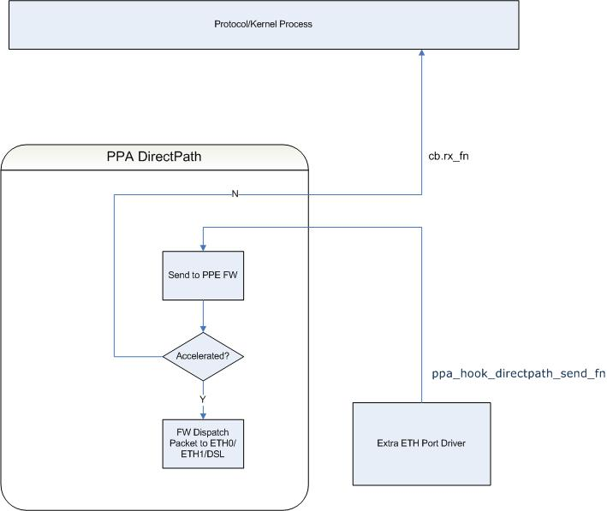
PPA DirectPath Diagram (RX)
RX: Packet from Extra ETH driver

Slide 8
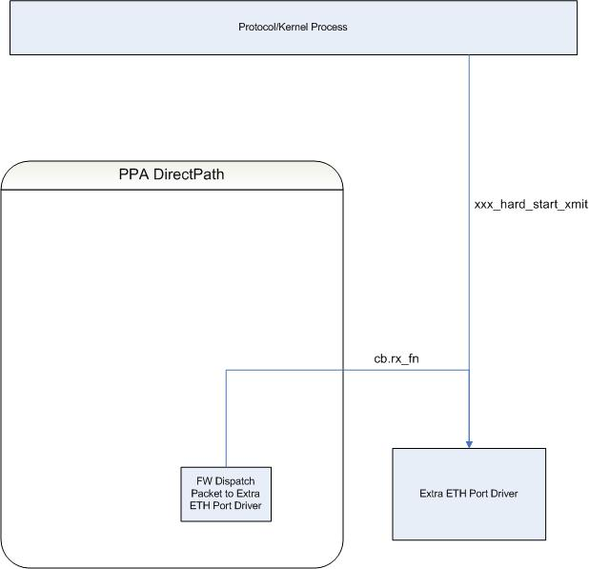
PPA DirectPath Diagram (TX)
TX: Packet to Extra ETH driver

Slide 9
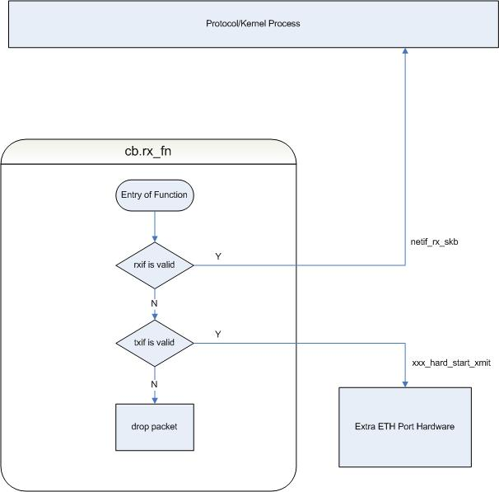
PPA DirectPath: Flow of “cb.rx_fn”

Slide 10
PPA basic usage with Ppacmd
Enable PPA
  Ppacmd init
  Ppacmd control –enable-lan –enable-wan
Set LAN/WAN interfaces
  Ppacmd addlan
  Ppacmd addwan
Multicast Routing
  Ppacmd addmc
  Ppacmd setmcextra
VLAN interface/filter setting
  Ppacmd setvif
  Pppcmd setvfilter
Note, ppacmd parameter all use hex value.

Slide 11
PPA Unicast TCP/UDP Routing Example
For Unicast TCP/UDP routing acceleration, it can be done almost automatically.
Test case 1: eth0 ---- NAT/Routing --- ppp0
PPA Initialization procedure:
  ./ppacmd init
  ./ppacmd control --enable-lan --enable-wan
  ./ppacmd addlan -i eth0
  ./ppacmd addwan -i ppp0
How to check whether the cession is accelerated or not:
  cat /proc/ppa/api/sessions
or
  Ppacmd getwansessions
  Ppacmd getlansessions
  cat /proc/eth/mibs

Slide 12
PPA Unicast TCP/UDP routing example
Test case 2: br0 ---- NAT/Routing --- ppp0
PPA Initialization procedure
  ./ppacmd init
  ./ppacmd control --enable-lan --enable-wan
  ./ppacmd addlan -i eth0
  ./ppacmd addwan -i ppp0
  ./ppacmd addlan -i br0
PPA Initialize procedure with PROC
echo enable > /proc/ppa/api/hook
Run below commands if necessary:
    echo add wan ppp0 > /proc/ppa/api/netif
    echo add lan eth0 > /proc/ppa/api/netif
PPA

Slide 13
PPA Unicast TCP/UDP routing example
Test case 3: br0 ---- NAT/Routing --- eth1.2
PPA Initialization procedure
  ./ppacmd init
  ./ppacmd control --enable-lan --enable-wan
  ./ppacmd addlan -i eth0
  ./ppacmd addwan -i eth1.2
  ./ppacmd addlan -i br0
PPA

Slide 14
PPA IGMP Proxy (Multicast routing) example
Test case 1: br0 ---- NAT/Routing --- ppp0
( Suppose there is a video stream 239.1.1.1 from ppp0 to eth0 )
PPA Initialization procedure:
  ./ppacmd init
  ./ppacmd control --enable-lan --enable-wan
  ./ppacmd addlan -i eth0
  ./ppacmd addwan -i ppp0
  ./ppacmd addlan -i br0
./ppacmd addmc -g 239.1.1.1 -l eth0
Note, If want to add inner vlan 20 and outvlan 81000003, just run below commands:
./ppacmd setmcextra -g 239.1.1.1 -i insert:20 -o insert:81000003
By the way, in fact, in kernel, we already add a hook in net/ipv4/ipmr.c so there is no need to call ppacmd addmc any more in IGMP Proxy mode.

Slide 15
PPA basic unicast bridging example. (A4/D4)
Test case 1: eth0---Bridge-- eth1 ( ie, br0: eth0,eth1 )
PPA Initialization procedure:
  ./ppacmd init
  ./ppacmd control --enable-lan --enable-wan
  ./ppacmd addlan -i eth0
  ./ppacmd addlan -i br0
  ./ppacmd addwan -i eth1
Note
  For D5, all bridging acceleration is done by switch.
  For A5, downstreaming acceleration is done by PPE FW, but for upstreaming packet, it is done by MIPS, ie, no acceleration.

Slide 16
PPA IGMP Snooping(Multicast bridging) example
Test case 1: eth0---Bridge-- eth1 (ie, br0: eth0,eth1 )
PPA Initialization procedure:
  ./ppacmd init
  ./ppacmd control --enable-lan --enable-wan
  ./ppacmd addlan -i eth0
  ./ppacmd addlan -i br0
  ./ppacmd addwan -i eth1
  ./ppacmd addmc -g 239.1.1.1 -l eth0
Note:
If in br_input.c already installed ppa hook ppa_hook_mc_group_update_fn, then there is no need to call ppacmd addmc command.

Slide 17
PPA vlan bridging
Vlan Types and priority from highest to lowest
  Src IP based
  Ethernet Type based
  Vlan Tag based
  Port based
Parameter/Action
  Src IP/Ethernet Type/Port based:
    Parameter ( like VLAN ID) from source/receiving interface
    Action from destination interface
  Vlan tag based bridging
    Parameter/Action both from source/receiving interface
VLAN ID Difference
  Outer Vlan tag: 4 bytes, like 81000002
  Inner Vlan tag: 12 bites, like 2

Slide 18
PPA stack Vlan bridging example
Test case 1: eth0---Bridge--eth1.2.20 (br0: eth0, eth1.2.20)
PPA Initialization procedure with Port based Vlan bridging
    ./ppacmd init
    ./ppacmd control --enable-lan --enable-wan
    ./ppacmd addlan -i eth0
    ./ppacmd addlan -i br0
    ./ppacmd addwan -i eth1
    ./ppacmd addwan -i eth1.2
    ./ppacmd addwan -i eth1.2.20
    ./ppacmd setvif -i eth0 -V port -O remove -c remove
    ./ppacmd setvif -i eth1.2.20 -V port -O insert -c insert
    ./ppacmd addvfilter -i eth0 -t 14 -o 81000002 -d eth1.2.20
    ./ppacmd addvfilter -i eth1.2.20 -t 14 -o 81000002 -d eth0

Slide 19
PPA IGMP snooping/multicast bridging based on stack VLAN example
Test case 1: eth0---Bridge--eth1.2.20 (br0: eth0, eth1.2.20)
PPA Initialization procedure – Port based in LAN/WAN
  ./ppacmd init
  ./ppacmd control --enable-lan --enable-wan
  ./ppacmd addlan -i eth0
  ./ppacmd addlan -i br0
  ./ppacmd addwan -i eth1
  ./ppacmd addwan -i eth1.2
  ./ppacmd addwan -i eth1.2.20
  ./ppacmd setvif -i eth0 -V port -O remove -c remove
  ./ppacmd setvif -i eth1.2.20 -V port -O insert -c insert
  ./ppacmd addvfilter -i eth0 -t 14 -o 81000002 -d eth1.2.20
  ./ppacmd addvfilter -i eth1.2.20 -t 14 -o 81000002 -d eth0
  ./ppacmd addmc -g 239.1.1.1 -l eth0

Slide 20
PPA IGMP snooping(Multicast bridging) based on single VLAN example
Test case 1: eth0---Bridge--eth1.2 (br0: eth0, eth1.2)
PPA Initialization procedure – Src IP based in WAN
  ./ppacmd init
  ./ppacmd control --enable-lan --enable-wan
  ./ppacmd addlan -i eth0
  ./ppacmd addlan -i br0
  ./ppacmd addwan -i eth1
  ./ppacmd addwan -i eth1.2
  ./ppacmd setvif -i eth0 -V port -O remove
  ./ppacmd setvif -i eth1.2 -V src-ip-addr -O insert
  ./ppacmd addvfilter -i eth0 -t 0 -o 81000002 -d eth1.2
  ./ppacmd addvfilter -a 192.168.2.1 -t 0 -o 81000002 -d eth0

Slide 21
PPA IGMP snooping/multicast bridging based on single VLAN example
Test case 1: eth0---Bridge--eth1.2 (br0: eth0, eth1.2)
PPA Initialization procedure – Ethernet Type based
  ./ppacmd init
  ./ppacmd control --enable-lan --enable-wan
  ./ppacmd addlan -i eth0
  ./ppacmd addlan -i br0
  ./ppacmd addwan -i eth1
  ./ppacmd addwan -i eth1.2
  ./ppacmd setvif -i eth0 -V port -O remove
  ./ppacmd setvif -i eth1.2 -V eth-type -O insert
  ./ppacmd addvfilter -i eth0 -t 0 -o 81000002 -d eth1.2
  ./ppacmd addvfilter -e 0800 -t 0 -o 81000002 -d eth0
  ./ppacmd addvfilter -e 0806 -t 0 -o 81000002 -d eth0

Slide 22
PPA IGMP snooping/multicast bridging based on single VLAN example
Test case 1: eth0---Bridge--eth1.2 (br0: eth0, eth1.2)
PPA Initialization procedure – Vlan tag based at wan side
  ./ppacmd init
  ./ppacmd control --enable-lan --enable-wan
  ./ppacmd addlan -i eth0
  ./ppacmd addlan -i br0
  ./ppacmd addwan -i eth1
  ./ppacmd addwan -i eth1.2
  ./ppacmd setvif -i eth0 -V port -O remove
  ./ppacmd setvif -i eth1.2 -V ingress-vid -O insert
  ./ppacmd addvfilter -i eth0 -t 0 -o 81000002 -d eth1.2
  ./ppacmd addvfilter -V 2 -t 0 -o 81000002 -d eth0 -r remove
  Note, although outer vlan tag header have 4 bytes, but PPE FW only take VLAN ID ( 12 bits) for comparing.

Slide 23


PPA Hybrid Vlan example from customer
CPE
LAN
WAN
(MII)
(MII)
(MII)
(MII)
WAN
VDSL2
VDSL2
AFE
VDSL2
DFE
MII
1
PPE
MII
0
Single
Phy
LAN
ETH
VLAN 2
tagged
(MII)
PC
VLAN 2
untagged
tag
untag
VLAN ≠2
tagged
(MII)
VLAN ≠2
tagged
STB
VLAN ≠2
Bridge
For example: br0: eth0, eth0.3, eth1.2, eth1.3
eth1.2 ←> eth0
eth1.3 ←> eth0.3 ( 192.168.3.2 )

Slide 24
PPA Hybrid Vlan example
PPA Initialization procedure:
  ppacmd init
  ppacmd control --enable-lan --enable-wan
  ppacmd addlan -i eth0
  ppacmd addlan -i eth0.3
  ppacmd addwan -i eth1
  ppacmd addwan -i eth1.2
  ppacmd addwan -i eth1.3
  # eth1: use tag based
  # eth0: note, we cannot use vlan tag based anymore since one vlan id can be used
  # twice, one for insert action, another is remove action
  # so eth0 we have to use port based and src-ip-based
  # Note, src-ip-based is high priority than port based.
  ppacmd setvif -i eth1 -V ingress-vid -O insert
  ppacmd setvif -i eth0 -V src-ip-addr -V port -O remove
  #eth1 vlan tag based filter rule:
  ppacmd addvfilter -V 2 -t 0 -o 81000002 -d eth0 -c none -r remove
  ppacmd addvfilter -V 3 -t 0 -o 81000003 -d eth0.3 -c none -r none
  #eth0 port based and src-ip based filter rule:
  ppacmd addvfilter -a 192.168.3.2 -t 0 -o 81000003 -d eth1.3
  ppacmd addvfilter -i eth0 -t 0 -o 81000002 -d eth1.2

Slide 25
PPA mixed LAN/WAN mode example
First need set ethwan to 1 during loading PPA module
Set WAN Vlan Range with ppacmd:
ppacmd addvlanrange
Test case: LAN: eth0.20 ( vlan ID 20 as lan packets)
WAN: eth0.2 ( vlan ID 2 as wan packets)
eth0.20(LAN) --NAT/Routing– eth0.2 (WAN)
PPA Initialization:
  ./ppacmd init
  ./ppacmd control --enable-lan --enable-wan
  #WAN Interface use VLAN ID from 1 ~ 6
  ./ppacmd addvlanrange -s 1 -e 6
  ./ppacmd addlan -i eth0.20
  ./ppacmd addwan -i eth0.2

Slide 26
PPA common issues
Case 1: although PPA is enable, but routing packets can not be accelerated at all
Method: echo enable all > /proc/ppa/api/dbg
Possible reason:
  It is not an accelerable packet like TCP/UDP or multicast packet
  The related interface not set properly: Try to use ppacmd addlan or addwan commands accordingly.
  Acceleration resource used up
  The interface cannot be accelerated.

Slide 27
PPA common issues
Case 2: although PPA is enable, but L2 packets can not be accelerated at all
Method: echo enable all > /proc/ppa/api/dbg
Possible reason:
  The mac address already learned by Linux bridge before PPA enabled. Try to run below commands:
  ifconfig brx Down
  ifconifg brx up
  2) The Interface has not added yet. Run ppacmd addlan or addwan commands accordingly.
  3) Acceleration resource used up already
  4) The interface cannot be accelerated

Slide 28
Main Proc for debugging
/proc/eth/fw
/proc/eth/mibs
/proc/ppa/api/hooks
/proc/ppa/api/sessions
/proc/ppa/hal/a4/routes (a4/d4/a5/d5)
/proc/ppa/hal/a4/bridge

Slide 29
Ppacmd limitation at present
So far ppacmd in PPA v2.1 not support DSL queue manipulation.
We have to use proc at present.
#create four queue for pvc 0.37
echo pvc 0.37 add > /proc/eth/prio
echo pvc 0.37 add > /proc/eth/prio
echo pvc 0.37 add > /proc/eth/prio
#mapping skb->priority to PPE queue
echo pvc 0.37 prio 0 queue 4 > /proc/eth/prio
echo pvc 0.37 prio 1 queue 2 > /proc/eth/prio
echo pvc 0.37 prio 2 queue 1 > /proc/eth/prio
echo pvc 0.37 prio 3 queue 0 > /proc/eth/prio

