Slide 1
Country | Year | Var1 | Var1 | Var3
A | 2009 | NA | 1.6 | 4
A | 2010 | NA | NA | NA
A | 2011 | 10 | NA | NA

Slide 2


Raw data
Imputed M1
yr1
NA
5
yr1
5
4
1.5
5
5
4
yr2
8
5.5
5.5
NA
NA
yr2
8
1.5
5
yr3
NA
1.5
NA
yr3
6.5
1.5
NA
5
5.3
yr4
NA
NA
6.5
NA
yr4
6.5
1.5
6.5
5
Imputed M3
yr1
1.5
5
5
4
Interpolation
yr2
8
1.5
5.5
5
yr3
8
1.5
6
5
LOCF 2
yr4
8
1.5
6.5
5

Slide 3
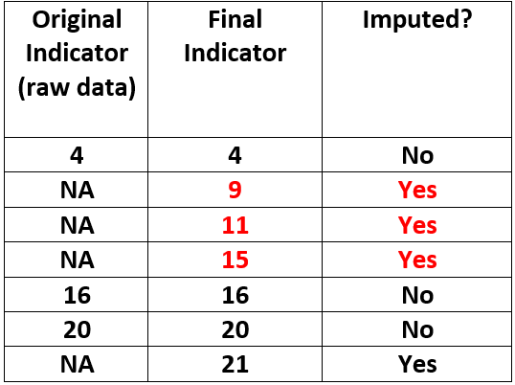
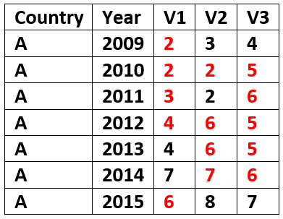

Slide 4

AQUASTAT database
faoswsAquastatImputation
faoswsAquastatCalculation
faoswsAquastatValidation
All countries
Context
Imputed data
Context
All years
Raw data
Context
Calculated data
All items
Missingness level
Calculations (from imputed)
Validation rules
Run query
Imputation
Calculations (primary var.)
Data – Rules confrontation
raw data
Imputed data
Assessment of outputs
Domain knowledge modification
Calculated data
Consolidated dataset

