Slide 1
Country | Year | Var1 | Var1 | Var3
A | 2009 | NA | 1.6 | 4
A | 2010 | NA | NA | NA
A | 2011 | 10 | NA | NA

Slide 2


Raw data
Imputed M1
yr1
NA
5
yr1
5
4
1.5
5
5
4
yr2
8
5.5
5.5
NA
NA
yr2
8
1.5
5
yr3
NA
1.5
NA
yr3
6.5
1.5
NA
5
5.3
yr4
NA
NA
6.5
NA
yr4
6.5
1.5
6.5
5
Imputed M3
yr1
1.5
5
5
4
Interpolation
yr2
8
1.5
5.5
5
yr3
8
1.5
6
5
LOCF 2
yr4
8
1.5
6.5
5

Slide 3
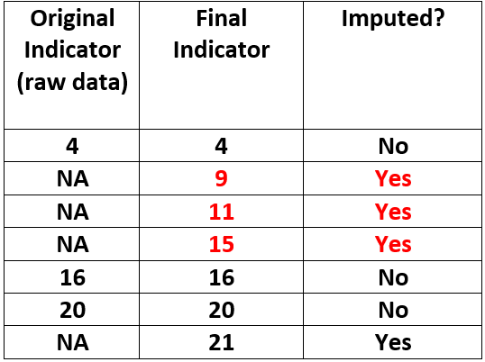
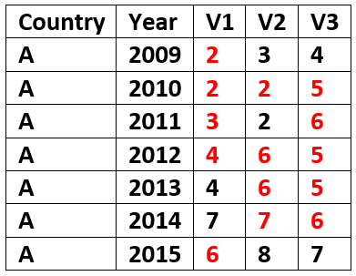

Slide 4

Context
Imputed data
Raw data acquisition
Context
Missingness level
Calculations (from imputed)
Imputation
Calculations (primary var.)
Imputed data
Assessment of outputs

Slide 5
SWS Domains
Land
Population
faostat_datasets
Aquastat
1
4
4
74
83
AQUASTAT database

Slide 6

Data with all elements
Elements
Time-series
Empty
Elements
Time-series
Non empty
Elements
Zero Variance
Full time-series
Elements
Zero Variance
At least 1 NA
in time-series
Elements
Nonzero variance
At least 1 NA
in time-series
No imputation.
Time-series
completely empty
Imputation: No
Imputation: “YES”
Time-series
filled with one single value
Imputation:“Yes”.
Linear Interpolation
Recombination
Long format dataset
(geographicAreaM49,
timePointYears,
aquastatElement,
Value)
Save data for calculation

