Slide 1
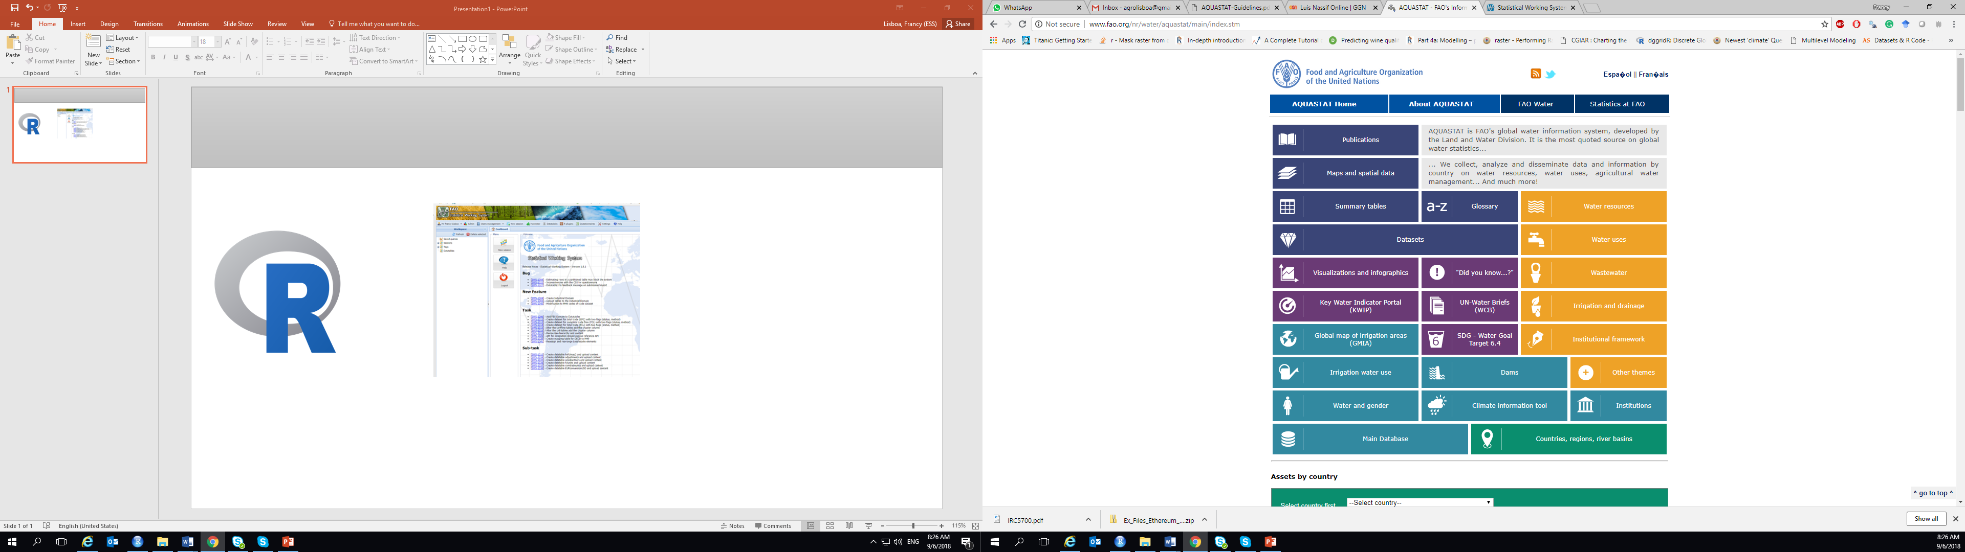
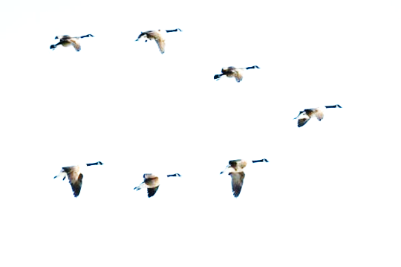
Migration of Aquastat data analytical procedures into the Statistical Working Systems (SWS)
Francy Lisboa
(Statistical team – ESS)

Slide 2
Outline
Overview of current management of Aquastat database
Data team requirements
Planned actions
What has been doing so far

Slide 3

Aquastat management information
Aquastat database
Data collection
National capacities and expertise/ International organizations
Literature
Surveys
Critical analysis & data processing
Standardization
Feedback/Approval authorities

Slide 4
What do Aquastat want from us regarding database-related statistical procedures?
Calculated rules
Validation rules
Show latest values
Fill in the variable "Total Dam Capacity" [var. ] by calculating a time-series from the "Dams" Datatable
Reminder (to insert a source for each data) ?
Directly direct automatically generated PDFs to their corresponding folders (mirror website) ?
Standardization (method, variables, metadata, etc.)
Imputation (completeness)
Aggregation (by regions allowed only if DB complete)
Quality indicators
More complex validation rules ? (such as the one with IF and else conditionals I sent you yesterday)

Slide 5

Planned actions
Calculated rules: plugin
Validation rules: plugin
Show latest values: (probably already incorporated)
Fill in the variable "Total Dam Capacity" [var. ] by calculating a time-series from the "Dams" Datatable script
Reminder (to insert a source for each data) ? Scri script (maybe)
Standardization (method, variables, metadata, etc.) (Need further clarification)
Imputation (completeness) plugin
Aggregation (by regions allowed only if DB complete) script
Quality indicators script
More complex validation rules ? (such as the one with IF and else conditionals )

Slide 6

Yes! But how?
“Data”
“Set of rules (69) ”
Headwinds
Lack of resources
Staff constraints
Affecting database update and completeness
Confrontation
Calculated indicators
Time-series gaps
High missingness of elements
Critical checking/ approval (data team)
Update the database

Slide 7


What do I propose?
A SWS MODULE performing ELEMENT-WISE IMPUTATIONS UPFRONT the calculations.
SDG 6.4.1 (Water use efficiency)
SDG 6.4.2 (Water stress)

Slide 8
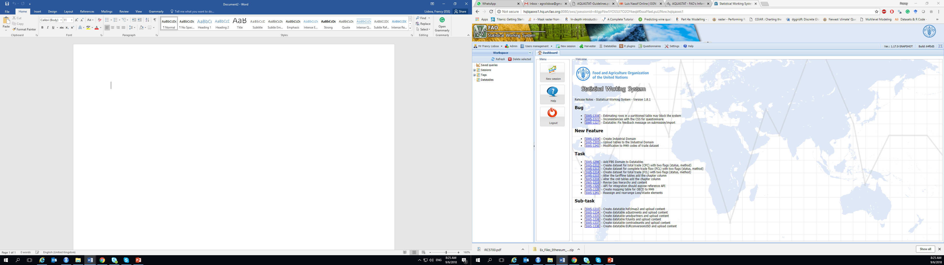
How much of Aquastat IS has already been migrated into SWS?
Datasets
“aquastat”
“aquastat_cloned”
60 countries
250 elements
Auxiliary Datatables
“aquastat_sources”
“Global Dam Reservoir”
“Global Map of Irrigated Area (Sub-national)”
“Global Map of Irrigated Area”

Slide 9

faoswsAquastatImputation
module workflow
MECE
Imputation method
Raw input data
TS with all missing values
No imputation
TS with ONLT only observation
Imputed dataset
LOCF/B
SWS
TS with zero variance and at least one missing value
TS expansion
LOCF/B
TS with zero variance and no missing values
No imputation
Feedback/
Approval from
AQUASTAT
TS with non-zero variance and at least one missing value
Linear interpolation

Slide 10

So far…
Datasets
“aquastat”
“aquastat_cloned”
“aquastat_imputed”
60 countries
250 elements
125879 rows (35% of imputation)

Slide 11
But what needs to be clarified?
The number of elements Aquastat wants to impute. Are they only those in the set of calculation rules?
Time-series expansion window
Role of imputated numbers in the 5-yr period dissemination context. Does imputation make sense in this case?
1961 - 2017
Between firs and last years
First year to 2017

Slide 12

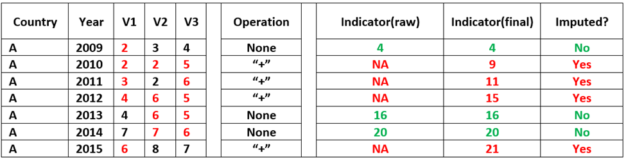
faoswsAquastatCalculation
module workflow
aquastat_imputed
aquastat_calculated
aquastat_calculated
aquastat_imputed
+
=
Calculation rules

Slide 13
faoswsAquastatValidation module
What do I propose?
“aquastat”
“aquastat_imputed”
Metrics (# imputed values, % of imputation)
Time-series comparison (before and after imputation
“aquastat_calculated”
Metrics ( # indicators, % of indicators )
Whether indicators measure up their components

Slide 14


faoswsAquastatValidation module
“Operationalization”
Does requirement programming
It is free
Huge interactive and manipulative power
Ilimited number of reports and dashboards
Does not require programming (ONLY FOR VISUALIZATION)
It is free
Requires a google account
Ilimited number of reports and dashboards

Slide 15


Summary
“faoswsAquastatImputation”
“faoswsAquastatCalculation”
“aquastat_cloned”
“aquastat_imputed”
“Updated
database”
“Database”
“aquastat_imputed”
“aquastat_calculated”
“filter data based on 5-yr period dissemination?”
“faoswsAquastatValidation”

Slide 16
Thank you!!

