Slide 1


Team A
FAO ESS - STATISTICS DIVISION
Food Module
(Bruno Caetano Vidigal, ESS)

Slide 2


Team A
FAO ESS - STATISTICS DIVISION
Food Module
what?
Food Availability up to the retail level
by country/commodity (cpc level)
engel curve
commodities: Food Estimate or Food Residual
how?
Food Estimate: benchmark quantities, elasticity, gdp? and population (engel law)
Food Residual (processed products): net trade or net supply (net trade + production)?

Slide 3
Team A
FAO ESS - STATISTICS DIVISION
Scenarios
Scenario 2
Net Trade + Production
GDP
Elasticity matrix
Scenario 3
Net Trade
HH Final Consump. Expenditure
Elasticity matrix
Scenario 1
Net Trade
GDP
Elasticity matrix
Scenario 4
Net Trade
GDP
Elasticity matrix filled
Scenario 5
Net Trade + Production
HH Final Consump. Expenditure
Elasticity matrix updated

Slide 4
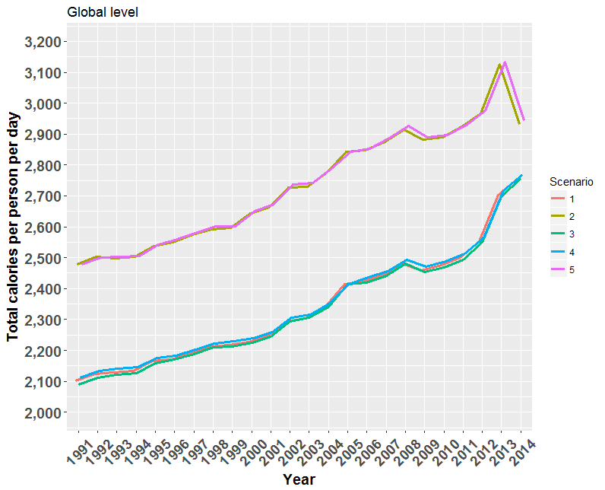
Team A
FAO ESS - STATISTICS DIVISION
Scenarios: Global average
173 countries
414 commodities (at cpc level)

Slide 5
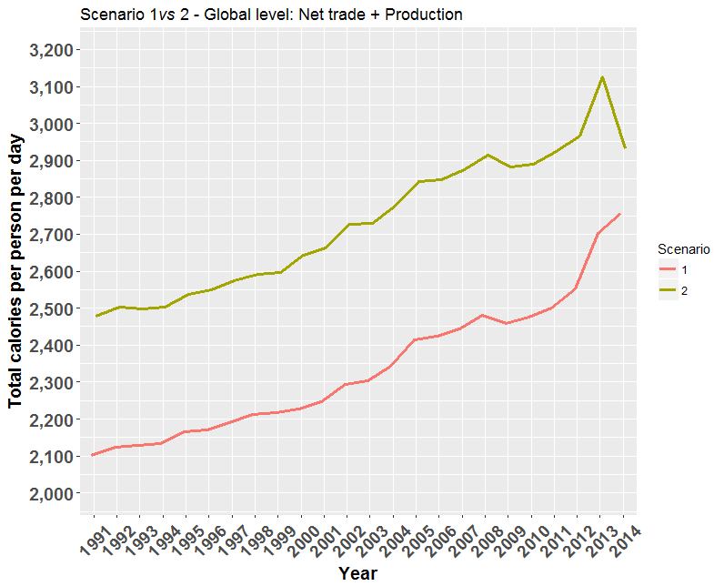
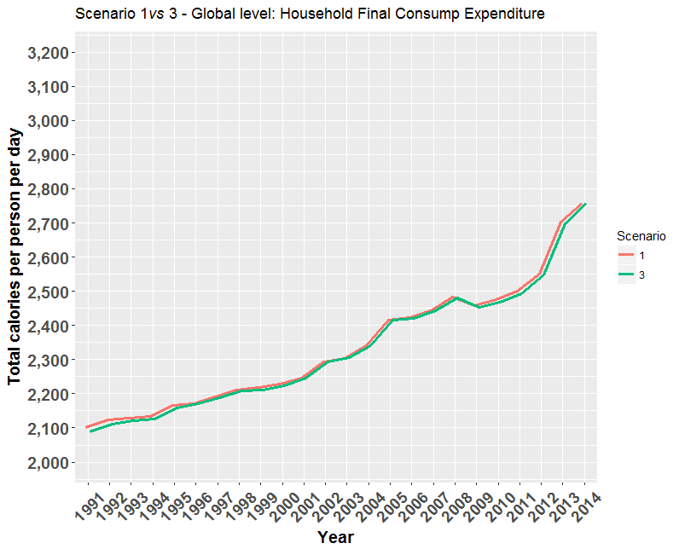
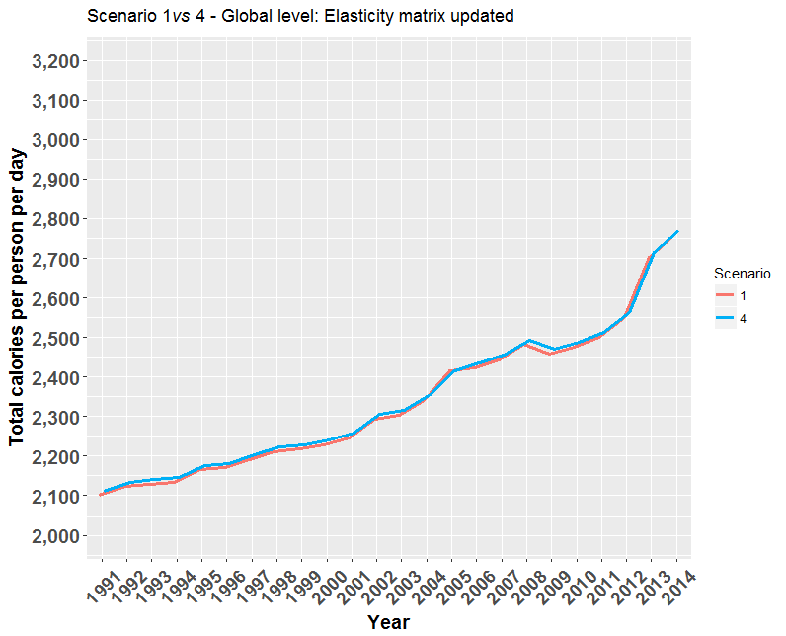
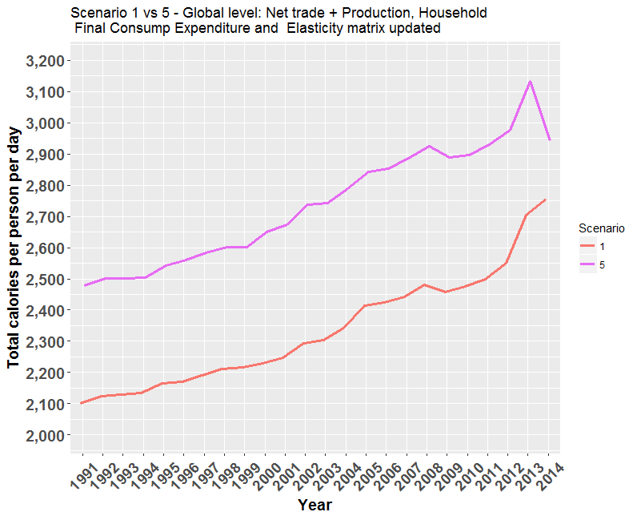
Team A
FAO ESS - STATISTICS DIVISION
Scenarios: Global average
+14.1%
-0.01%
+0.04%
+14.3%

Slide 6
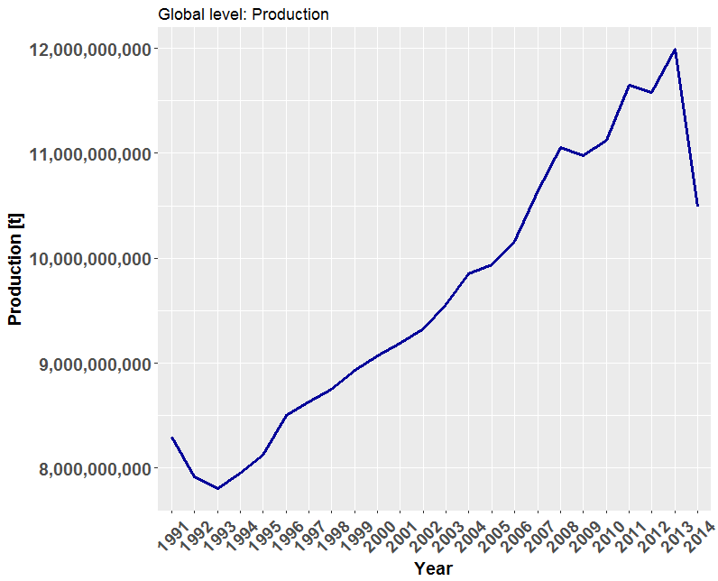
Team A
FAO ESS - STATISTICS DIVISION
Total Production

Slide 7
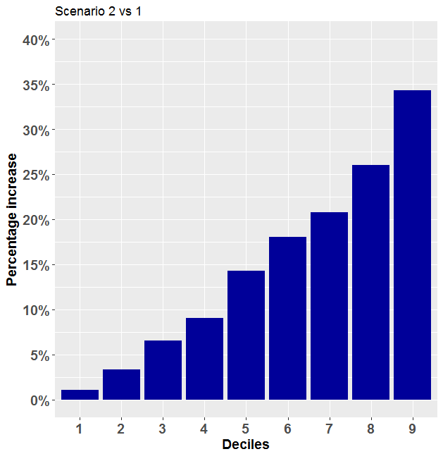
Team A
FAO ESS - STATISTICS DIVISION
Scenario 2 vs 1: deciles – increase kcal/person/day
Min: 0
Max: 100%
50% of countries with at most 15% of increase

Slide 8
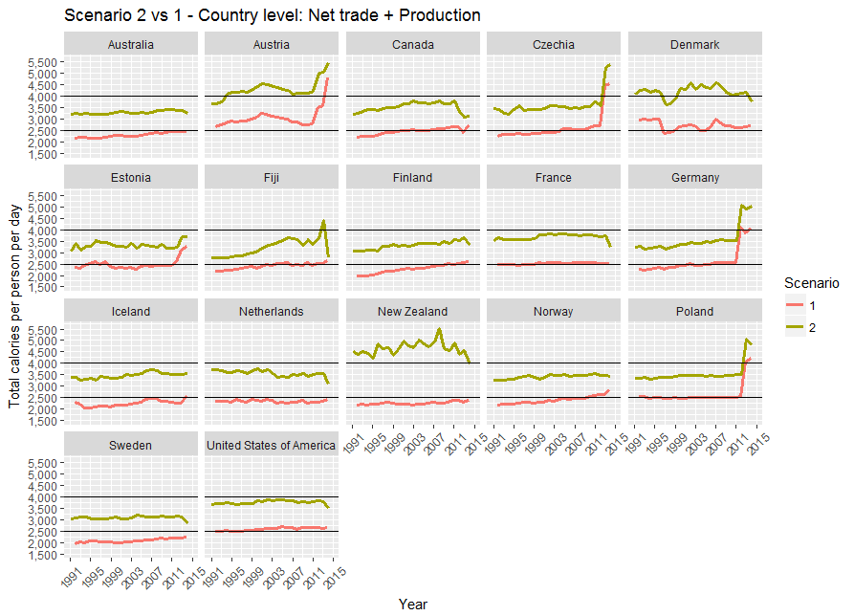
Team A
FAO ESS - STATISTICS DIVISION
Scenario 2 vs 1: time series
10% most affected
Increase > 35%

Slide 9
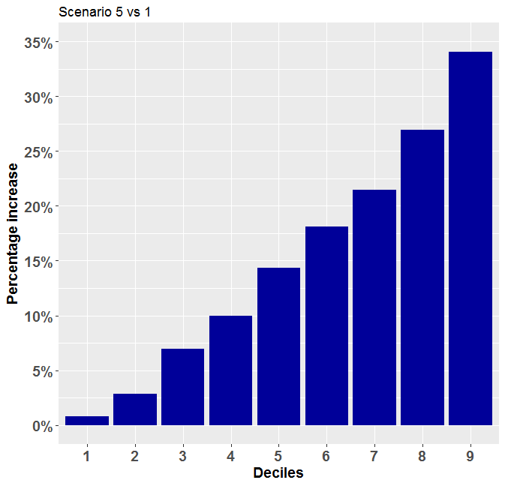
Team A
FAO ESS - STATISTICS DIVISION
Scenario 5 vs 1: deciles
Min: -11% (Liberia)
Max: 300% (Oman)
50% of countries with 15% of increase

Slide 10
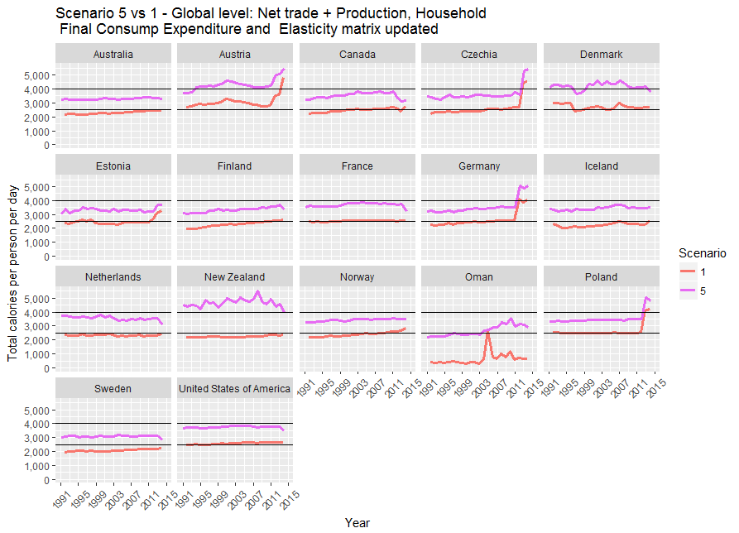
Team A
FAO ESS - STATISTICS DIVISION
Scenario 5 vs 1 – increase kcal/person/day
10% most affected
Oman: updating of elasticity matrix
Fiji: Household Final Consump Expenditure

Slide 11
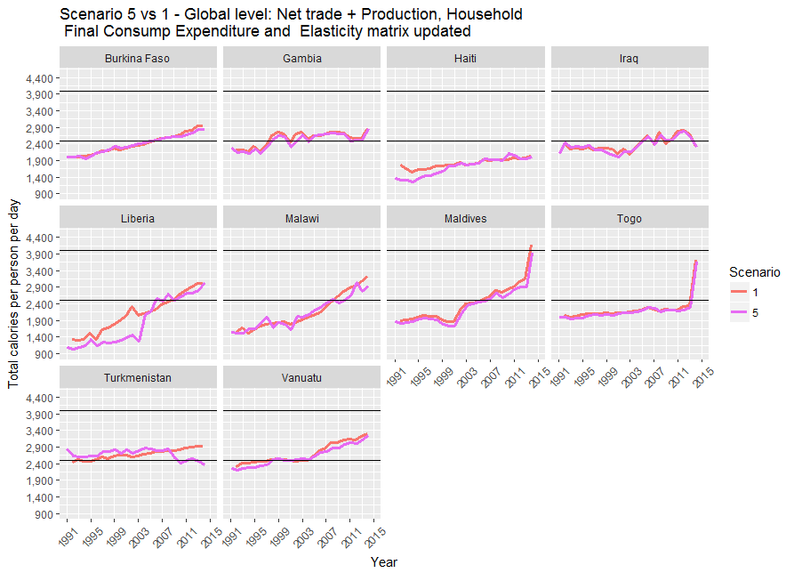
Team A
FAO ESS - STATISTICS DIVISION
Scenario 5 vs 1 – decrease kcal/person/day
Countries that had a decrease on Total kcal/person/day
Due to Household Final Consump. Expenditure

Slide 12

Team A
FAO ESS - STATISTICS DIVISION
Conclusion
Net Trade + Production
Fixed an underestimated problem of food availability
applying Net Supply to commodities classified as Food Residual;
Germany, Poland … (double counting issue)
Household Final Consumption Expenditure
Slightly different comparing to the results using GDP to commodities classified as Food Estimate;
Attention to Liberia and Haiti (decrease in the amount of calories estimated)
Elasticity matrix filled
Only Oman had missing values for elasticity.

Slide 13

Team A
FAO ESS - STATISTICS DIVISION
Next Steps...
Double counting issue (Standardization process?);
Improve benchmark estimates (Old FAOSTAT data);
Better understanding of the Elasticity matrix.

