Slide 1


Team A
FAO ESS - STATISTICS DIVISION
Food Module
Based on FAOSTAT website and Statistical Working System (Bruno Caetano Vidigal, ESS)

Slide 2


Team A
FAO ESS - STATISTICS DIVISION
Food Module
what?
Food Availability up to the retail level
by country/commodity (cpc level)
engel curve
commodities: Food Estimate or Food Residual
how?
Food Estimate: elasticity, gdp and population (engel curve)
Food Residual (processed products): net trade or net supply (net trade + production?)

Slide 3
Team A
FAO ESS - STATISTICS DIVISION
Food Module
Data
FBS
Data from FAOSTAT website in kcal/capita/day Grand Total.
Old food data
Old food data already converted to cpc code.
New food: net trade
Result from the new Food Module. In this outlook just net trade was used to compute “food availability” for those commodities classified as a “Food Residual’. For commodities classified as a “Food Estimate”, the estimated method used was based on elasticity, changes in GDP and population.
New Food: net Trade + Prod
Result from the new Food Module. In this case net trade and production were used to compute “food availability” for those commodities classified as a “Food Residual’. For commodities classified as a “Food Estimate”, the estimated method used was based on elasticity, changes in GDP and population.

Slide 4
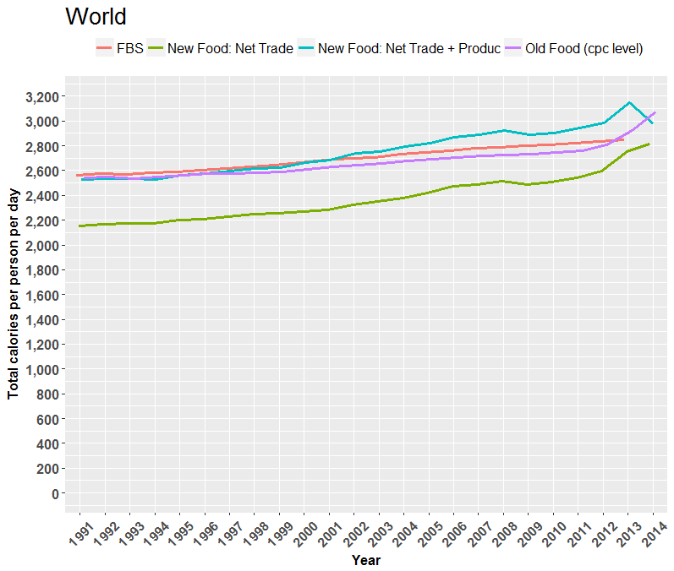
Team A
FAO ESS - STATISTICS DIVISION
Food Module

Slide 5
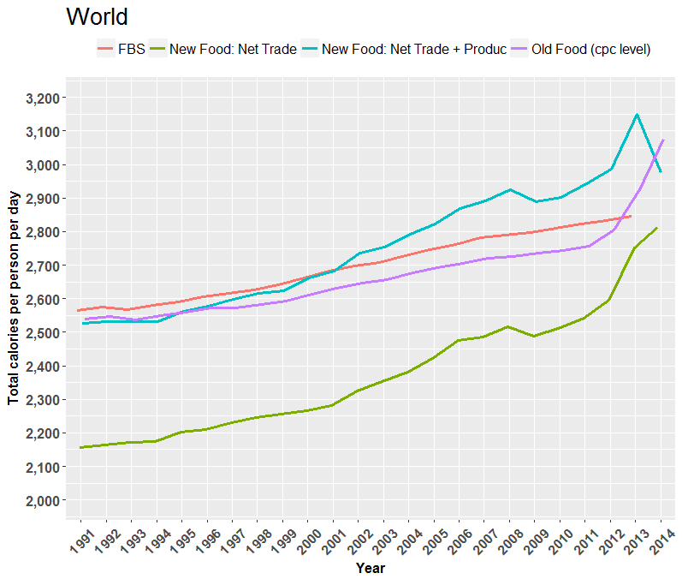
Team A
FAO ESS - STATISTICS DIVISION
Food Module

Slide 6
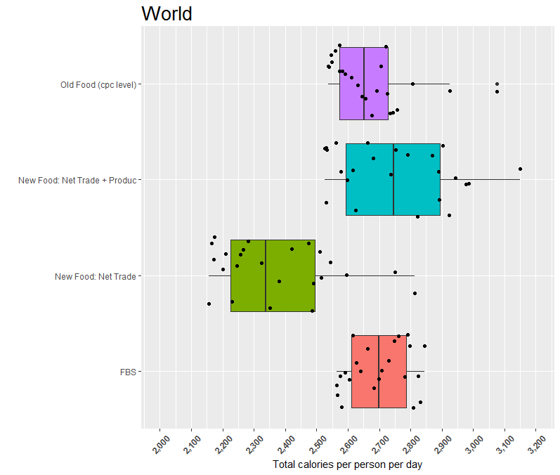
Team A
FAO ESS - STATISTICS DIVISION
Food Module

Slide 7
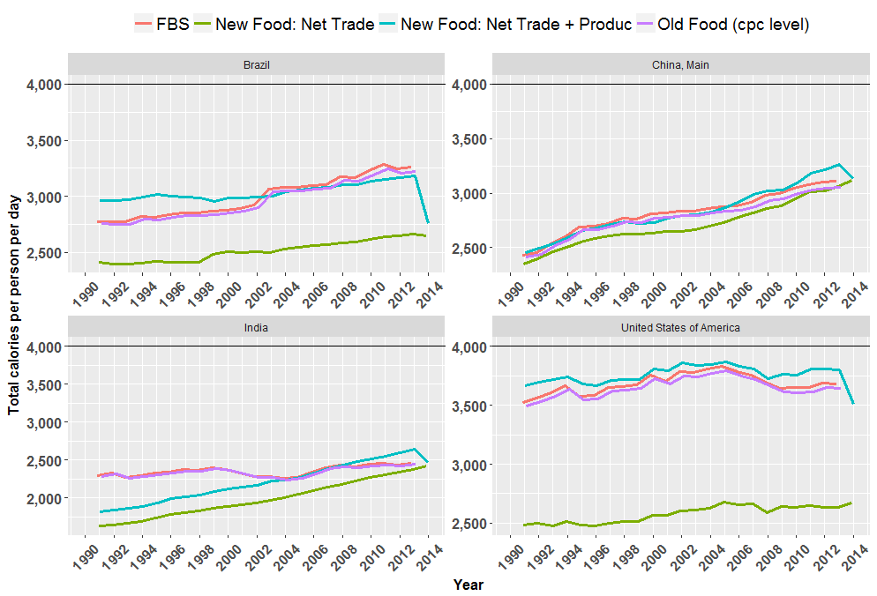
Team A
FAO ESS - STATISTICS DIVISION
Food Module

Slide 8

Team A
FAO ESS - STATISTICS DIVISION
Food Module
Conclusion
At worldwide level
”Old food (cpc)” and ”FBS” have similar behaviour;
”New Food: Net Trade” is underestimating food availability in all outlooks;
”New Food: Net Trade + Produc” is below “FBS” until 1999. However, from 2002 onwards it is higher than “FBS”.
Results for ”New Food: Net Trade + Produc” are more consistent with “Old food (cpc)” and “FBS” than “New Food: Net Trade”.
At country level
In the USA the kcal/capita/day estimated by the “New Food: Net Trade” is between 2,500 and 2,700 whereas ”FBS” and “New Food: Net Trade + Prod” goes from 3,500 to 3,800;
”New Food: Net Trade + Produc” is underestimating food availability for India until 2003. From 2009 onwards is smoothly getting higher than other methods.

