Slide 1
Producer prices methodological improvements
SWS implementation
Meeting 5/10/2020

Slide 2
Index
Progress
Proposed workflow
Steps to go

Slide 3
Last two months progress
Test Arima for short missing series
Questionnaire harvester tested (10 countries)
Data migration planned (end of October)
Two plugins (to be approved):
from LCU to SLC and USD and Outlier detection
Arima imputation
Agreement on Exchange rates

Slide 4
Overall proposed workflow
PP quest
Questionnaire dataset
Plugin
Preparation dataset
Plugin
Validation dataset
Validated dataset
≤ 60% total
price records
*
*could be the same ‘Preparation’ dataset or two datasets
datatable
dataset
R module
Harvester
Human intervention Shiny tool(?)
Other data
Questionnaire

Slide 5
Workflow focus (1/6)
PP quest
Questionnaire dataset
10 questionnaire uploaded from 2019
Found few revision to do on harvester (Enrico Anello) and questionnaires (already communicated to Jean Marie Munyeshyaka and Claudio Valeri)
There might be other issues with other countries questionnaires
datatable
dataset
R module
Harvester
Human intervention Shiny tool(?)
Other data
Questionnaire

Slide 6
Workflow focus (2/6)
Exchange rates
Validated prices
Questionnaire data
Data processing
PP dataset to check
Pulls questionnaire, exchange rates, validated data
Convert questionnaire series (LCU) in USD and SLC series (accounts for currency change)
First outlier detection (on SLC series, to be reviewed by clerk)
datatable
dataset
R module
Harvester
Human intervention Shiny tool(?)
Other data
Questionnaire

Slide 7
Workflow focus (3/6)
ADD another plugin to apply outlier validation to all elements!
Preparation dataset
(to check)
Preparation dataset (checked)
Manual revision of detected outliers either with shiny or directly in SWS (to be discussed)
PP dataset to check and checked can be the same or different dataset (to be discussed)
datatable
dataset
R module
Harvester
Human intervention Shiny tool(?)
Other data
Questionnaire

Slide 8
Workflow focus (4/6)
Preparation
Dataset (checked)
Test
Results
cointegration test more than 3 (5?) missing points
lag test needed for all
datatable
dataset
R module
Harvester
Human intervention Shiny tool(?)
Other data
Questionnaire

Slide 9
Workflow focus (5/6)
To be tested
FGLS
(exogenous factors)
If long series missing
Tool
If short series missing
VAR, ARIMA or ARIMAX
Validation dataset (imputed)
Results
To be tested
Monthly prices
Holt-Winters
datatable
dataset
R module
Harvester
Human intervention Shiny tool(?)
Other data
Questionnaire

Slide 10
Short missing series
ONLY RUN FOR LAST PERIOD MISSING
Macro indicators
Yield (Agriculture Production)
TOI (dataset or datatable)
Other data (?)
Preparation dataset (checked)
ARIMAX
Validation dataset (imputed)
Identify short missing series (less than 5 consecutive missing points)
Select best variable selection through AIC
Run ARIMAX currently with GDP, VA, Yield and TOI
Every year re-impute all (even if previously imputed) or only last year?
datatable
dataset
R module
Harvester
Human intervention Shiny tool(?)
Other data
Questionnaire

Slide 11
Workflow focus (6/6)
Validation dataset (imputed)
Validation dataset (imputed)
+ calculation of PPP and PPI
After the imputation step:
final validation
Shiny app for validation (?)
Are there aggregates to compute?
datatable
dataset
R module
Harvester
Human intervention Shiny tool(?)
Other data
Questionnaire

Slide 12
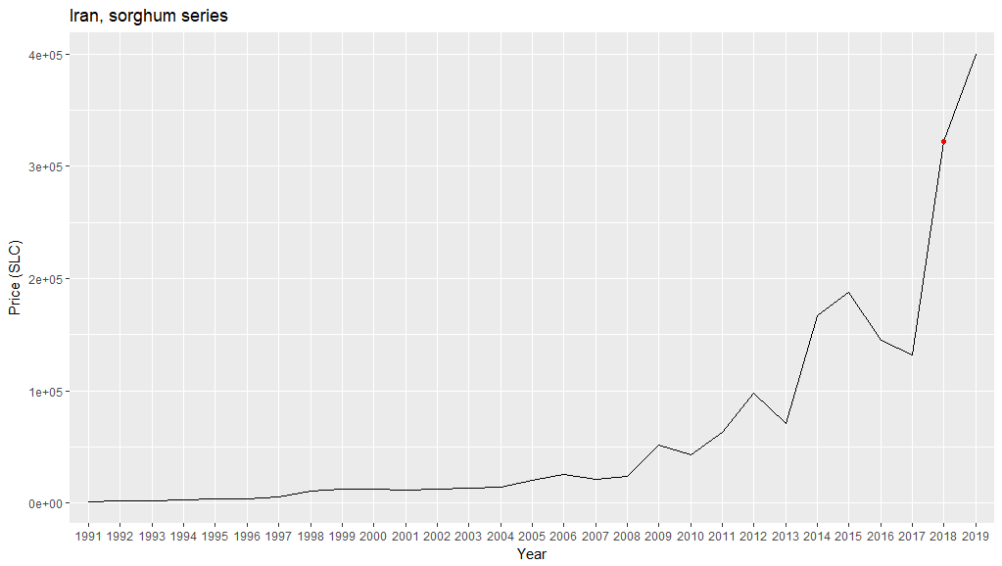
Outlier validation example
The user is presented with the series of outlier, it could be possible to check below the graph also data for the same country or globally for the same product.
Outlier detection based on %variation therefore 2019 is not highlighted as outlier but the user could mark it as outlier!
Outlier
Value set as NA and will be imputed with other missing data
Non-Outlier
Value kept and flagged (;q)

Slide 13
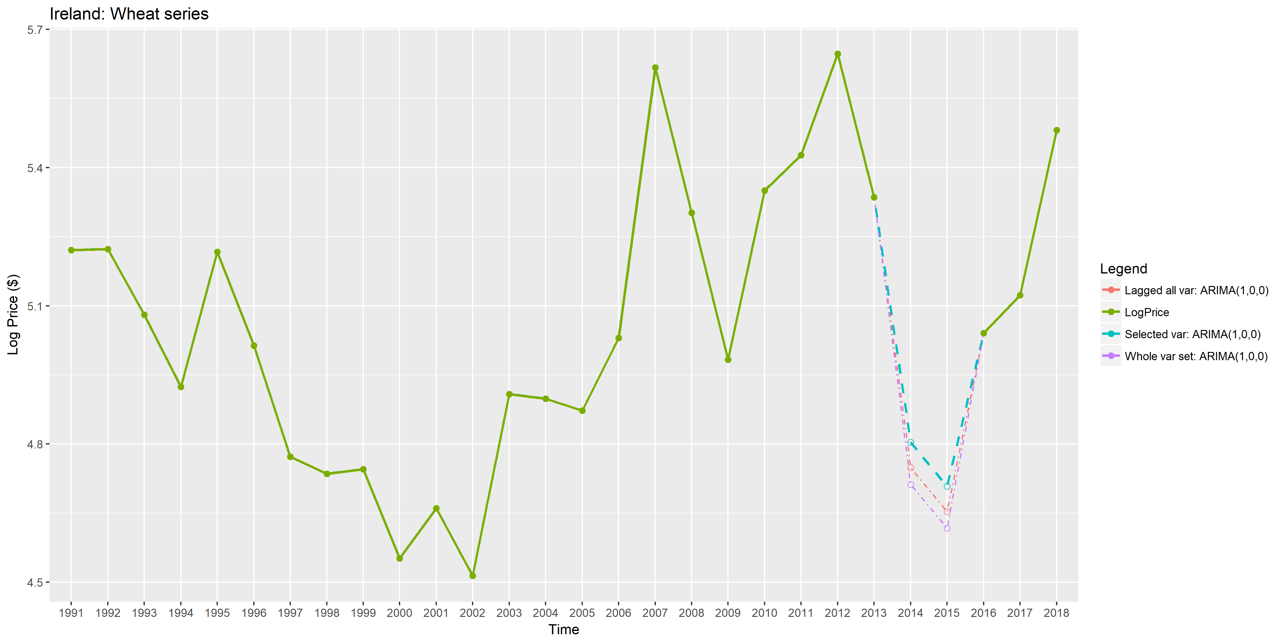
ARIMAX validation example
As in outlier validation, the user is presented with the series of imputed series, and the proposed value has to be accepted or replaced manually
Refuse
Expert estimate inserted manually flagged (E;f)
Validate
Value kept and flagged (I;e)

Slide 14
Steps to go
Test long series
Test monthly data
Validation tool (outlier and imputation)
Exchange rates dataset
Outlier, shiny
Migration end Oct (Legacy)
Plugins, have green light on outlier detection (keeping manual intervention)
Imputation (ARIMAX) either automatic selection or a manual validation (just for the last three years)
Long series imputation (Michele)
ARIMAX test, manual intervention required, more insight needed and reduce uncertainty (Michele)

