Slide 1
Consultation meeting on SWS Exchange rate
24 Sept 2020

Slide 2
Meeting agenda
Current situation and agreed points
Issues yet to solve
Discussion

Slide 3
Exchange rate overview in SWS
Domain | Dataset | Datatable | Dimension
Fisheries | Exchange rates FI (all currency to USD from 1948 to 2018) |  | FromCurrency, ToCurrency, Split Year, timePointYears
 |  | Exchange Rates (fi_exchange_rate) | (Emtpy)
Fisheries commodities |  | FT – exchange rates fi (fi_exchange_rate_fi)
Macro_stats |  | Unsd_xpop
Common domain | Exchange rate (by country and currency to USD from 1990 to 2015) |  | geographicAreaM49, currency_iso, currency_source, timePointYears
Trade (reference files): |  | EUR/USD conversion (from 2000 until 2018)

Slide 4
Agreed points
ECO team responsible for updating. At any update there is tag of the dataset and an email to all the users.
Hierarchy of sources:
IMF (UNSD for SLC, monthly IMF LCU)
World bank
UN operational XR
Central banks
Legacy kept in the common domain for each current dataset
Source saved in metadata
Updates handled by ECO team as soon as the IMF publishes them. A tag for each year will be saved so to keep historical track available. Teams are free to pull from the Common domain dataset when best suit them. (end of March) (check/subscribe if any update from IMF in July or August).

Slide 5
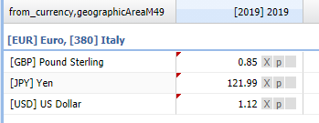
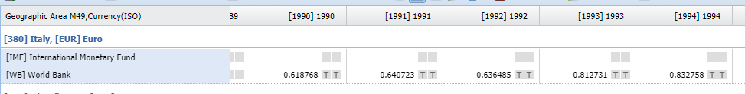
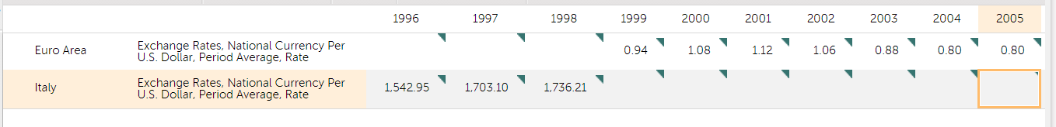
Proposed structure and content issues
1. Initial proposal with countries
2. Exchange rate to insert
(given that the ‘to_currency’ is the USD)
From_currency | To_currency | Exchange rate
X EUR | 1 USD | direct
1 EUR | Y USD | inverse
3. SLC vs LCU

Slide 6
Summary and points to agree on
Source | Decimals | Type or rate | Currency
IMF | 14 | Domestic currency per USD & inverse | LCU
UNSD | 15 | Domestic currency per USD | SLC
FAOSTAT | 4 | Domestic currency per USD | SLC
Fisheries | 10 | Inverse (USD per domestic currency) | LCU
Trade (Clfs team) | 6 | Inverse (USD per domestic currency) | Not applicable only EUR from 2000
Issue | Choice | Advisable | Consequences | Decision
Value | Direct or inverse | Direct (as follows the usual structure from-to currency) | Take into account when extracting data if inverse previously used | Direct
Currency | LCU or SLC | LCU (SLC series always computable if needed) | Change in FAOSTAT publication, no data from UNSD (Macro indicators stand-alone domain) | SLC and LCU (two elements needed)
Country | Yes-No | Depends on currency choice | If no an up-to-date datatable with country-currency link is required | YES
Decimals | From 4 to 15 | 14 IMF standard and compatible with SWS | Rounding (?) | 14
Source location | 3rd flag or metadata | Source in metadata | - | Metadata

Slide 7
Other points
Separate dataset with monthly data instead of split year
End-year of the currency as metadata (just reference)
Conversion rates in case of currency change a separated datatable

