Slide 1
Consultation meeting on SWS Exchange rate
10 Sept 2020

Slide 2
Meeting agenda
Introduction of the purpose and objective of the consultation meeting
Overview of exchange rate in SWS
Current updates in SWS and EBX5 on exchange rate reference files
Proposed structure of the common exchange rate repository
Discussion

Slide 3
Exchange rate overview in SWS
All over the place
Domain-specific
Duplication of effort in updating data
Potential lack of internal coherency
Domain | Dataset | Datatable | Dimension
Fisheries | Exchange rates FI (all currency to USD from 1948 to 2018) |  | FromCurrency, ToCurrency, Split Year, timePointYears
 |  | Exchange Rates (fi_exchange_rate) | (Emtpy)
Fisheries commodities |  | FT – exchange rates fi (fi_exchange_rate_fi)
Macro_stats |  | Unsd_xpop
Common domain | Exchange rate (by country and currency to USD from 1990 to 2015) |  | geographicAreaM49, currency_iso, currency_source, timePointYears
Trade (reference files): |  | EUR/USD conversion (from 2000 until 2018)

Slide 4
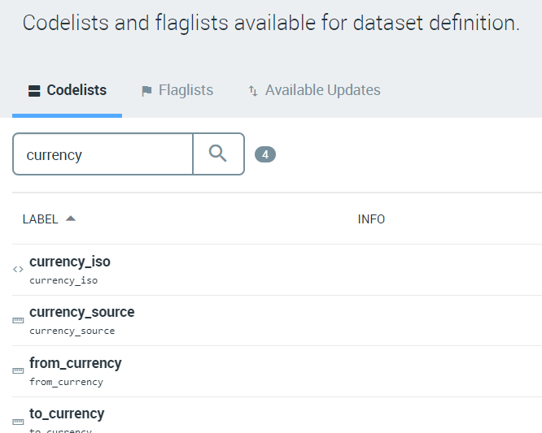
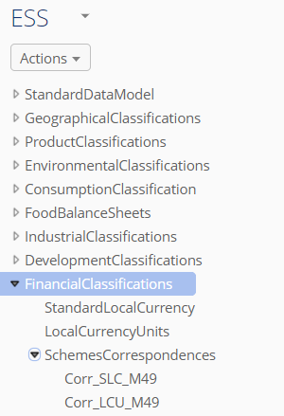
Current updates in SWS and EBX5 on exchange rate reference files
Updating the reference files both in SWS and EBX5 (http://ebx5prod.fao.org/ebx/)
Expanding the decimal places from 11 to 14

Slide 5
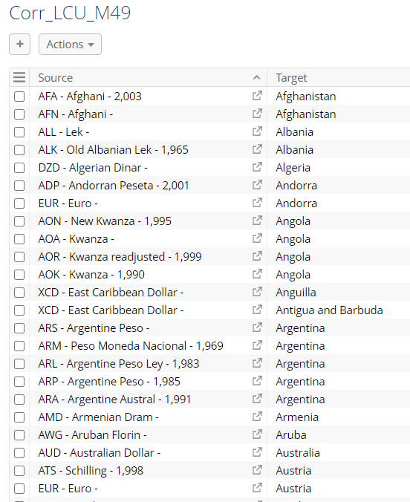
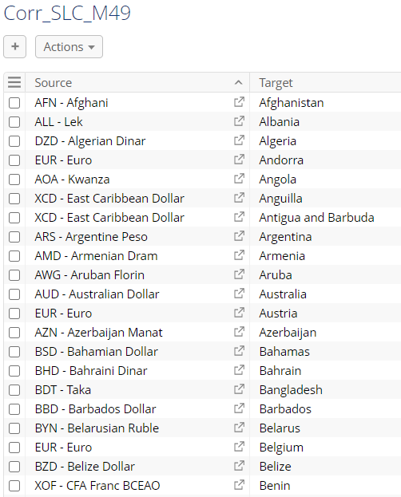
EBX5 reference files- Standard Local Currency and Local Currency Unit
currency-country correspondence
currency-validity-country correspondence

Slide 6
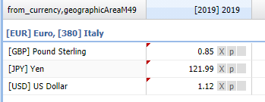
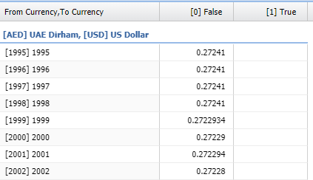
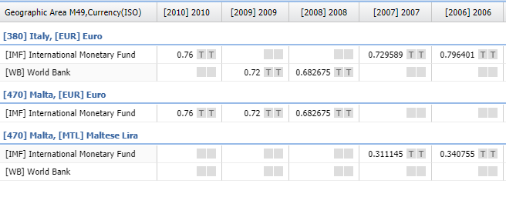
Proposed structure of the common exchange rate repository
Reflect the needs and requirement of current users (domains)
Flexible to accomodate requirement of future users
Takes inspiration from the existing structure
Proposal:
Dimensions: Area M49, from currency, to currency and Year (possibility to add split year)
Metadata or additional flag: source (IMF, World bank…)
Fishery current dataset
Common domain current dataset

Slide 7
Proposed structure of the common exchange rate repository
Domain | Dataset | Dimension
Common domain | Exchange rate (from 1948 to most recent year) | geographicAreaM49, FromCurrency, ToCurrency, timePointYears
Dataset features :
values are stored both by country and currency;
it is possible to insert any exchange rate, not only US Dollar;
as there is not a dimension dedicated to the source, we propose this information to be included either in a flag or (even better) in the metadata and remove the ‘Exchange data source’ codelist;
Reference period is the calendar year; a parallel dataset may be created to include monthly rates;
the split year dimension is not currently included but this could be modified;
conversion factors between old and new currencies of a same country can be stored into a datatable since they remain stable or be included in the dataset itself;
a relational country-currency-validity period table can be included in a datatable and/or in the EBX5;
series will be appropriately flagged to highlight breaks in the series.
figures stored until 14th decimal place

Slide 8
Discussion
Ownership of the exchange rate data
Maintenance and regular data updates
Defined ‘hierarchy’ of sources, e.g. IMF, World Bank, Banca D’Italia.
Data requirement and future needs
Different reference periods
Split year
Monthly exchange rate
All available exchange rate combinatoin (e.g. EUR to GBP, GBP to NOK)
FAOSTAT and SWS exchange rate consistency
Change of current plugin/shiny app using exchange rate data
Any other domain specific need

