Slide 1

AACS Setup Manual
Team 3 : 100 % Certified

Slide 2
PC Client Setup
Download Source Code
https://github.com/SWSS2021Team3/ControlAndDisplay
- desktop_app01 : PC Client Source Code Directory
- gtest_sample01 & simple-server : Source code directory for internal testing

Slide 3
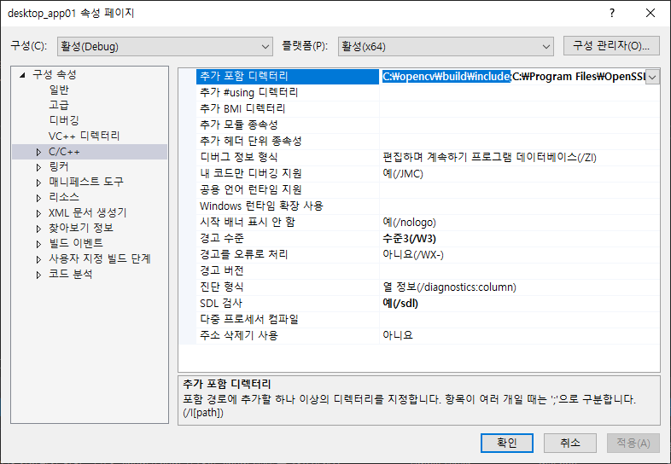
PC Client Setup
OpenCV Setup for MS Visual Studio
Add the installed opencv\build\include path to the project's property page -> C/C++ -> additional include directories

Slide 4
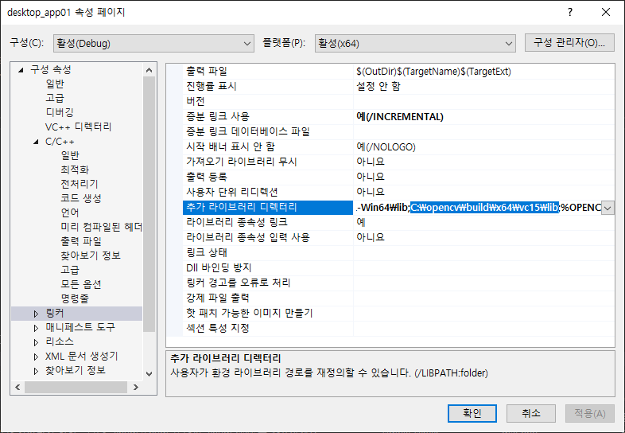
PC Client Setup
OpenCV Setup for MS Visual Studio
Add the installed opencv\build\x64\vc15\lib path to your project's property page -> Linker -> Additional include directories

Slide 5
PC Client Setup
OpenSSL Download / Install
https://slproweb.com/products/Win32OpenSSL.html
Download and install Win64 OpenSSL v1.1.1k (63MB Installer)
Default installation path: C:\Program Files\OpenSSL-Win64

Slide 6
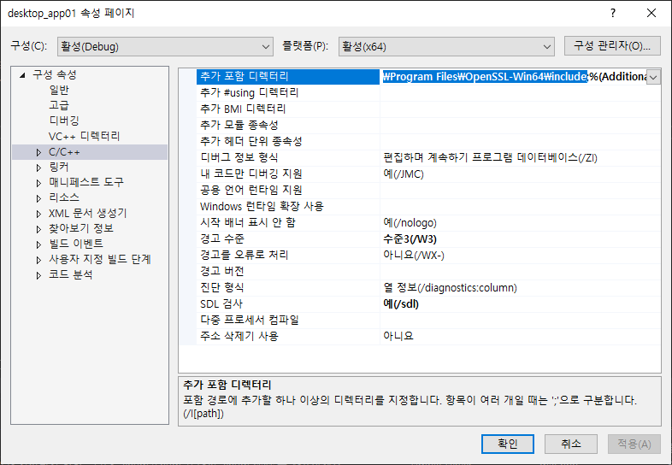
PC Client Setup
OpenSSL Setup for MS Visual Studio
Add the installed OpenSSL-Win64\include path to your project's property page -> C/C++ -> Additional Include Directories

Slide 7
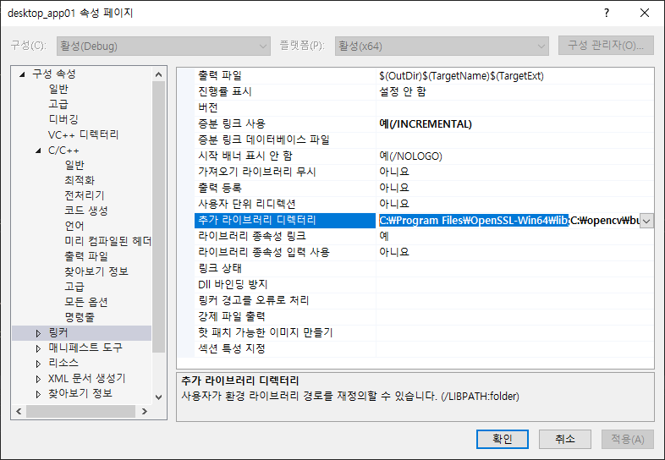
PC Client Setup
OpenSSL Setup for MS Visual Studio
Add the installed OpenSSL-Win64\lib path to your project's property page -> Linker -> Additional Include Directories

Slide 8
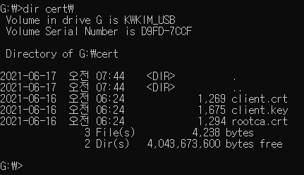
PC Client Setup
USB Key Setup
Download USB Key
https://github.com/SWSS2021Team3/USB_Key
Copy ClientKey\*.* to USB Flash Drive
rootca.crt file should be exist on “USB_FLASH_DRIVE:\cert\rootca.crt”

Slide 9
PC Client Setup
Account Information to log in
ID | Password | Authorization
admin | qorvjdlswmd | Admin
kyuwoon.kim | rlarbdns | User
gyeonghun.ro | shrudgns | User
wonyoung.chang | wkddnjsdud | User
soohyun.yi | dltngus | User
hyejin.oh | dhgPwls | User
hyungjin.choi | chlgudwls | User
vibhanshu.dhote | qlqmgkstb | User
cliff.huff | zmfflvm | User

Slide 10
Server Setup
Download Source Code
https://github.com/SWSS2021Team3/LgFaceRecDemoTCP_Jetson_NanoV2
Project Build
/LgFaceRecDemoTCP_Jetson_NanoV2$ mkdir build /LgFaceRecDemoTCP_Jetson_NanoV2$ cd build /LgFaceRecDemoTCP_Jetson_NanoV2/build$ cmake .. /LgFaceRecDemoTCP_Jetson_NanoV2/build$ make
Project Run
/LgFaceRecDemoTCP_Jetson_NanoV2/build$ ./LgFaceRecDemoTCP_Jetson_NanoV2 [PORT]

Slide 11
Server Setup
OpenSSL Library Setup
Library install
$ sudo apt-get install libssl-dev

Slide 12
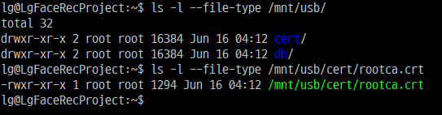
Server Setup
USB Key Setup (need USB Flash drive)
Mount to Jetson Nano
Download USB Key
https://github.com/SWSS2021Team3/USB_Key
Copy ServerKey\*.* to /mnt/usb/
rootca.crt file should be exist on “/mnt/usb/cert/rootca.crt”
$ sudo mkdir /mnt/usb $ sudo mount -t vfat /dev/sda1 /mnt/usb

Slide 13
Admin Setup
Admin could make connection information(IP/Port/SecurePort)
* prepare for sign openssl.exe clientconf.bin (Ip, port, secure port are written each line.) clientconf.crt (https://github.com/SWSS2021Team3/USB_Key) clientconf.key (https://github.com/SWSS2021Team3/USB_Key) > type clientconf.bin 192.168.0.106 5000 5010 > openssl cms -sign -in clientconf.bin -signer clientconf.crt -inkey clientconf.key -outform DER -out clientconf.sign -binary > copy clientconf.bin clientconf.sign [client application directory]

