Slide 1

Phase 1 Presentation
Team 3 : 100 % Certified

Slide 2
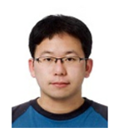
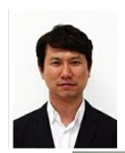
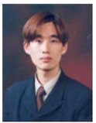
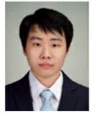

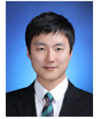
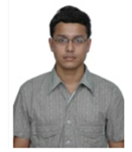
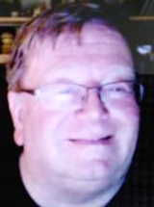
Team 3 - Member Introduction
Name | Kyuwoon Kim | Gyeonghun Ro | Wonyoung Chang | Soohyun Yi | Hyejin Oh | Hyungjin Choi | Vibhanshu Dhote | Cliff Huff
Role & Responsibility | PC App Development, Requirements, Threat Modeling, Security Implementation | Project Manager, Test case, Architect, Requirements, Threat Modeling | PC App/Embedded Development, Environment, Requirements, Threat Modeling | Embedded Development, Static Analysis, Requirements, Threat Modeling | Documentation, Security Standards, Requirements, Threat Modeling, Static Analysis | Embedded Development, Tool Research, Requirements, Threat Modeling | Vulnerability Research, Requirements, Threat Modeling | Mentor
LGE Email | kyuwoon.kim@lge.com | gyeonghun.ro@lge.com | wonyoung.jang@lge.com | soohyun.yi@lge.com | hyejin.oh@lge.com | jin0925.choi@lge.com | vibhanshu.dhote@lge.com
Personal Email (CMU account) | mnik83@gmail.com | gyeonghun.ro@gmail.com | wonyoungjjang@gmail.com | randelx@gmail.com | chaolly007@gmail.com | zzzzdx@gmail.com | dhotevibhanshu@gmail.com | cch@sei.cmu.edu
Alias Email of Team 3 : cmu-team3@lge.com
Notes:
팀원 소개 - 멘토
3시간 30

Slide 3

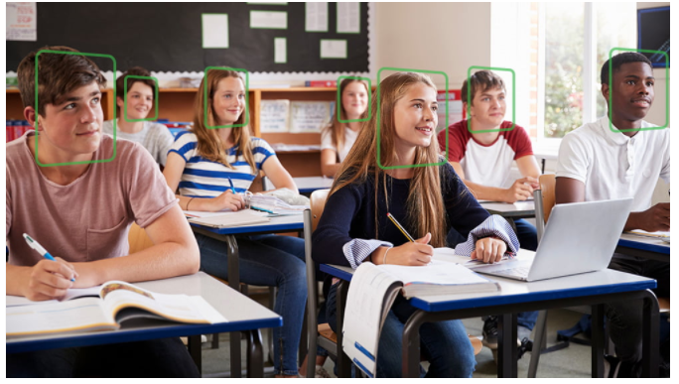





Project Overview - Redefining for practical implementation
[ CMU Student Attendance Check System ]
Students in the classroom
“100% recognition engine”
find faces and recognize who they are.
The face and name recognized by the system are displayed.
Student attendance is checked.
Notes:
프로젝트 소개
First or all, we discussed about our studio project with AI recognize system.
A few ideas came up with, however we made our system for AI Attendance check system. (I'm going to call it AACS and have a plan to provide it to CMU later.)
System overview is that
AI engine learn student image from camera and recognize who they are.
Recognized face and their name are displayed and also should check student attendance. => Professors no longer have to call attendance list.

Slide 4


Context Diagram
Camera & Image analysis app
User Display & System Control app
Student
Admin
Face Recognition System
(FRS)
Attendance Check System
(ACS)
Student
legend
boundary
System
App
camera
user
Network
Connection
Notes:
AACS can be divided into two separate areas.
Jetson 보드에 연결된 FRS영역과 Control app이 설치되어 있는 PC인 ACS영역이다.
Left system is called Face Recognition system
This area is for the Jetson Nano board
FRS has a camera to register student faces, identify students by AI algorithm, and should check student attendance.
And the ACS area(called Attendence Check system), is the for control PC where the Control application is installed.
FRS와 ACS는 network connection으로 연결된다

Slide 5
Security Goal
AACS Security Goal :
Confidentiality : The sensitive data(User DB, Video, Face data ... ) in the system should be accessible
only by the authorized people.
Integrity : The sensitive data in the system should not be tampered by attacker.
Availability : The attendance system should be available at all times during the semester.

Slide 6

Project Overview
AI Attendance Check System
Demo
Enjoy a cup of coffee during the attendance check time

Slide 7
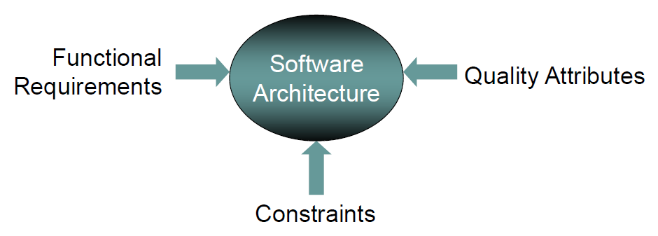
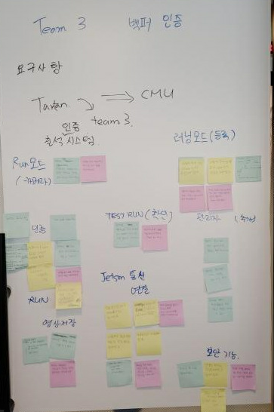
Deriving architecture drivers
Item | Category | Count
Functional requirements | log in | 9
 | register of student (Learn mode) | 5
 | attendance check (Run mode, Test run mode) | 8
 | security | 29
 | Total | 51
Quality Attribute |  | 10
Constraints |  | 8
Original requirements : 75%
Additional requirements : 25%

Slide 8

User DB
Initial Design
Camera Device
Engine
id, pw
userdata
Engine data
User Auth
Manager
Student
Controller
images
AI Manager
Config setting
result
ip/port
id
video/vlist
video
id, pw
result
video/
vid/videolist
Video DB
vid
id/password
request
(id, #pic)
Comm Manager
(FRS)
Comm Manager
(ACS)
User
Auth
Manager
result
Face
Manager
id/password
photo list
video list/video/uid
Attendance Controller
User
vid req
uid,fid
result
Face Recognition System
Attendance
Check
System
Face DB
time/uid
time/uid
log
Attendance DB
legend
thread
storage
external
device
data
flow

Slide 9
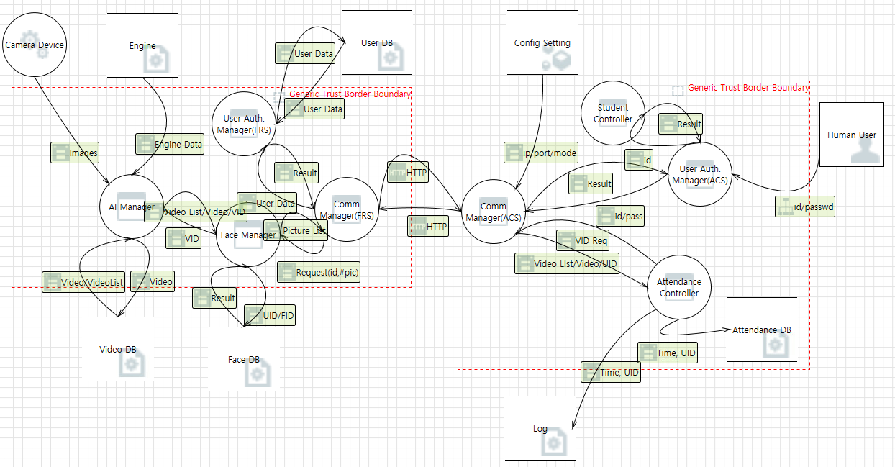
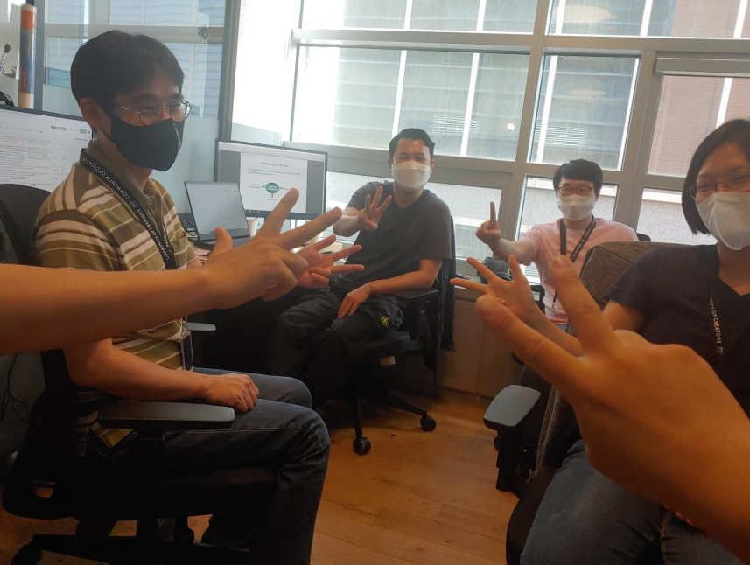
Threat Analysis & Risk Assessment
[ Voting for risk assessment ]
Threat Analysis | Risk assessment for high priority threats | Security Requirements from threat mitigation
138 | 29 | 23

Slide 10
Security Requirements from risk assessment
limited photos | Each student must be able to save up to 5 photos.
check capacity | When saving student photos, this system should be able to check the remaining capacity.
check capacity | When saving a video about attendance, this system should be able to check the remaining capacity.
separate partition | This system should be able to save the video of the attendance in a separate partition.
operation | This system should be able to operate the attendance function even if it is not possible to save the video of the attendance.
encryption | Videos of attendance in this system must be encrypted.
hash | User accounts accessing this system must be hashed.
hash | Config setting file that manages device information stored in the system should be hashed
encryption | Face DB in the system must be encrypted.
input validation | When logging into the system, the input data should be verified.
sign | Face DB data stored in the system must be signed by admin.
encryption | Video DB data stored in the system must be encrypted.
sign | Video DB data stored in the system must be signed by admin.
encryption | User DB data stored in the system must be encrypted.
sign | User DB data stored in the system must be signed by admin.
heart beat | The system's Comm Manager (ACS) must apply a heart beat.
input validation | Input verification for the Config setting in the system should be done.
hash | AI Engine data shall be hashed.
input validation | Input verification for engine data in the system should be done.
data loading | It is necessary to check the loading completion of the engine data of the system.
input validation | The Comm Manager (FRS) in the system should verify the input.
TLS | TLS version 1.2 and above is needed must be applied for communication between FRS and ACS in the system.
1. Input Validation
2. Encryption
3. Sign
4. Hash
5. Secure Communication

Slide 11





User DB
Re-Design with Security Requirement
Camera Device
Engine
id, pw
userdata
Engine data
User Auth
Manager
Student
Controller
images
AI Manager
Config setting
result
ip/port
id
video/vlist
video
id, pw
result
video/
vid/videolist
Video DB
vid
id/password
request
(id, #pic)
Comm Manager
(FRS)
TLS
Comm Manager
(ACS)
User
Auth
Manager
result
Face
Manager
id/password
photo list
video list/video/uid
mutual authentication
Attendance Controller
User
vid req
uid,fid
result
Face Recognition System
Attendance
Check
System
Face DB
time/uid
time/uid
log
Attendance DB
legend
thread
storage
external
device
data
flow
encryption
input
validation
sign
hash
decryption

Slide 12
AACS Static view
Presentation
Layer
Login
Register of student
Attendance check
Business
Layer
Authentication
Face Recognition
Attendance Report
Privacy
Communication
Service
Layer
AI Manager
Face
Manager
User Auth
Manager
Comm
Manager
Attendance controller
Student
Controller
User Auth
Manager
Comm
Manager
Security
Layer
Encryption
Decryption
sign
Hash
Encryption
Decryption
Hash
Data
Layer
FaceDB
UserDB
VideoDB
Engine
Attendance DB
log
Config setting
FRS(Face Recognition System)
ACS(Attendance Check System)

Slide 13
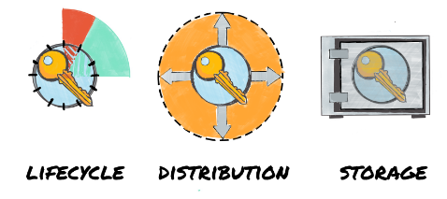
AACS Key Management
Category | Recommendations
Key lifecycle | Cryptographic key management is critical to the security of a cryptosystem. This includes the generation, exchange, storage, use, destruction and replacement of keys.
Key distribution | The generated keys shall be transported (when necessary) using secure channels and shall be used by their associated cryptographic algorithm within at least FIPS 140-2 compliant cryptographic modules.
Key storage | Ensure all keys are stored in cryptographic vault, such as a hardware security module (HSM) or isolated cryptographic service

Slide 14
AACS Key Management Architectural Alternatives
AACS-QA-010) Key management for system must be secure.
1.protected service request
1.protected service request
Comm
Manager
Comm
Manager
Comm
Manager
Comm
Manager
2. provide server certificate
2. provide server certificate
3. provide client certificate
3. provide client certificate
4. protected service executed
4. protected service executed
request store
key stored
request store
key stored
Key Store
Key Store
request store
key stored
request store
key stored
FRS
ACS
Key Store
Key Store
FRS
ACS
external USB
external USB
pre-install key management
external device key management
 | Pre-installed key management | External Device key management
Pros | Easy to distribution Easy to key management | Update usb to update key Securely distribution Secure key storage
Cons | Update the whole program to update the key The key is easy to be exposed to risk | Physical usb key management Difficult to distribution
Architectural Decision :
Selected as an external device key management for key lifecycle management and secure key management

Slide 15


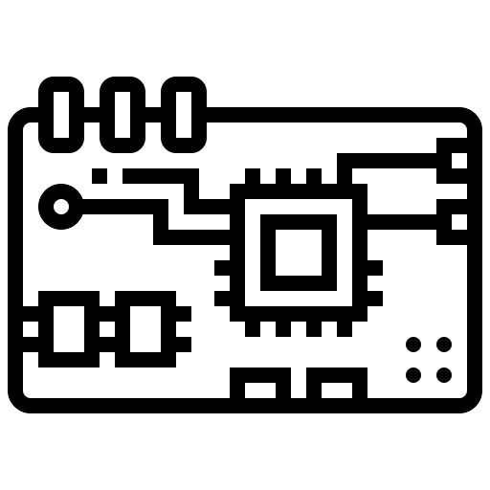





AACS Physical view
Face Recognition System
Attendance check system

Slide 16
AACS Secure Design Pattern
principles for secure design
: defense in depth
principles for secure design
: keep it simple
AI Manager
Secure design pattern
: single point of access
DB
Simple interface
Face Manager
Security Manager
facade
pattern
User Auth
Manager
(Hide complexity / Provide simple interface)
input validation
encryption
sign
secure read/write
principles for secure design
: least privilege
Face
Video
User
secure read/write
secure read/write
secure read/write
: Each class performs encryption/decryption using a different key.

Slide 17


AACS Secure UX
Secure design pattern
: Limited view
Each student is given permission to view only their own photos.
Students must register their faces in the attendance system.
Could you take a picture of your smiling face?
Add Picture
This function is designed to register the face of a registered student. Students can register up to 5 photos.
Add Photo
Delete Photo
Delete Picture
This is a function to delete a registered student's face photo.
Finish
password change
1/5

Slide 18
Secure communication with TLS 1.3
Category | Recommendations | Applied to our project | Reason for selection
SSL/TLS version | TLS 1.2 or TLS 1.3 | TLS 1.3 | The latest version of TLS Don’t need to consider backward compatibility The highest level of security
Cryptographic library for TLS | GnuTLS OpenSSL wolfSSL | OpenSSL v1.1.1 - v1.1.1k (ACS) - v1.1.1 (FRS) | Widely used in industries for the commercial products
Cipher suites | Recommended for TLS 1.3 : TLS_AES_128_GCM_SHA256 TLS_AES_256_GCM_SHA384 TLS_AES_128_CCM_SHA256 | TLS_AES_128_GCM_SHA256 | AES-128 for performance
Signature keys for certificates | RSA : 2000 bits ~ (~2023) 3000 bits ~ (2024~2027+) | RSA-2048 bits | RSA-2048 bits for performance
Notes:
TLS communication cipher suites - TLS_AES_128_GCM_SHA256

Slide 19
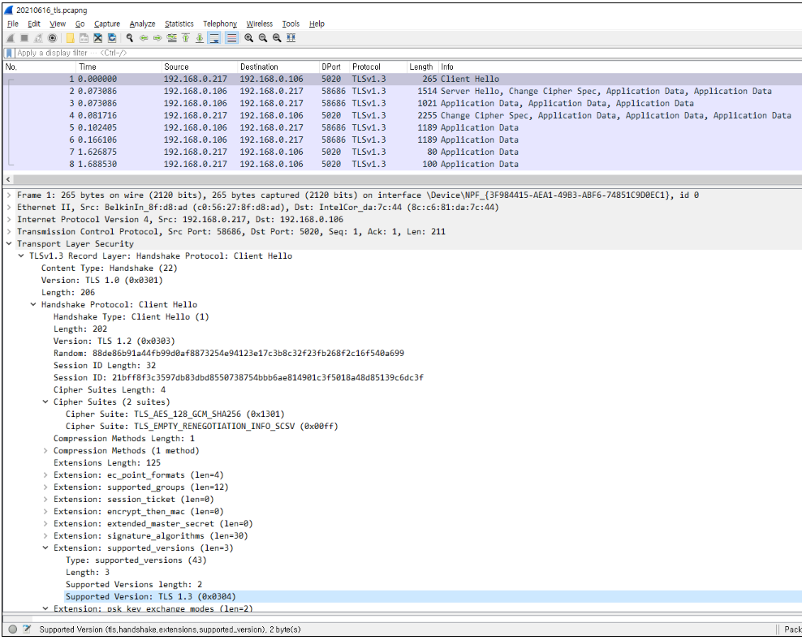

Secure communication with TLS 1.3

Slide 20
Cryptographic Algorithms
Category | Recommendations | Applied to our project | Reason for selection
Block ciphers | AES-128, AES-192, AES-256 | AES-128 | Choose the shortest key length for performance
Mode of operation for block ciphers | CCM (Counter with Cipher Block Chaining Message Authentication) GCM (Galois/Counter Mode) CBC (Cipher Block Chaining) CTR (Counter Mode) | CBC | The most secure mode among the block cipher modes
Hash functions | SHA-256, SHA-512/256, SHA-384 and SHA-512 SHA3-256, SHA3-384, SHA3-512 | SHA-256 | Most widely used. Fast and strong enough for most purposes.
Digital signatures | RSA, DSA, ECDSA, ECKDSA, ECGDSA, XMSS+ or LMS | - RSA-2048 bits (Self-signed certificate) | Most widely used.
Notes:
Data encryption

Slide 21
Crytoperiod
No. | Key Type | Cryptographic keys stored in server-side USB | Cryptographic keys stored in client-side USB | Cryptoperiod Recommended
 |  |  |  | Originator-Usage Period (OUP) | Recipient-Usage Period
1 | Private signature key | Private signature key for signing Video DB Private signature key for signing User DB Private signature key for signing Face DB |  | 1 to 3 years | -
2 | Public signature-verification key | Public signature-verification key for Video DB Public signature-verification key for User DB Public signature-verification key for Face DB Root CA certificate | Client certificate Root CA certificate | Several years (depends on key size)
4 | Private authentication key | Server key | Client key | 1 to 2 years
5 | Public authentication key | Server certificate Root CA certificate | Client certificate Root CA certificate | 1 to 2 years
6 | Symmetric data encryption key | Symmetric data encryption key for encrypting Video DB Symmetric data encryption key for encrypting User DB Symmetric data encryption key for encrypting Face DB |  | Up to 2 years | Up to OUP + 3 years
Applied to our project
Root CA certificate cryptoperiod : 365 days
Client/Server certificate cryptoperiod : 90 days
** Root CA private key, Private signature key for signing client configuration file are located in Admin PC

Slide 22
Security Assessment Reports
1) Static Analysis Report based on RATS
2) Open Source Vulnerability Report
Folder | High | Low | Medium | 총계
ControlAndDisplay | 6 | 2 |  | 8
LgFaceRecDemoTCP_Jetson_NanoV2 | 6 | 9 | 6 | 21
총계 | 12 | 11 | 6 | 29
OSS Name / Version | High | Low | Medium | Grand Total
NVIDIA Tegra kernel v4.9 | 1 |  | 2 | 3
OpenCV v4.1.1 |  |  | 1 | 1
OpenSSL v1.1.1 | 2 | 2 | 8 | 12
Grand Total | 3 | 2 | 11 | 16
Issue | High | Low | Medium | 총계
EVP_DecryptUpdate |  |  | 1 | 1
EVP_EncryptUpdate |  |  | 1 | 1
fixed size global buffer | 10 |  |  | 10
fixed size local buffer |  | 7 |  | 7
memcpy |  | 4 |  | 4
read |  |  | 4 | 4
wsprintf | 2 |  |  | 2
총계 | 12 | 11 | 6 | 29
https://security.web.cern.ch/recommendations/en/codetools/rats.shtml

Slide 23
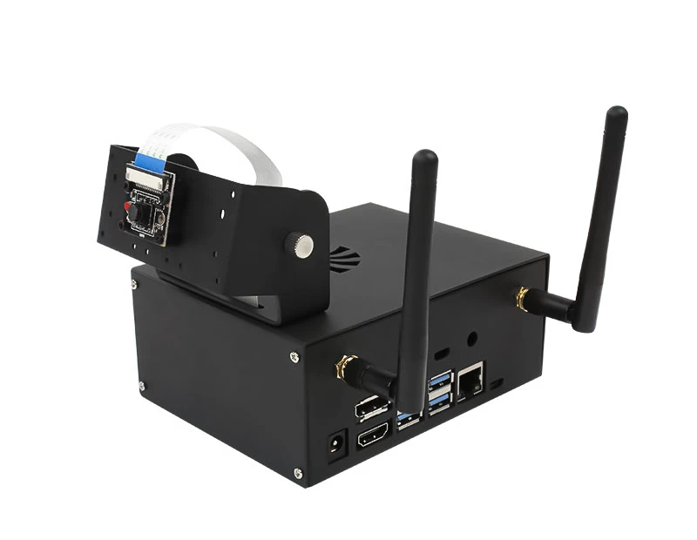
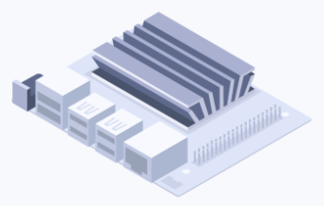
AACS Test Environment Improvements
The development environment was difficult to develop with one test board.
In some cases, performance was slow or the system crashed when multiple people connected to the board and tested it.
To solve this problem, a virtual jetson nano board was developed and used for testing.
real test environment
virtual test environment
Although it cannot operate with the same function as the actual jetson nano board, it was useful for data communication testing using the protocol.

Slide 24


