Slide 1

AACS_Cryptographic_Algorithms
Team 3 : 100% Certified

Slide 2
Secure communication with TLS 1.3
Category | Recommendations | Applied to our project | Reason for selection
SSL/TLS version | TLS 1.2 or TLS 1.3 | TLS 1.3 | The latest version of TLS Don’t need to consider backward compatibility The highest level of security
Cryptographic library for TLS | GnuTLS OpenSSL wolfSSL | OpenSSL v1.1.1 - v1.1.1k (client) - v1.1.1 (server) | Widely used in industries for the commercial products
Cipher suites | Recommended for TLS 1.3 : TLS_AES_128_GCM_SHA256 TLS_AES_256_GCM_SHA384 TLS_AES_128_CCM_SHA256 | TLS_AES_128_GCM_SHA256 | AES-128 for performance
Signature keys for certificates | RSA : 2000 bits ~ (~2023) 3000 bits ~ (2024~2027+) | RSA-2048 bits | RSA-2048 bits for performance
Notes:
https://www.bsi.bund.de/SharedDocs/Downloads/EN/BSI/Publications/TechGuidelines/TG02102/BSI-TR-02102-2.pdf;jsessionid=5F329BE1A7F78E9EE6D83A5D7ECCA71B.internet081?__blob=publicationFile&v=2
https://ko.wikipedia.org/wiki/TLS_%EA%B5%AC%ED%98%84%EC%9D%98_%EB%B9%84%EA%B5%90

Slide 3
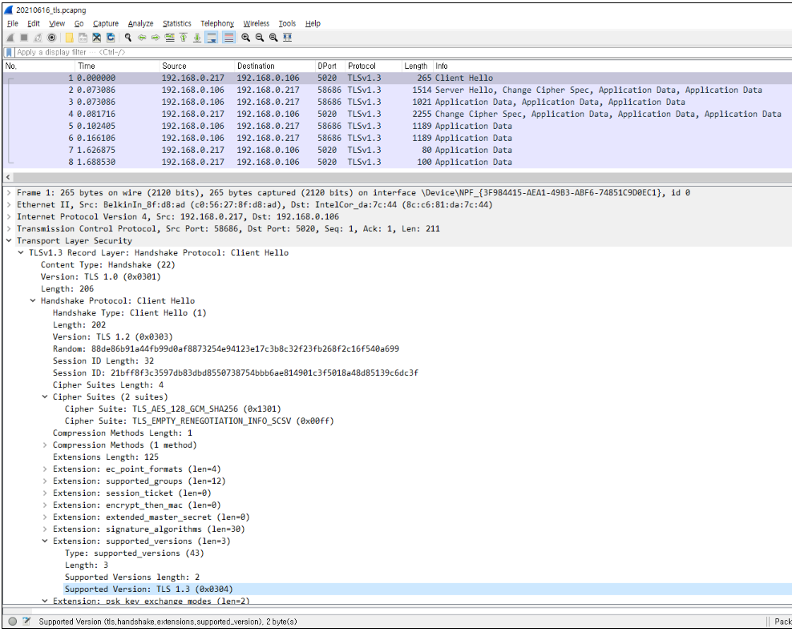
Secure communication with TLS 1.3

Slide 4
Security Manager
Handle all cryptographic keys and certificates
Provide all security functions for the processes based on openssl (v1.1.1)
hash (sha 256)
encryption/decryption (AES-128)
signing/signing verification (RSA-2048)
Set/free network context for TLS
Applied Facade pattern (Hide complexity / Provide simple interface)

Slide 5
Cryptographic Algorithms Applied
Category | Recommendations | Applied to our project | Reason for selection
Block ciphers | AES-128, AES-192, AES-256 | AES-128 | Choose the shortest key length for performance
Mode of operation for block ciphers | CCM (Counter with Cipher Block Chaining Message Authentication) GCM (Galois/Counter Mode) CBC (Cipher Block Chaining) CTR (Counter Mode) | CBC | The most secure mode among the block cipher modes
Hash functions | SHA-256, SHA-512/256, SHA-384 and SHA-512 SHA3-256, SHA3-384, SHA3-512 | SHA-256 | Most widely used. Fast and strong enough for most purposes.
Digital signatures | RSA, DSA, ECDSA, ECKDSA, ECGDSA, XMSS+ or LMS | - RSA-2048 bits (Self-signed certificate) | Most widely used.
Notes:
https://www.bsi.bund.de/SharedDocs/Downloads/EN/BSI/Publications/TechGuidelines/TG02102/BSI-TR-02102-1.pdf;jsessionid=5F329BE1A7F78E9EE6D83A5D7ECCA71B.internet081?__blob=publicationFile&v=2
https://ko.wikipedia.org/wiki/TLS_%EA%B5%AC%ED%98%84%EC%9D%98_%EB%B9%84%EA%B5%90

Slide 6
Key Management
Category | Recommendations | Applied to our project | Reason for selection
Key distribution | The generated keys shall be transported (when necessary) using secure channels and shall be used by their associated cryptographic algorithm within at least FIPS 140-2 compliant cryptographic modules. | All cryptographic keys and client/server CAs are distributed via USB (assuming that USB is a kind of a secure storage). Root CA is distributed with the developed software. | Decide to use USB instead of FIPS compliant module due to the time limitation.
Key storage | Ensure all keys are stored in cryptographic vault, such as a hardware security module (HSM) or isolated cryptographic service | All cryptographic keys are stored in USB. | Assume that USB is a kind of secure storage like HSM.
Key revocation | The details for key revocation should reflect the lifecycle for each particular key | Do not consider this scenario. | Key lifecycle management and revocation scenario can not be implemented due to the time limitation.
Notes:
https://nvlpubs.nist.gov/nistpubs/SpecialPublications/NIST.SP.800-57pt1r5.pdf
revocation
p114

Slide 7
Crytoperiod
NIST SP 800-57
No. | Key Type | Cryptographic keys stored in server-side USB | Cryptographic keys stored in client-side USB | Cryptoperiod Recommended
 |  |  |  | Originator-Usage Period (OUP) | Recipient-Usage Period
1 | Private signature key | Private signature key for signing Video DB Private signature key for signing User DB Private signature key for signing Face DB | Private signature key for signing client configuration file | 1 to 3 years | -
2 | Public signature-verification key | Public signature-verification key for Video DB Public signature-verification key for User DB Public signature-verification key for Face DB Root CA certificate | Client certificate Root CA certificate | Several years (depends on key size)
4 | Private authentication key | Server key | Client key | 1 to 2 years
5 | Public authentication key | Server certificate Root CA certificate | Client certificate Root CA certificate | 1 to 2 years
6 | Symmetric data encryption key | Symmetric data encryption key for encrypting Video DB Symmetric data encryption key for encrypting User DB Symmetric data encryption key for encrypting Face DB |  | Up to 2 years | Up to OUP + 3 years
Applied to our project
Root CA certificate cryptoperiod : 365 days
Client/Server certificate cryptoperiod : 90 days
Notes:
https://nvlpubs.nist.gov/nistpubs/SpecialPublications/NIST.SP.800-57pt1r5.pdf
https://www.kisa.or.kr/jsp/common/downloadAction.jsp?bno=259&dno=83&fseq=1
https://docs.google.com/spreadsheets/d/1kevsh5xUsMg5bls1BfxH-EmaKrmo-GNk4uao9wwIM9A/edit#gid=0

Slide 8
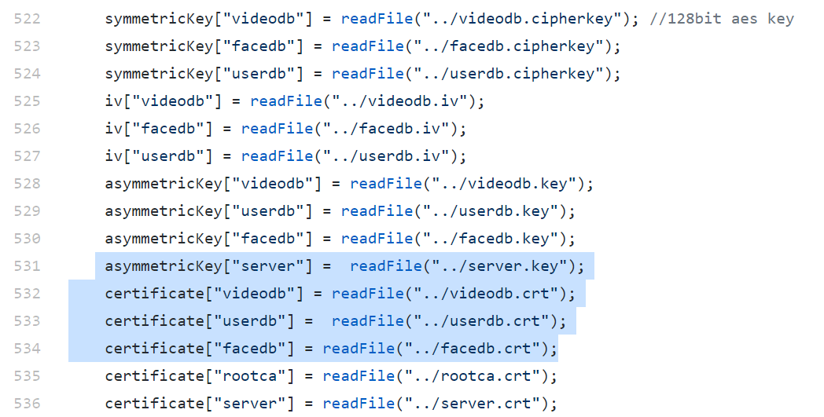
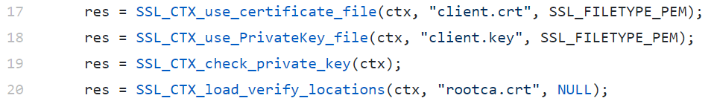
Cryptographic Keys of Security Manager in implementation
6. Symmetric data encryption key (AES)
6. a kind of Symmetric data encryption key
In block cipher cbc mode, XOR operation happens
with this value (Initialization vector) and plain text in every block
1. Private signature key for signing DBs
server
4. Private authentication key for TLS (key pair : public key, private key)
2. Public signature-verification key Verify signature before using DB file
5. Public authentication key rootCA certificate needed for verifying server certificate
5. Public authentication key
client
1. Private signature key / 4. Private authentication key
5. Public authentication key
rootCA certificate needed for verifying client certificate
Notes:
https://github.com/SWSS2021Team3/LgFaceRecDemoTCP_Jetson_NanoV2/blob/8895c72a7ddb4f63da6dd01db2f33e1ba04f2b22/src/SecurityManager.cpp

Slide 9
References
1. BSI TR-02102-1 : Cryptographic Mechanisms: Recommendations and Key Lengths, BSI Technical Guideline, Mar 24, 2021.
2. BSI TR-02102-2 : Cryptographic Mechanisms: Part 2 - Use of Transport Layer Security (TLS), BSI Technical Guideline, Mar 12, 2021.
3. NIST SP 800-131A Rev. 2: Transitioning the Use of Cryptographic Algorithms and Key Lengths, NIST Special Publication, Mar 21, 2019.
4. NIST SP 800-57 Revision 5: Recommendation for Key Management : Part 1 - General, NIST Special Publication, May 4, 2020.
5. NIST SP 800-133 Rev.2 : Recommendation for Cryptographic Key Generation, NIST Special Publication, June 2020.

