Slide 1


AI Attendance Check System
Enjoy a cup of coffee during the attendance check time

Slide 2
Chapter | Chapter 1 | ID | AACS-UX-01 | Note
Location | Initial Page | Side | PC
Welcome to
AI Attendance Check System
Communication Mode :
〮 Secure Mode
Communication between
the embedded board of
this system and the PC should
provide a mode that
supports the encryption
function for data.
〮 Real-time Mode
Communication between the
embedded board of this system
and the PC should provide
a mode of data transfer fast
without delay
This system automatically checks attendance in the classroom.
Could you register your face?
ID :
PASSWORD :
Communication Mode :
○ Secure Mode
ⓞ Real-time Mode
Login
Login :
This function connects to the camera system through IP : 192.168.0.106 / port : xxxx
and ID/PW information with communication mode

Slide 3






Chapter |  | ID |  | Note
Location | Student login | Side | PC
Students must register their faces in the attendance system.
Could you take a picture of your smiling face?
Add Picture
This function is designed to register the face of a registered student. Students can register up to 5 photos.
Add Photo
Delete Photo
Delete Picture
This is a function to delete a registered student's face photo.
Finish
Finish
This function closes the menu for students.

Slide 4
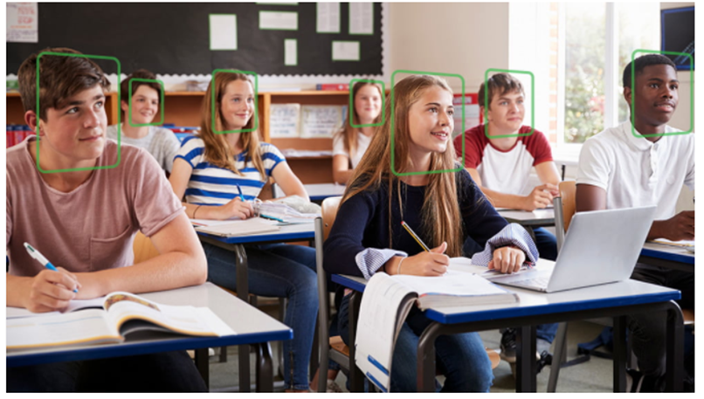
Chapter |  | ID |  | Note
Location | Admin login | Side | PC
AI Attendance Check System
Live
Past
Live :
This is a mode to check attendance live. Attendance, lateness, and absence will be determined based on attendance time.
Student’s List
Attendance Status
Cliff
Jeff
Dan
Cathy
David
Bradley
Cliff
Jeff
Absent
Cathy
David
Bradley
Past :
This is a mode to check attendance through videos saved in the past. Attendance, lateness, and absence will be determined based on attendance time.
Start
End
Clear
Start
End
Clear
This is the menu to start attendance mode on Live. When you start attendance mode, it is automatically saved as a video. Later, the administrator can check attendance through this video.
This is the menu to end attendance mode on Live. After exiting the attendance mode, the video recording is automatically stopped.
If you select this menu, the displayed student attendance time is cleared.

Slide 5
Chapter |  | ID |  | Note
Location | Admin login | Side | PC
AI Attendance Check System
Attendance
Time
:
Live
Past
9
00
Live :
This is a mode to check attendance live. Attendance, lateness, and absence will be determined based on attendance time.
Student’s List
Attendance Time
Cliff
Jeff
Dan
Cathy
David
Bradley
AM 8:00
AM 9:10 late
Absent
AM 8:30
AM 8:45
AM 8:45
Past :
This is a mode to check attendance through videos saved in the past. Attendance, lateness, and absence will be determined based on attendance time.
Start
End
Clear
Start
End
Clear
This is the menu to start attendance mode. When you start attendance mode, it is automatically saved as a video. Later, the administrator can check attendance through this video.
This is the menu to end attendance mode. After exiting the attendance mode, the video recording is automatically stopped.
If you select this menu, the displayed student attendance time is cleared.

