Slide 1

AACS Setup Manual
Team 3 : 100 % Certified

Slide 2
PC Client Setup
Download Source Code
https://github.com/SWSS2021Team3/ControlAndDisplay
- desktop_app01 : PC Client Source Code Directory
- gtest_sample01 & simple-server : Source code directory for internal testing

Slide 3
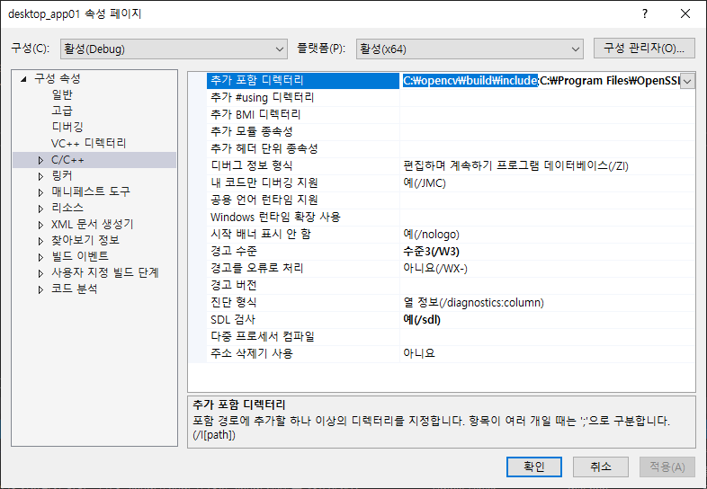
PC Client Setup
OpenCV Setup for MS Visual Studio
Add the installed opencv\build\include path to the project's property page -> C/C++ -> additional include directories

Slide 4
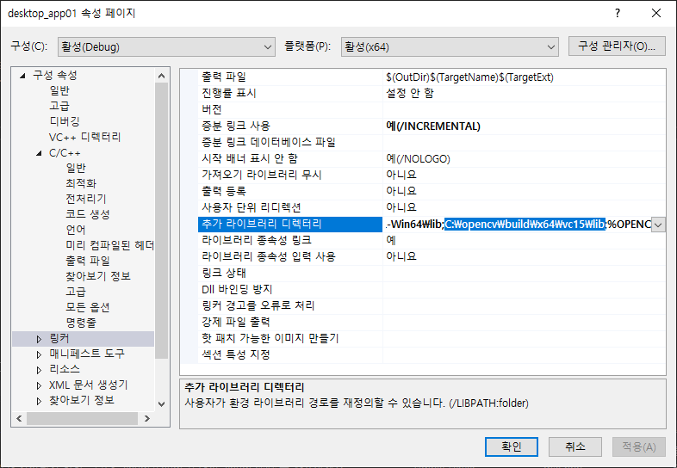
PC Client Setup
OpenCV Setup for MS Visual Studio
Add the installed opencv\build\x64\vc15\lib path to your project's property page -> Linker -> Additional include directories

Slide 5
PC Client Setup
OpenSSL Download / Install
https://slproweb.com/products/Win32OpenSSL.html
Download and install Win64 OpenSSL v1.1.1k (63MB Installer)
Default installation path: C:\Program Files\OpenSSL-Win64

Slide 6
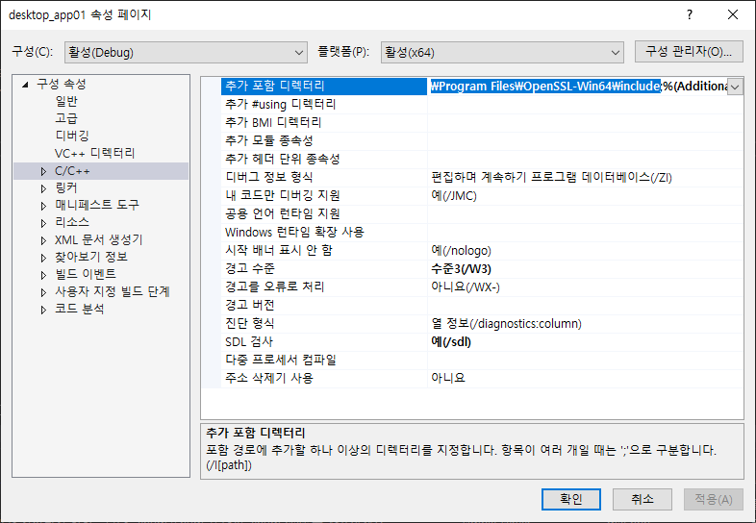
PC Client Setup
OpenSSL Setup for MS Visual Studio
Add the installed OpenSSL-Win64\include path to your project's property page -> C/C++ -> Additional Include Directories

Slide 7
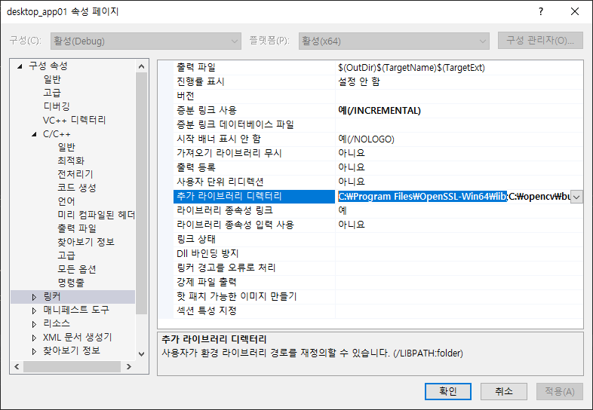
PC Client Setup
OpenSSL Setup for MS Visual Studio
Add the installed OpenSSL-Win64\lib path to your project's property page -> Linker -> Additional Include Directories

Slide 8
PC Client Setup
USB Key Setup

Slide 9
Server Setup
Download Source Code
https://github.com/SWSS2021Team3/LgFaceRecDemoTCP_Jetson_NanoV2
Project Build
/LgFaceRecDemoTCP_Jetson_NanoV2$ mkdir build /LgFaceRecDemoTCP_Jetson_NanoV2$ cd build /LgFaceRecDemoTCP_Jetson_NanoV2/build$ cmake .. /LgFaceRecDemoTCP_Jetson_NanoV2/build$ make
Project Run
/LgFaceRecDemoTCP_Jetson_NanoV2/build$ ./LgFaceRecDemoTCP_Jetson_NanoV2 [PORT]

Slide 10
Server Setup
OpenSSL Setup

Slide 11
Server Setup
USB Key Setup

