Slide 1

AACS Setup Manual
Team 3 : 100 % Certified

Slide 2
PC Client Setup
Download Source Code
https://github.com/SWSS2021Team3/ControlAndDisplay
- desktop_app01 : PC Client Source Code Directory
- gtest_sample01 & simple-server : Source code directory for internal testing

Slide 3
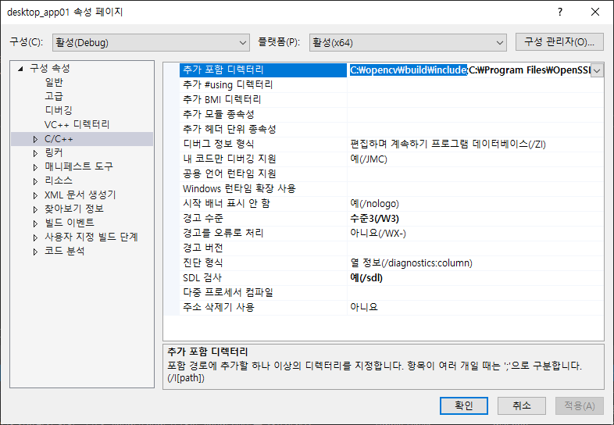
PC Client Setup
OpenCV Setup for MS Visual Studio
Add the installed opencv\build\include path to the project's property page -> C/C++ -> additional include directories

Slide 4
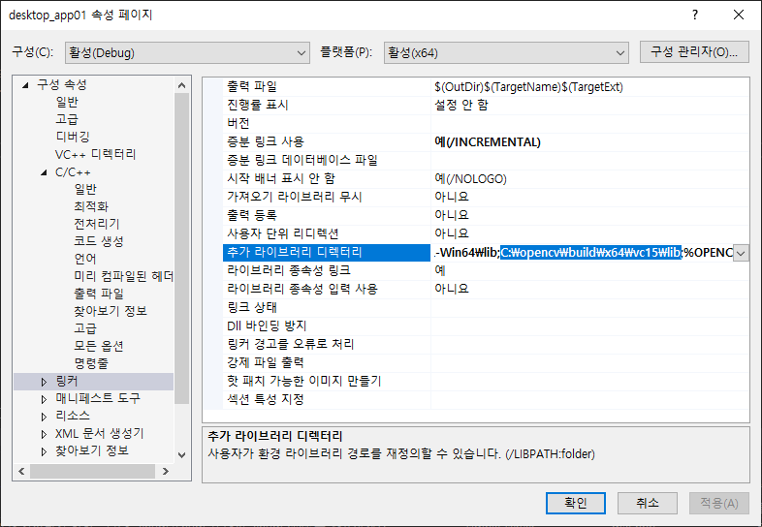
PC Client Setup
OpenCV Setup for MS Visual Studio
Add the installed opencv\build\x64\vc15\lib path to your project's property page -> Linker -> Additional include directories

Slide 5
PC Client Setup
OpenSSL Download / Install
https://slproweb.com/products/Win32OpenSSL.html
Download and install Win64 OpenSSL v1.1.1k (63MB Installer)
Default installation path: C:\Program Files\OpenSSL-Win64

Slide 6
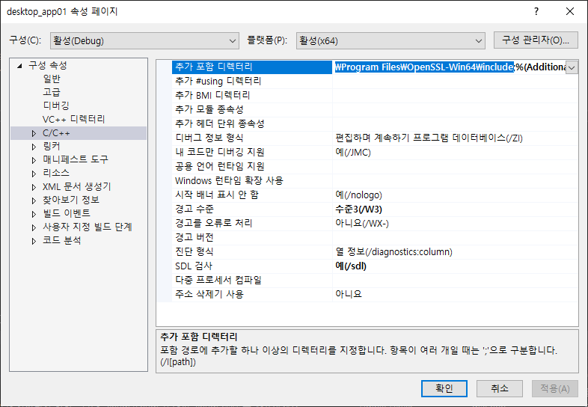
PC Client Setup
OpenSSL Setup for MS Visual Studio
Add the installed OpenSSL-Win64\include path to your project's property page -> C/C++ -> Additional Include Directories

Slide 7
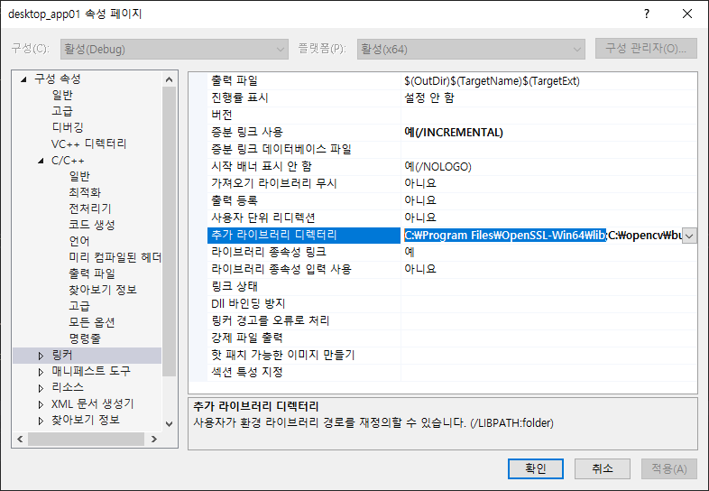
PC Client Setup
OpenSSL Setup for MS Visual Studio
Add the installed OpenSSL-Win64\lib path to your project's property page -> Linker -> Additional Include Directories

Slide 8
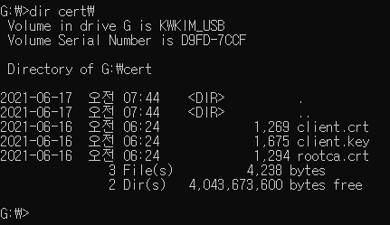
PC Client Setup
USB Key Setup(If you need USB Drive, then ask to TEAM 3)
Download USB Key
https://github.com/SWSS2021Team3/USB_Key
Copy ClientKey\*.* to USB Flash Drive
rootca.crt file should be exist on “USB_FLASH_DRIVE:\cert\rootca.crt”

Slide 9
PC Client Setup
Account Information to log in
ID | Password | Authorization
admin | qorvjdlswmd | Admin
kyuwoon.kim | rlarbdns | User
gyeonghun.ro | shrudgns | User
wonyoung.chang | wkddnjsdud | User
soohyun.yi | dltngus | User
hyejin.oh | dhgPwls | User
hyungjin.choi | chlgudwls | User
vibhanshu.dhote | qlqmgkstb | User
cliff.huff | zmfflvm | User

Slide 10
Server Setup
Download Source Code
https://github.com/SWSS2021Team3/LgFaceRecDemoTCP_Jetson_NanoV2
Project Build
/LgFaceRecDemoTCP_Jetson_NanoV2$ mkdir build /LgFaceRecDemoTCP_Jetson_NanoV2$ cd build /LgFaceRecDemoTCP_Jetson_NanoV2/build$ cmake .. /LgFaceRecDemoTCP_Jetson_NanoV2/build$ make
Project Run
/LgFaceRecDemoTCP_Jetson_NanoV2/build$ ./LgFaceRecDemoTCP_Jetson_NanoV2 [PORT]

Slide 11
Server Setup
OpenSSL Library Setup
Library install
$ sudo apt-get install libssl-dev

Slide 12
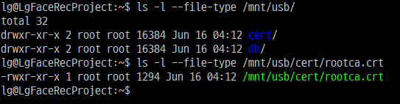
Server Setup
USB Key Setup (If you need USB Flash Drive, then ask to TEAM 3)
Mount to Jetson Nano
Download USB Key
https://github.com/SWSS2021Team3/USB_Key
Copy ServerKey\*.* to /mnt/usb/
rootca.crt file should be exist on “/mnt/usb/cert/rootca.crt”
$ sudo mkdir /mnt/usb $ sudo mount -t vfat /dev/sda1 /mnt/usb

Slide 13
Server Setup
Change engine and model files. (If you need. All the engine files are check HASH.)
Get hash
$ openssl sha256 facenetModels/* SHA256(facenetModels/facenet.engine)= 71493446240e3f9286437c5a0baab41aae6a1e47ddbcb21a24079440ba0e5d86 SHA256(facenetModels/facenet.uff)= 7049d18ad472b535ccd022edf80707d6598ad81472028f1c0024274524ff6ce4 SHA256(facenetModels/README.md)= c7337e9a56c2228229728eb09b823f85025e21387e228e32d3fb8e0d8658d7af $ openssl sha256 mtCNNModels/* SHA256(mtCNNModels/det1_relu1.engine)= 3c26255262c050185c5fa45521a96fedda59f635457b5c8795268a749f7a4c70 SHA256(mtCNNModels/det1_relu2.engine)= 9aab5f7788dc385391324c1bf6e51e92c5a2fdbf2f337490bf6cbbb063032a00 SHA256(mtCNNModels/det1_relu3.engine)= 0c7a81f29c930acb1ce67ca64a107b74ff3917760a8e7bdcd45343d6db4f022c SHA256(mtCNNModels/det1_relu4.engine)= 63866e8b088bd3e12fb4122dc569ee78e6b8c769dd529ffe62fb7f938d6659d5 SHA256(mtCNNModels/det1_relu5.engine)= 749a2f60a17677f3052cfca78fc6040d1b0a540766acfa70777203ed2f59f463 SHA256(mtCNNModels/det1_relu6.engine)= e4ac1e0b5ff0383fb3fd612826d0ac94fa67f094350c6439ab07b88d12fd6df9 SHA256(mtCNNModels/det1_relu7.engine)= fafbf0d0bd89ee02929940878b45edb80a0497bb99f881aab7b618a511434877 SHA256(mtCNNModels/det1_relu.caffemodel)= b46dbcf61b858c1ec67ffdf86b805a050e25b095b5f172b8bdedd48149f2dbbf SHA256(mtCNNModels/det1_relu.prototxt)= 6e1bedd5b73017623249445b43a1ca07eeb68343ff310bce4348bda9e3a50567 SHA256(mtCNNModels/det2_relu.caffemodel)= 053a4445c392878649aeed457ea1f3f7f5a1e23bfe29cb038c451131ed96a469 SHA256(mtCNNModels/det2_relu.engine)= 2253f2a34e568d0a9c033ae5028e9339918fff4d4c2832bf351d28f06b5b3ac5 SHA256(mtCNNModels/det2_relu.prototxt)= 3d6986b38f98954f57be8108f1b09794e2890906f2006526172139c3b5a2bff6 SHA256(mtCNNModels/det3_relu.caffemodel)= f5bf43cd05feea8fb5f7250dcc610065308e66f44b1fb2cd956bfcd43ae58c79 SHA256(mtCNNModels/det3_relu.engine)= be3c6934f2c112f34f20a3a99f1ee8bb7d272894a2fa772c99fcacf1ae419507 SHA256(mtCNNModels/det3_relu.prototxt)= 59f75d1ca76a78333646ff7d6c92e5866f187831f3579345ab7b62406efccf7e SHA256(mtCNNModels/README.md)= eee30b9ebf9c7946ec60811d7e969aa8cf09921aecd13a7b9a85043ce2988259 Appy hash value(right hand of ‘=’ ) to SecurityManager::readKey() at src/SecurityManger.cpp File.

Slide 14
Admin Setup
Admin could make connection information(IP/Port/SecurePort)
* prepare for sign openssl.exe clientconf.bin (Ip, port, secure port are written each line.) clientconf.crt (https://github.com/SWSS2021Team3/USB_Key) clientconf.key (https://github.com/SWSS2021Team3/USB_Key) > type clientconf.bin 192.168.0.106 5000 5010 > openssl cms -sign -in clientconf.bin -signer clientconf.crt -inkey clientconf.key -outform DER -out clientconf.sign -binary > copy clientconf.bin clientconf.sign [client application directory]

Slide 15
Deployment Setup
Download deployment
https://github.com/SWSS2021Team3/ProjectDocuments
It exists in the deploy subdirectory of ProjectDocuments
ACS : Attendance Check System (PC)
unzip ACS.zip
run ACS.exe
FRS : Face Recognition System (Jetson Nano)
Install
cat FRS.tar* | tar xvf -
unzip FRS.zip
cd deploy
Run Camera mode (has some problem with closing camera)
./run.sh
Run Play Record mode (can be switched to Camera mode)
./run-mov.sh

