Slide 1
Git Workflows
I4SWT

Slide 2
Git workflows
There is no one-size-fits-all Git workflow - often some kind of mix
General guidelines:
Workflow should be simple and enhance productivity
Short-lived branches, integrate often
Enable code reviews and CI
Minimize and simplify reverts
Support a given release model
Centralized/ Trunk based workflow
Single branch main is the only (public) branch
Short-lived feature branches (typically local only)
Partial features may be integrated using feature flags => may cause scattered feature history
Integration directly to main. Code review not via pull request (branch). Tools like Gerrit has temp branches
Feature branch workflow
Not specific about main being the only long-lived branches (may e.g. have release branches)
Short-lived feature branches (typically shared/pushed to central for CI and code review)
Features typically integrated when complete => no scattered feature history
Integration via feature branches. Code review on feature branch (pull request) or Gerrit temp branches

Slide 3
Git-flow, GitHub flow, and Trunk-based flow
Popular branching policies - using either feature branching or main branch
Git-flow:
Proposed by Vincent Driessen, 2010 on blog (later reflection added supporting GitHub flow)
Focus on branching model to support multiple versions of product releases
master, development, feature, release and hotfix branches and policies for use
May need separate testing and deployment of different releases (versions) in parallel
GitHub flow:
GitHub realized a need for a simplified version of Git-flow for their service
A web-app – with only a single version (latest) is deployed
No need for multiple versions simultaneously – hence no need for special release branches
Use feature branches
Use pull-requests to review changes from feature branches
Deploy soon and directly from main – when feature merged
Trunk-based flow:
The centralized workflow (single main)
Has gained traction lately as DevOps has become buzzword (claimed by e.g. Google and Facebook)
Favored for its simplicity and agility

Slide 4
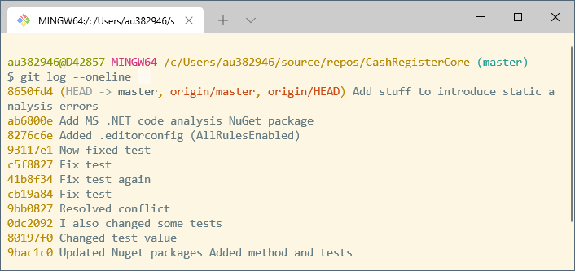
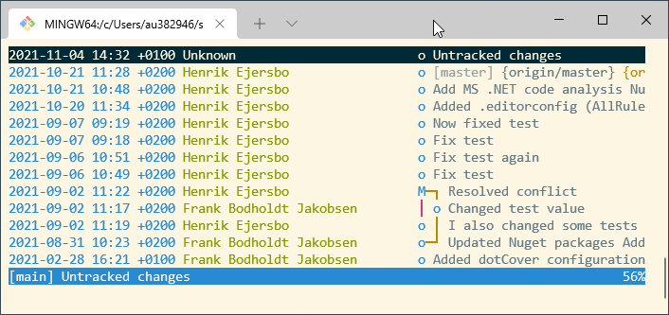
Git from the command line
Git command-line tools are standard available (Windows, Linux, Mac)
Git for Windows provides a BASH emulation (Git BASH shell)
Using a BASH shell is MUCH more convenient than e.g. CMD prompt
Git has very good TUI companion: Tig (https://jonas.github.io/tig/)
Tig is part of Git for Windows package

Slide 5
Git collaboration = working with remotes
Git's collaboration model = every developer has own copy of repository
Own local history and branch structure
Git commands to work with remotes: git clone / git fetch / git pull / git push / git remote
workspace
staging
local repo
remote repo
git clone/pull
git add
git commit
git push
git fetch

Slide 6
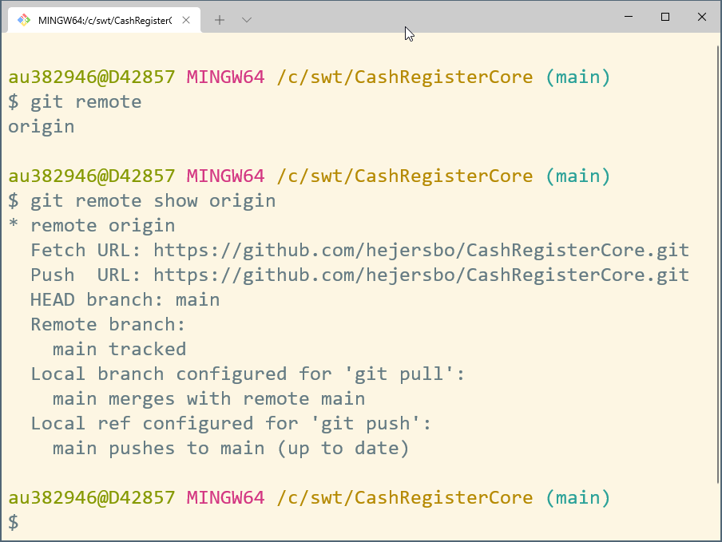
Git remote
Remotes are simply local names for addresses of remote repos
Cloning a repo automatically creates a default remote called ‘origin’
Can add multiple remotes: origin (main upstream), co-worker repos, release repos, …
Git commands: push, pull, fetch all takes a <remote> arg (default origin)

Slide 7
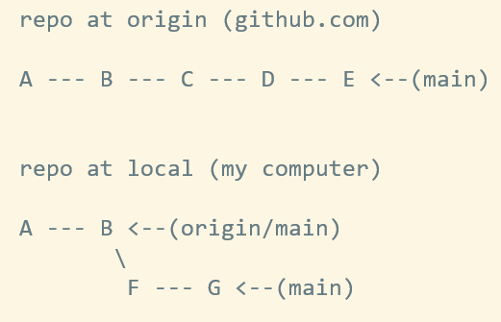
Remote tracking branches
Local reference to the state of remote branches
Git moves them when doing network communication (pull, fetch, pull)
Local “bookmarks” of remote branches state last time you connected
Local branches can be created off them
Can merge from them: git pull = git fetch + git merge

Slide 8
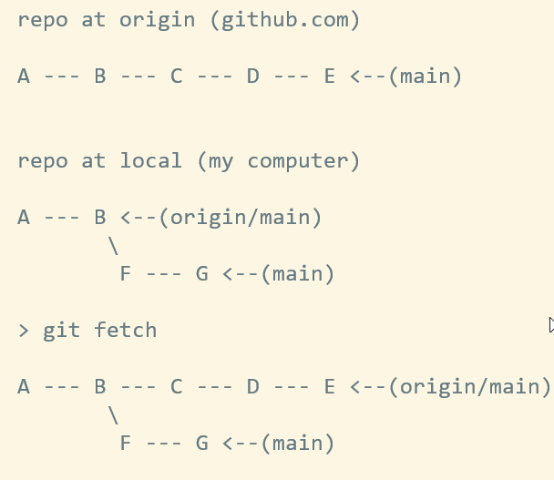
Git fetch
Fetches all branches of remote repo
Doesn’t touch working area
git fetch <remote> <branch>
git checkout -b <branch>
git log --oneline main..origin/main
git checkout main; git merge origin/main

Slide 9
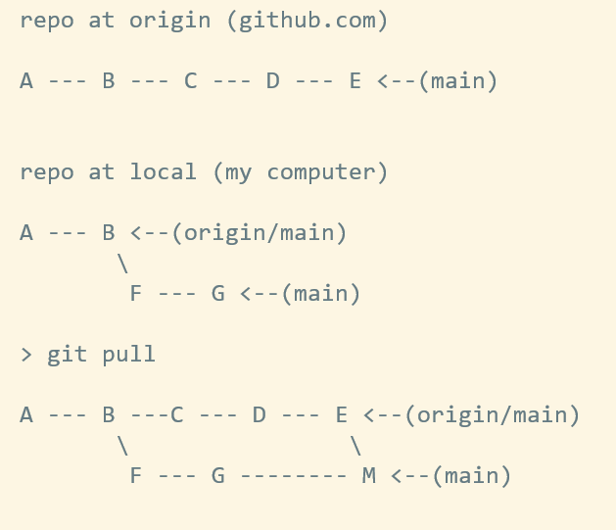
Git pull
Fetches remote branches AND merges
git pull = git fetch + git merge (current branch)
Merging may use different strategies (merge commit, fast-forward, rebase)
We will look at merge strategies in a moment

Slide 10
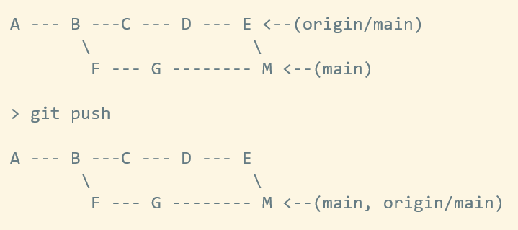
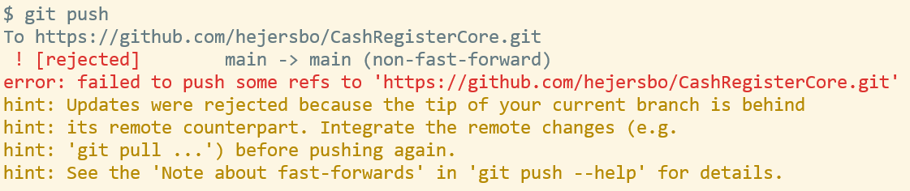
Git push
Uploads local branch to remote (and updates tracking branches)
Git rejects if local branch tip is behind remote tracking – do pull first
Git push will synchronize local branch and remote tracking
git push <remote> <branch>

Slide 11
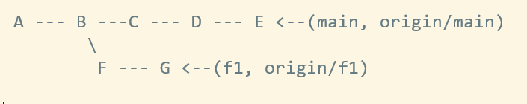
Git branches (feature)
Create (and push) branch:
git checkout –b f1
git push -u <remote-name> <branch-name>
Repeatedly commit locally (and push for CI)
git commit
git commit
git commit
git push
Get updates from main – strategy ?
Integrate back in to main – strategy ?

Slide 12
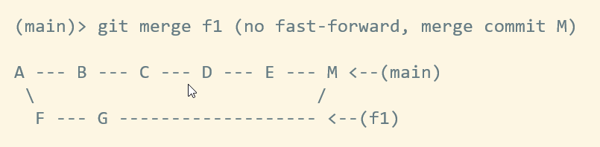
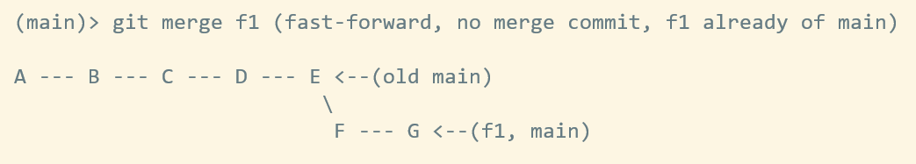
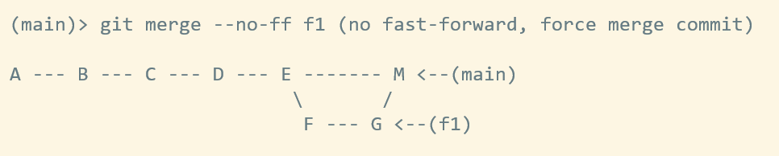
Git merge – merge commit / fast-forward
Merge commit, no fast forward
Fast forward, no merge commit
Forced commit, no fast forward

Slide 13
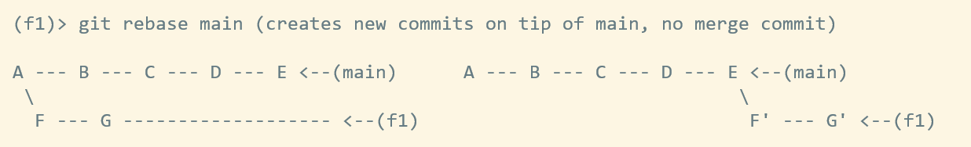
Git rebase
Rebasing allows for a clean history without merge commits
Merge conflicts can still occur and must be resolved
Creates new commits (and destroys old ones) by rewriting history
Golden Rule of Rebasing: Never rebase published branches
(… unless you dare to/know how to force push (-with-lease))
Git pull can either merge (default) or rebase: git pull --rebase
After rebase these commits are gone
New commits

Slide 14
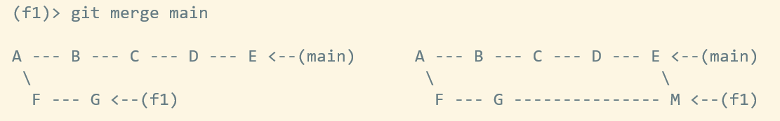
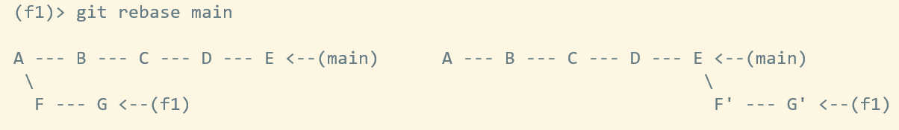
Git merge vs. rebase - same but different
Merge:
is non-destructive, but may result in lots of merge commits (non-clean history)
maintains history and traceability and makes for easier reverts
often used as strategy for integrating feature branch back to main (either --ff-only or --no-ff)
Rebase:
is destructive, but has no merge commits and thus a clean linear history (conflicts still needs resolving)
no history of branches, harder to revert
often used as strategy for repeatedly integrating main into feature branch
often used to clean up local, in-progress feature branch (interactive rebase)

Slide 15
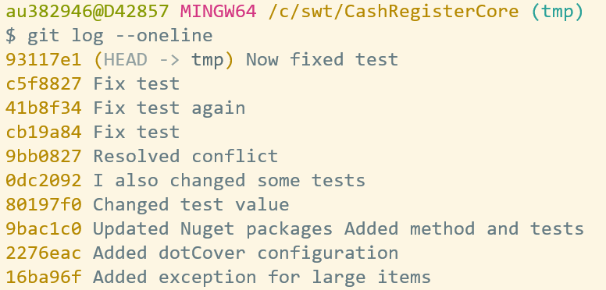
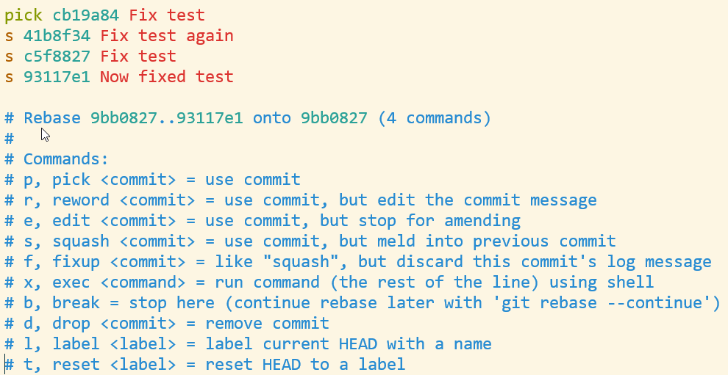
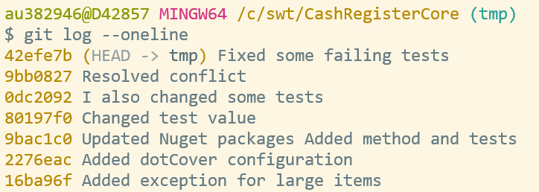
Git interactive rebasing – for local clean up
Rewrite a bounded series of commits into a cleaner set
Use locally on feature branch before integration to main

Slide 16

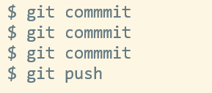



Git feature branch workflow – that you will use
Commit changes
(push for CI)
Integrate main by rebasing
(repeatedly)
Create a branch
Clean up local history
Push for Pull Req. (PR)
Review PR on GitHub
Merge PR to main on GitHub
If conflict resolve locally or on GitHub
(keep feature branch for us)

Slide 17
Demo
Use the workflow from the previous slide
Use our good old CashRegister
Add new features f1 and f2 from two separate users
Rebase for integration and clean up of history
Create pull requests (PRs) and review and merge
Resolve conflicts in PRs

