Slide 1
Path Discovery to Critical Regions via Symbolic Execution
Linhan Li

Slide 2
Outline
Background info
Symbolic Execution
PL - Abstract Syntax Tree
Motivation/Application
Approach
Example
Demo
Hard-coded demo
Interactive demo

Slide 3
Background
Symbolic execution
PL - AST

Slide 4
Symbolic execution
A program analysis technique used to explore all possible execution paths.
Uses symbolic inputs instead of concrete values, representing variables with symbolic expressions.
Tracks path conditions for each branching point, enabling it to explore multiple paths.
Each path has its unique symbolic state, which can be checked by a theorem prover.

Slide 5
Abstract Syntax Tree (AST)
A tree representation of the abstract syntactic structure of source code
commonly used in PL related tools
compilers
software analysis tools
Breaks down code into its fundamental components (e.g., expressions, statements) in a hierarchical format.
Why?
Provides a more organized and structured view than plain source code.
Executing source code can be viewed as a specialized traversal of the AST.
Python has standard lib for parsing source code to AST

Slide 6
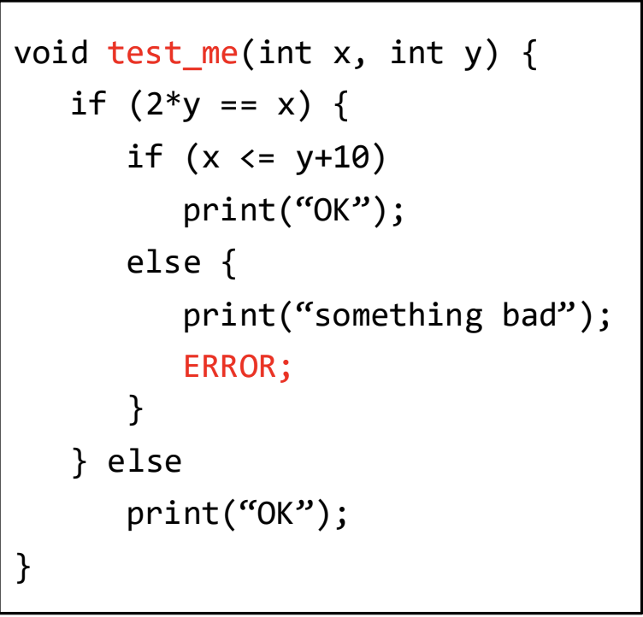

Abstract Syntax Tree (AST)
test_me
params
func_body
x
y
If_statement
conditional
if-branch
else-branch
2*y == x
If_statement
Print(“OK”)
X <= y+10
if-branch
else-branch
Print(“OK”)
Print(“something bad”)
Error
Credit: Prof. Luo (09-dynamic-analysis-I.pdf - p55)

Slide 7
Motivation/Application
To maximize coverage of test suit
To find adversarial input that can exploit certain vulnerability
Dead code removal
Program invariant generation

Slide 8
Approach
Parse the input program into AST
a piece of code wrapped in a function definition
Traverse the AST and generate symbolic states
Some control flow needs extra attention (e.g while, if)
The body of a while loop might be executed more than once
Only one branch gets executed in a if-else statement
We can utilize the inorder traversal and manipulate the stack to handle them.
The final symbolic states can be solved with Z3

Slide 9
What is supported
Integer parameters
Integer assignments
Integer return values
Integer arithmic
Cmp operations
Integer or integer variables
Control flow
While loop
Including Break, Continue
If … else …
Assertion
Pass

Slide 10
Demo

Slide 11
Interactive Demo

Slide 12
Question?
Code (will be) available from:
https://github.com/SWVM/681_prjt

