Slide 1
StoryMapJS
A story mapping software

Slide 2
Introduction | Overview
What are the main goals of StoryMap?
What are the main features?
Where is StoryMap located?
How is StoryMap funded?

Slide 3
Initial Research and Findings
Link: https://uploads.knightlab.com/storymapjs/259b02688d0e72de71c4e49d5fd87fab/whitey-bulger/index.html
Easy to use and learn.
Limited by the knowledge of the user and available information out there.
Limited space makes it difficult to detail everything.

Slide 4
Expression
Multiple expressive options (videos, twitter, etc.) allows for creativity in the presentation.
Map import allows for stories to be fictional as well as non-fictional.
Unable to properly express more detailed aspects of a story.
Maps with lots of back and forth can be hard to follow.

Slide 5
Usability
Pros
Can easily create visualizations of historical events.
Can be used in both geography and history courses.
Allows the user to combine the usefulness of a map and conveyance of interactivity.
Good customization.
Can be used creatively.
Easy to learn.
Cons
Map controls were hard to use.
Incomplete locations.

Slide 6
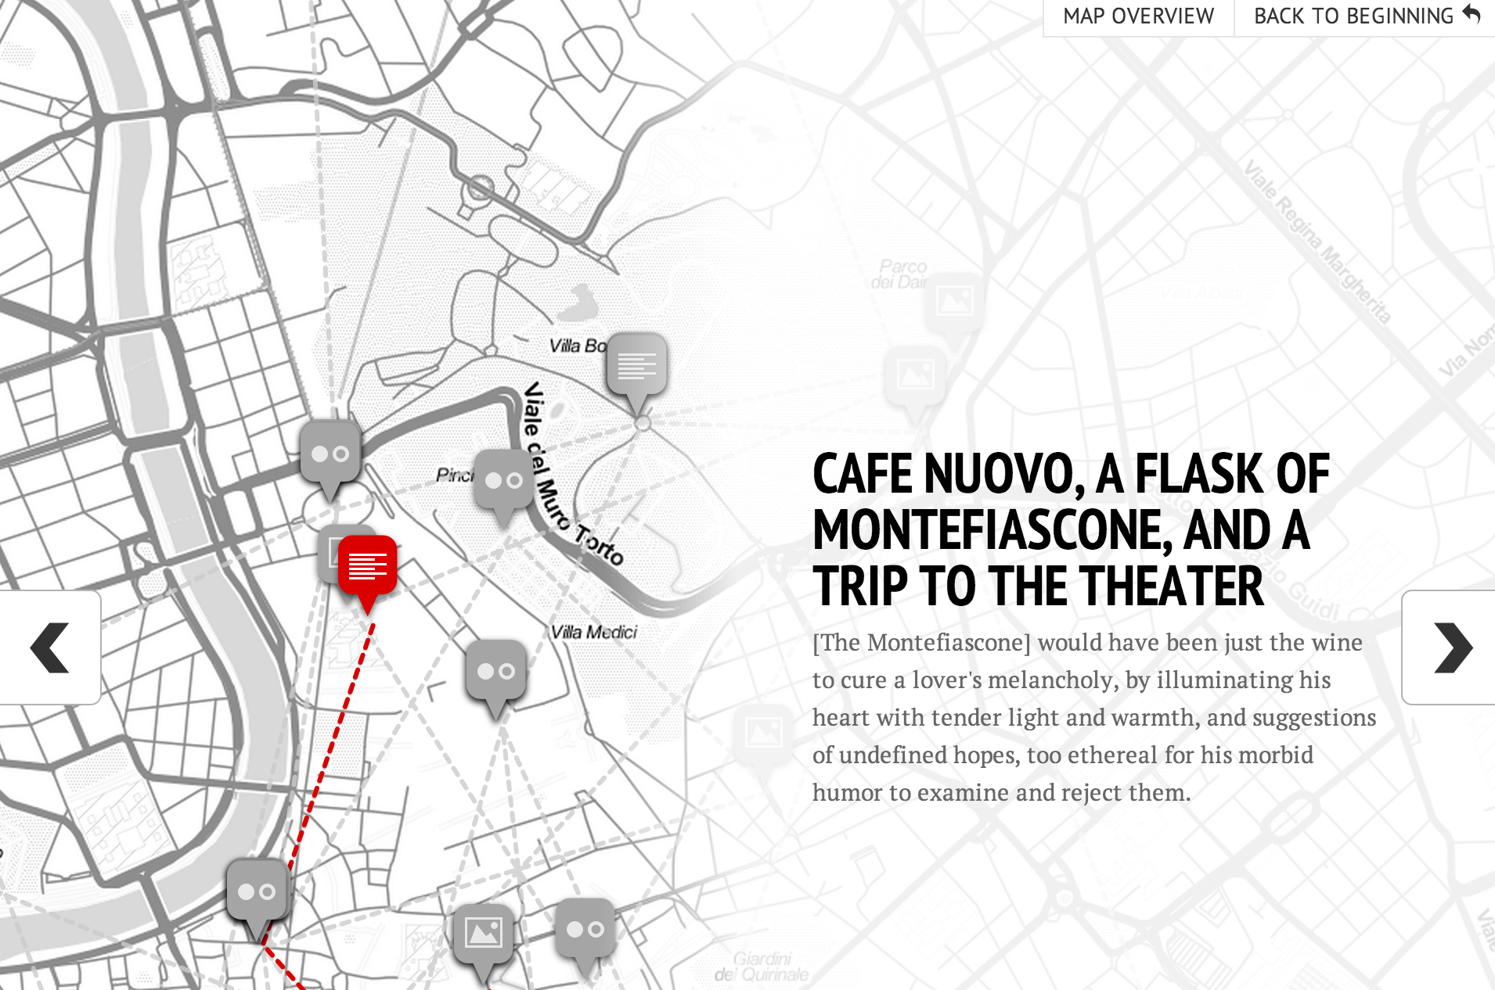
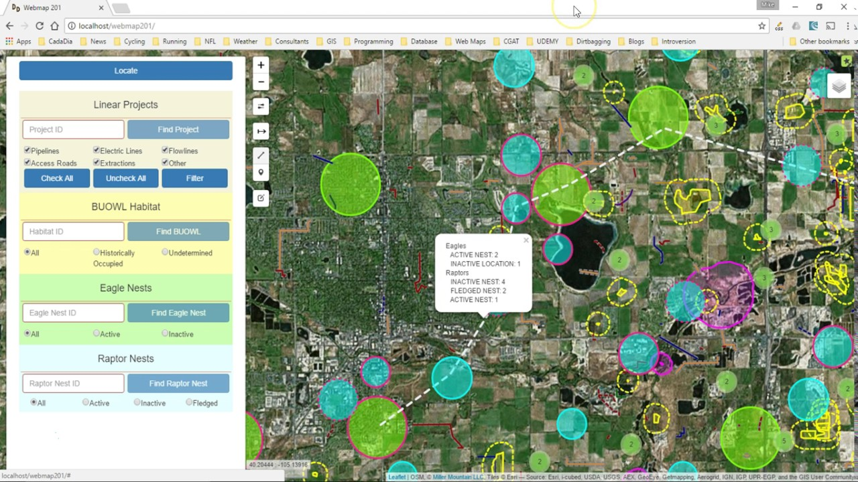
Theoretical discussion
The concepts allows viewers to see where stories/real events have taken place over time.
Its display is similar to that of GIS that Drucker's has discussed in “Humanities Approaches to Graphical Display", but it provides a deeper meaning.
The map is a reference to a plot in time and space that can be explored via digital media.

Slide 7
References | Links
Knight Lab. (2018). StoryMapJS. https://storymap.knightlab.com
Johanna Drucker (2011), "Humanities Approaches to Graphical Display"

