Slide 1

Batch Normalization
Normalizing activations
in a network
deeplearning.ai

Slide 2
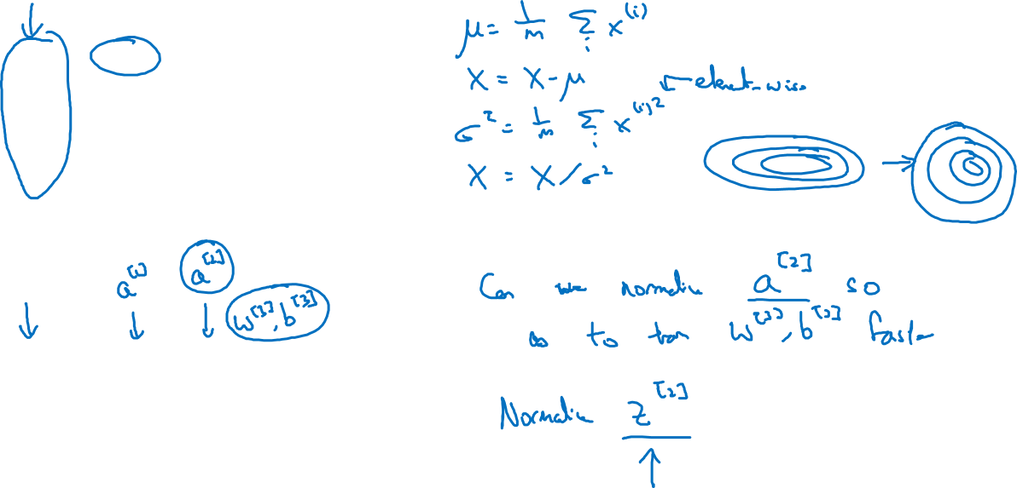









Normalizing inputs to speed up learning

Slide 3
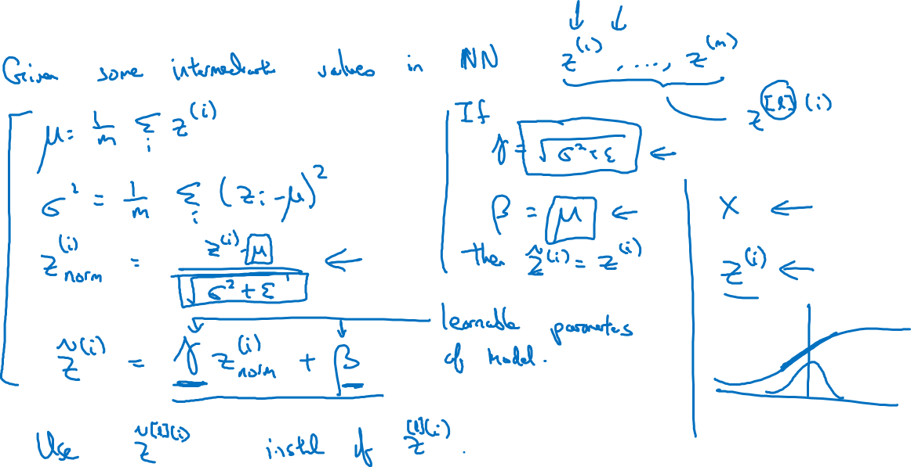
Implementing Batch Norm

