Slide 1

Batch Normalization
Why does
Batch Norm work?
deeplearning.ai

Slide 2
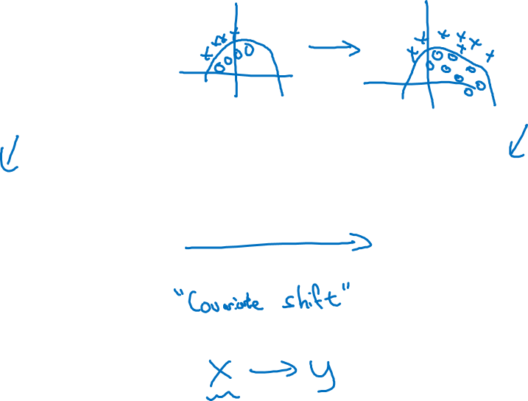
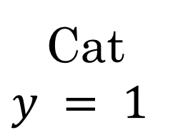
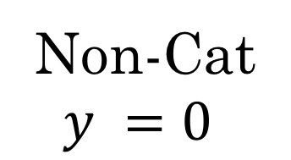



Learning on shifting input distribution
Cat
Non-Cat

Slide 3
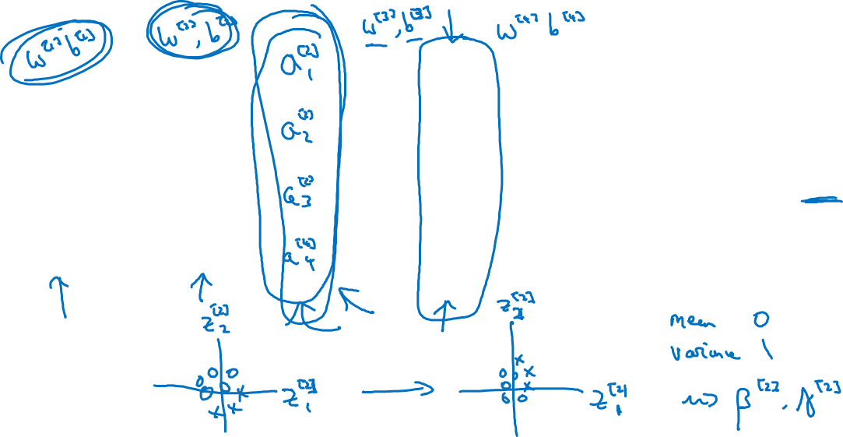




Why this is a problem with neural networks?

Slide 4
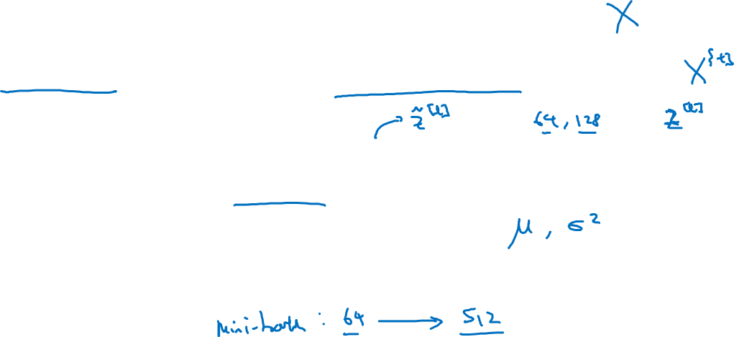
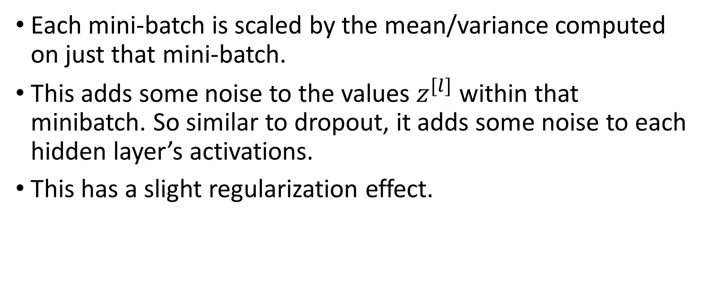
Batch Norm as regularization
Each mini-batch is scaled by the mean/variance computed on just that mini-batch.
This adds some noise to the values within that minibatch. So similar to dropout, it adds some noise to each hidden layer’s activations.
This has a slight regularization effect.

