Slide 1

Batch Normalization
Batch Norm at
test time
deeplearning.ai

Slide 2
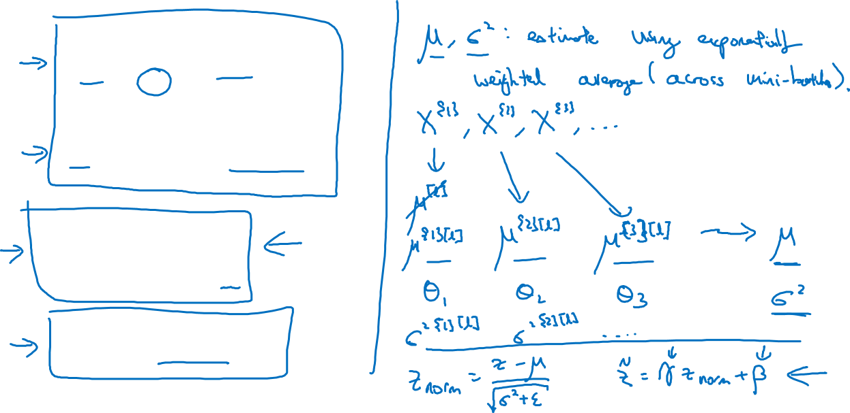
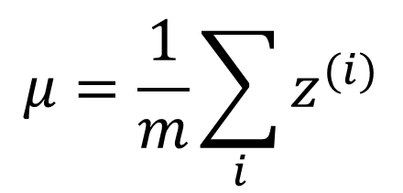

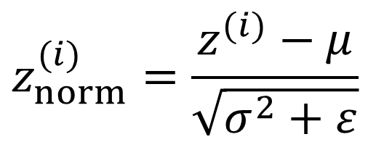

Batch Norm at test time

