Slide 1

Object Detection
Object localization
deeplearning.ai

Slide 2
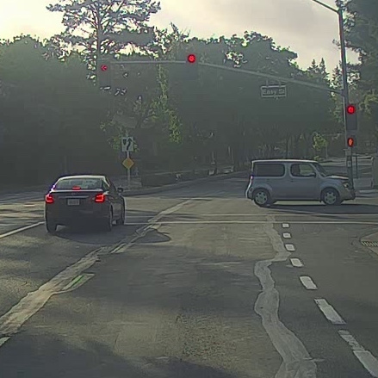
What are localization and detection?
Image classification
Classification with
localization
Detection

Slide 3
Classification with localization
1 - pedestrian
2 - car
3 - motorcycle
4 - background

Slide 4
Defining the target label y
1 - pedestrian
Need to output class label (1-4)
2 - car
3 - motorcycle
4 - background

