Slide 1

Object Detection
Object detection
deeplearning.ai

Slide 2
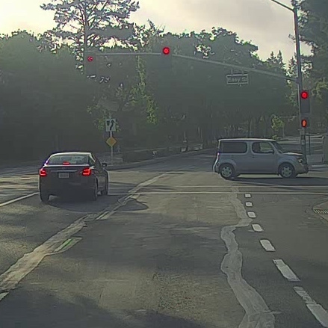
Car detection example
Training set:
x
y
1
1
1
0
0

Slide 3
Sliding windows detection

