Slide 1

Object Detection
Non-max suppression
deeplearning.ai

Slide 2
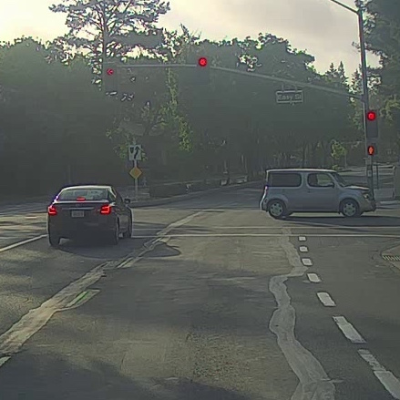
Non-max suppression example

Slide 3
Non-max suppression example
0.6
0.8
0.9
0.3
0.5

Slide 4
Non-max suppression example
0.6
0.8
0.9
0.7
0.7

Slide 5
Non-max suppression algorithm
Each output prediction is:
Discard all boxes with
While there are any remaining boxes:
Pick the box with the largest
Output that as a prediction.
19
Discard any remaining box with
IoU with the box output
in the previous step

