Slide 1

Object Detection
Putting it together:
YOLO algorithm
deeplearning.ai

Slide 2
Training
1 - pedestrian
2 - car
3 - motorcycle
y
=
y is
[Redmon et al., 2015, You Only Look Once: Unified real-time object detection]

Slide 3
Making predictions
=

Slide 4
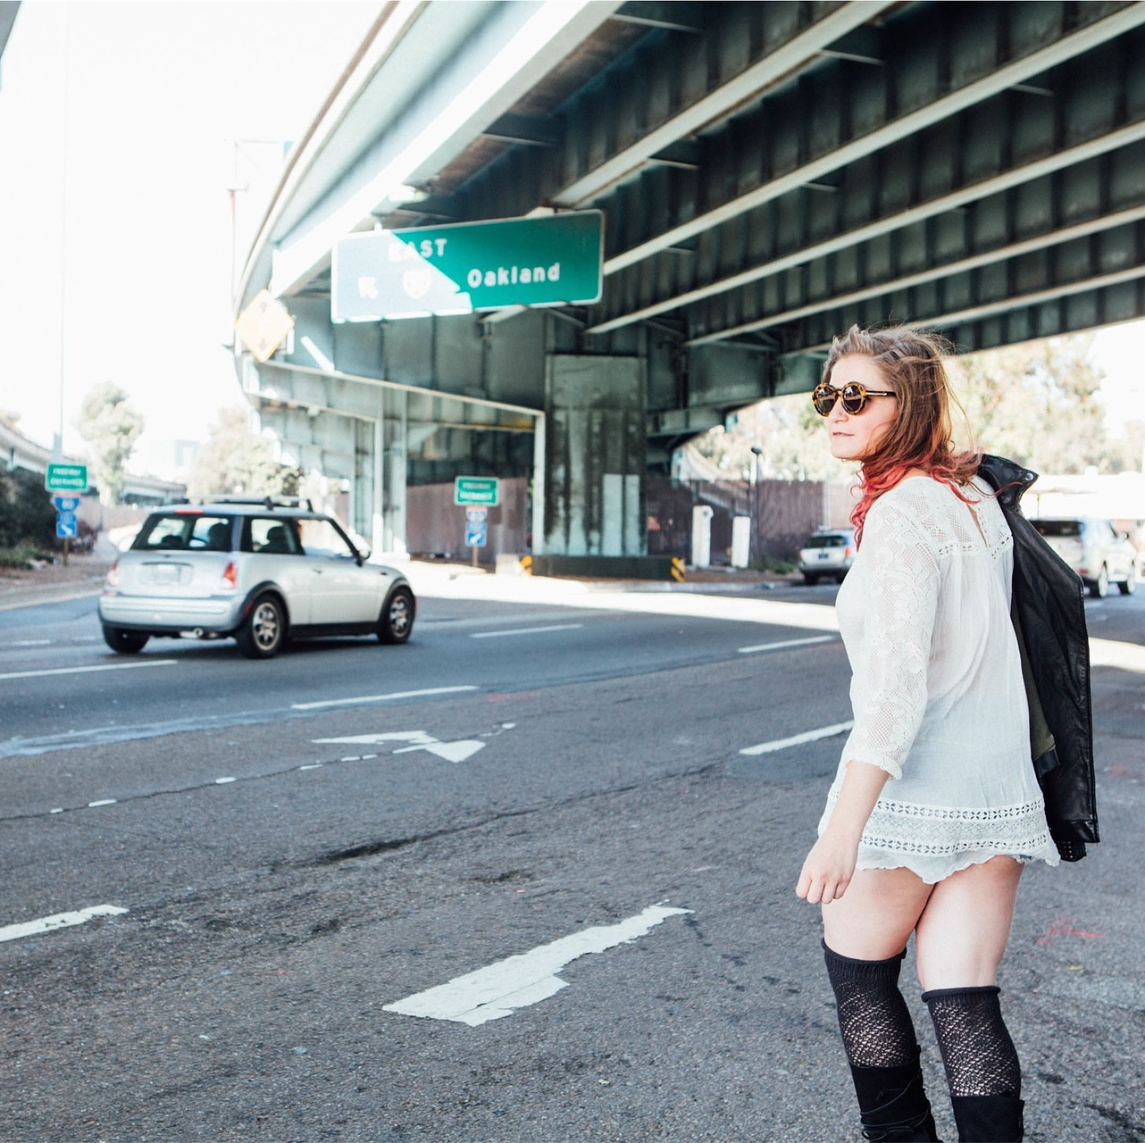
Outputting the non-max supressed outputs
For each grid call, get 2 predicted bounding boxes.
Get rid of low probability predictions.
For each class (pedestrian, car, motorcycle) use non-max suppression to generate final predictions.

