Slide 1

Audio data
Trigger word detection
deeplearning.ai

Slide 2
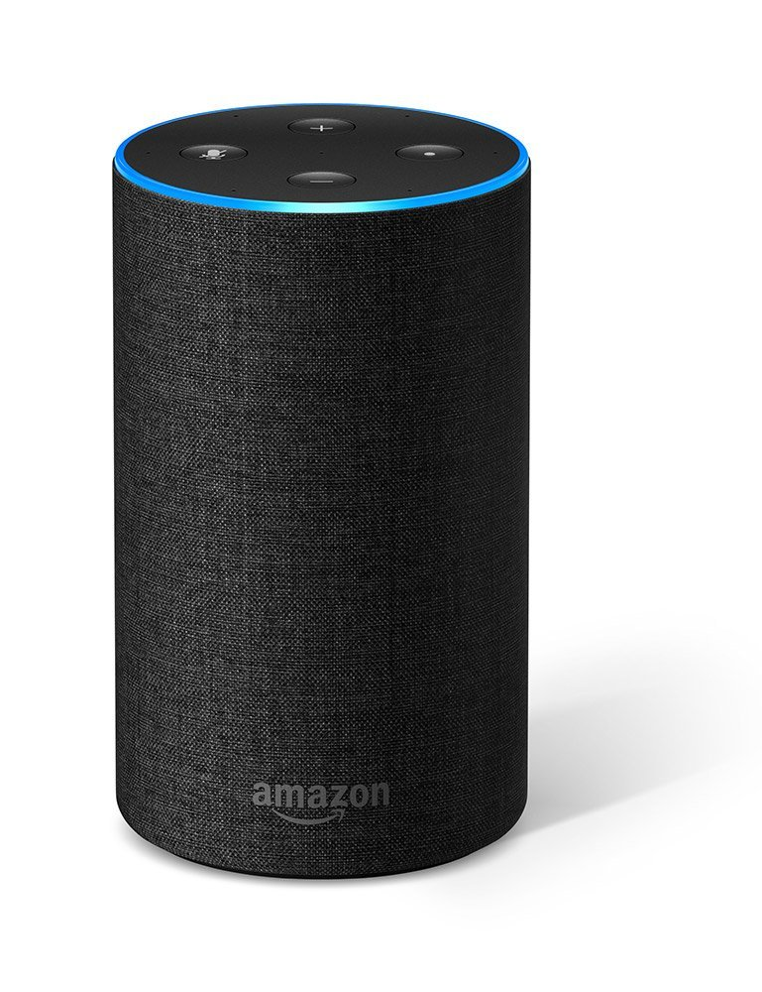

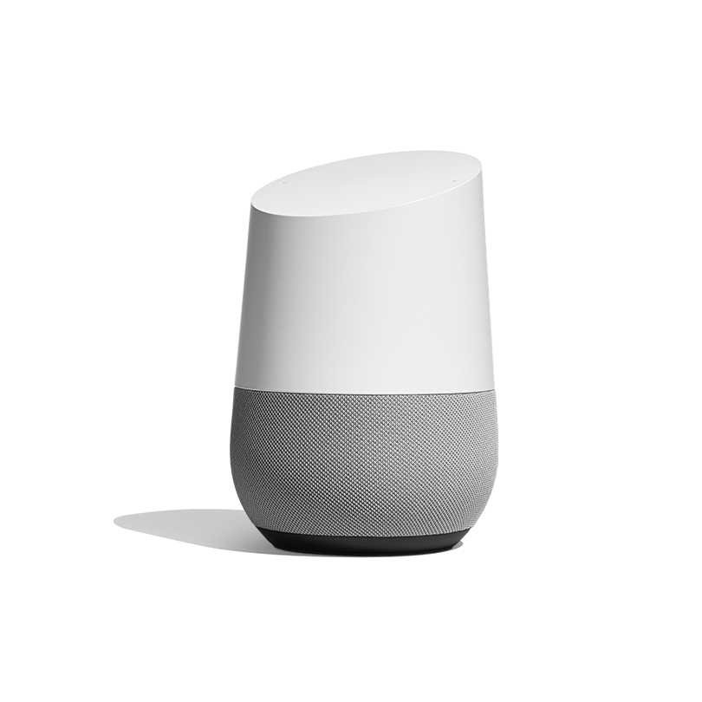
What is trigger word detection?
Amazon Echo
(Alexa)
Baidu DuerOS
(xiaodunihao)
Apple Siri
(Hey Siri)
Google Home
(Okay Google)

Slide 3
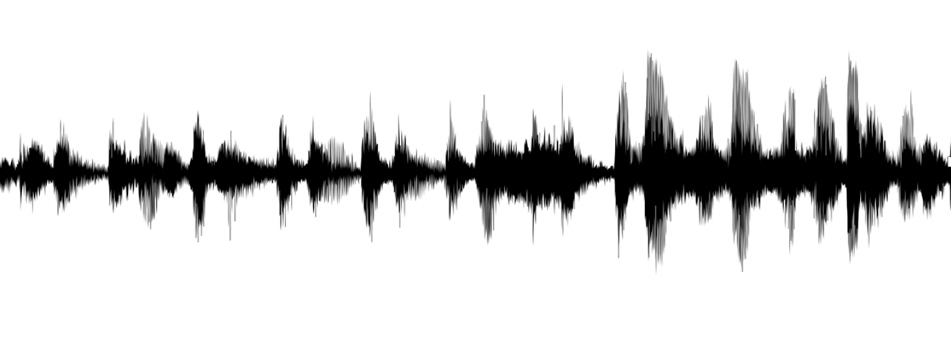
Trigger word detection algorithm

