Slide 1

Sequence to sequence models
Attention model
deeplearning.ai

Slide 2
Attention model
jane
visite
l’Afrique
en
septembre
[Bahdanau et. al., 2014. Neural machine translation by jointly learning to align and translate]

Slide 3
Computing attention
= amount of attention should pay to
=
[Bahdanau et. al., 2014. Neural machine translation by jointly learning to align and translate]
[Xu et. al., 2015. Show, attend and tell: Neural image caption generation with visual attention]

Slide 4
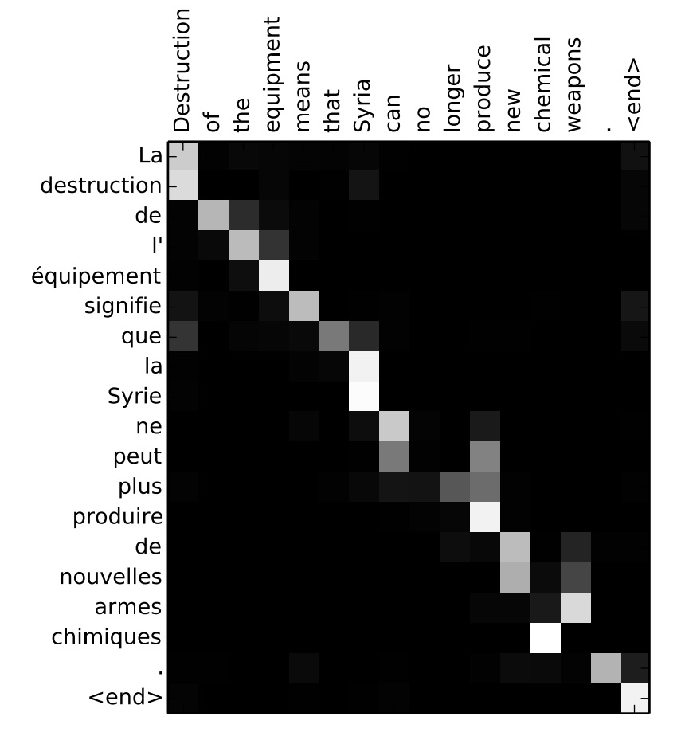
Attention examples
July 20th 1969
April,
Visualization of :

