Slide 1

Audio data
Speech recognition
deeplearning.ai

Slide 2
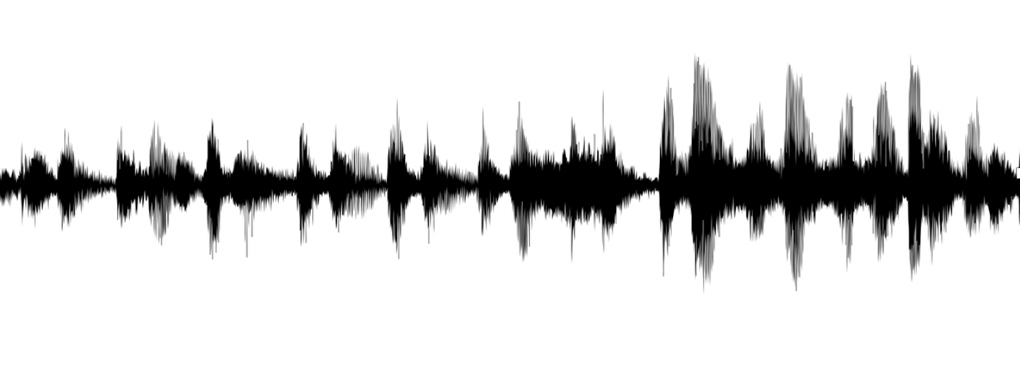
Speech recognition problem
audio clip
transcript
“the quick brown fox”

Slide 3
Attention model for speech recognition
“T”
“h”

Slide 4
CTC cost for speech recognition
(Connectionist temporal classification)
“the quick brown fox”
Basic rule: collapse repeated characters not separated by “blank”
[Graves et al., 2006. Connectionist Temporal Classification: Labeling unsegmented sequence data with recurrent neural networks]

