Slide 1

Neural Style Transfer
Style cost function
deeplearning.ai

Slide 2
Meaning of the “style” of an image
Say you are using layer ’s activation to measure “style.”
Define style as correlation between activations across channels.
How correlated are the activations across different channels?
[Gatys et al., 2015. A neural algorithm of artistic style]

Slide 3
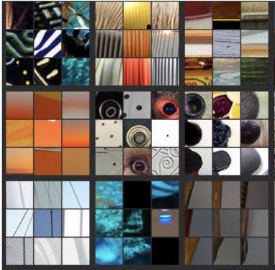
Intuition about style of an image
Style image
Generated Image
[Gatys et al., 2015. A neural algorithm of artistic style]

Slide 4
Style matrix
Let activation at is
[Gatys et al., 2015. A neural algorithm of artistic style]

Slide 5
Style cost function
[Gatys et al., 2015. A neural algorithm of artistic style]

