Slide 1

Convolutional Networks in 1D or 3D
1D and 3D generalizations of models
deeplearning.ai

Slide 2
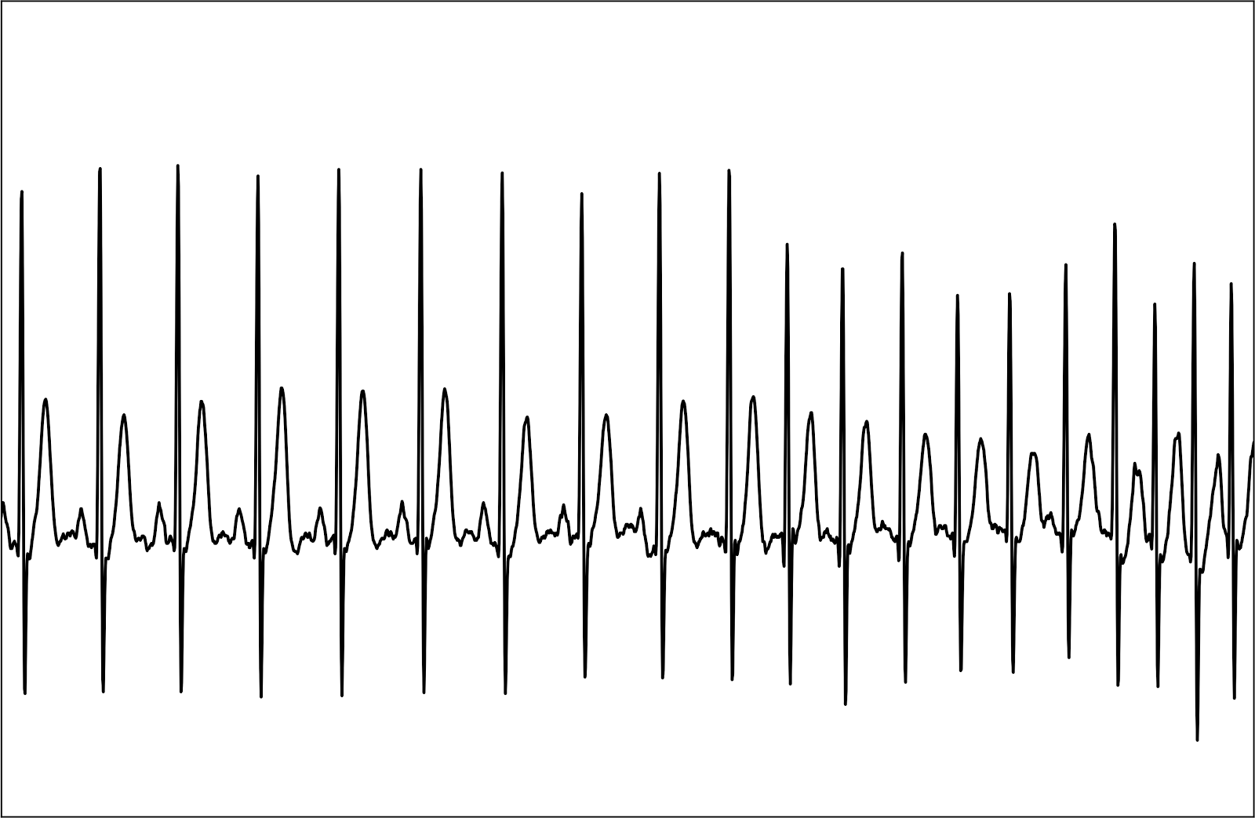
Convolutions in 2D and 1D
2D filter
2D input image
1 | 20 | 15 | 3 | 18 | 12 | 4 | 17
1 | 3 | 10 | 3 | 1

Slide 3
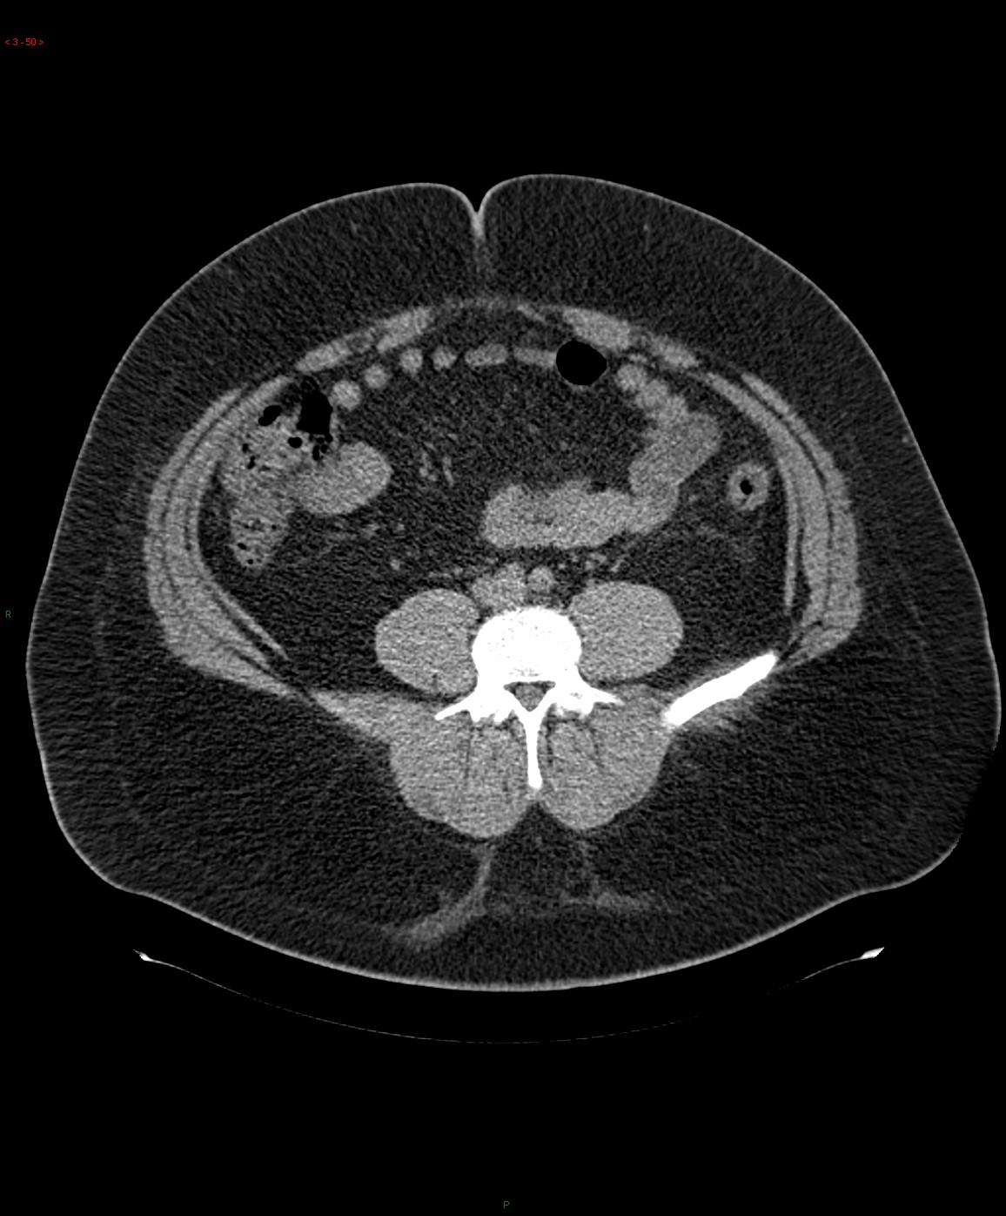
3D data
Andrew Ng
Notes:
3

Slide 4
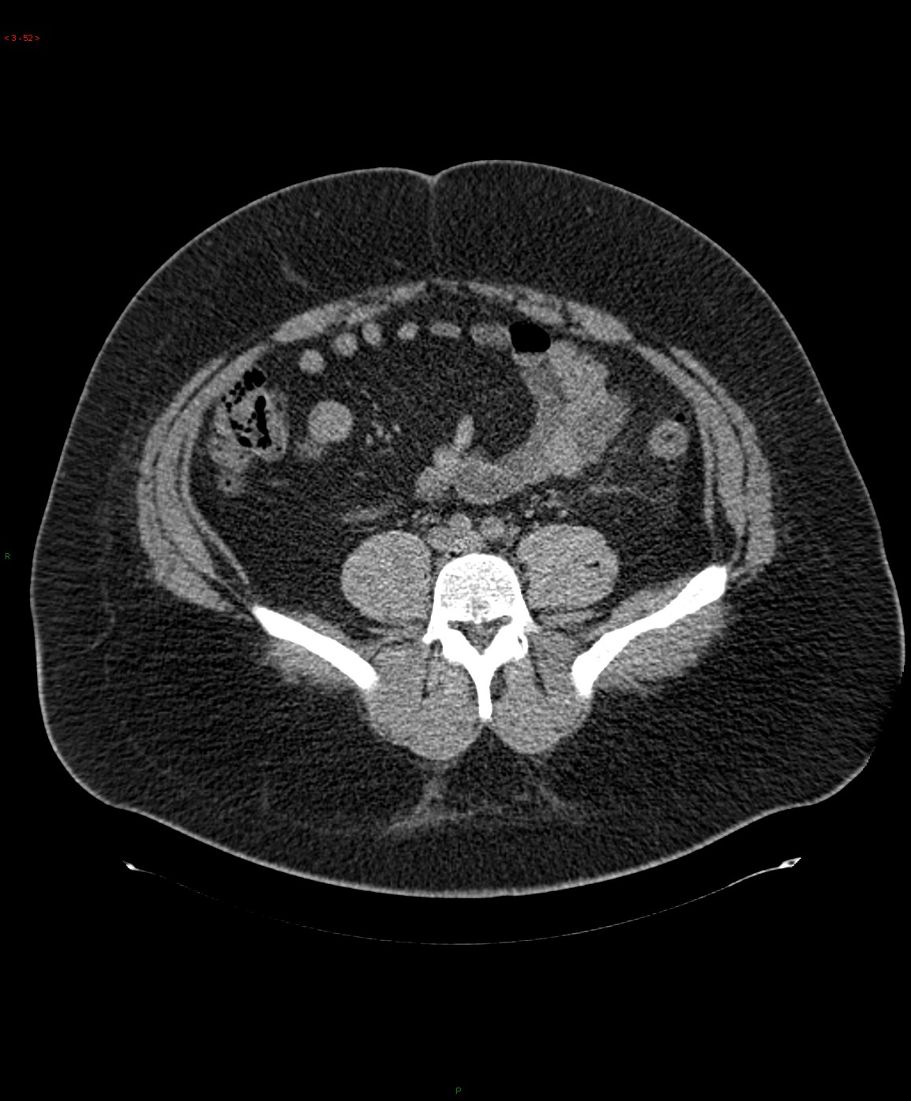
3D data
Andrew Ng
Notes:
4

Slide 5
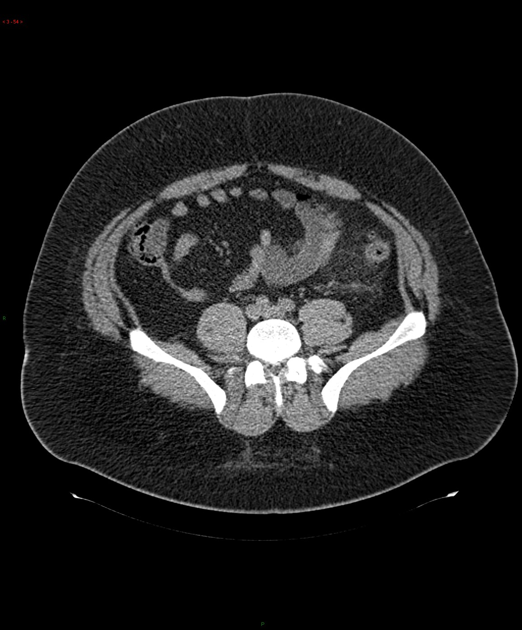
3D data
Andrew Ng
Notes:
5

Slide 6
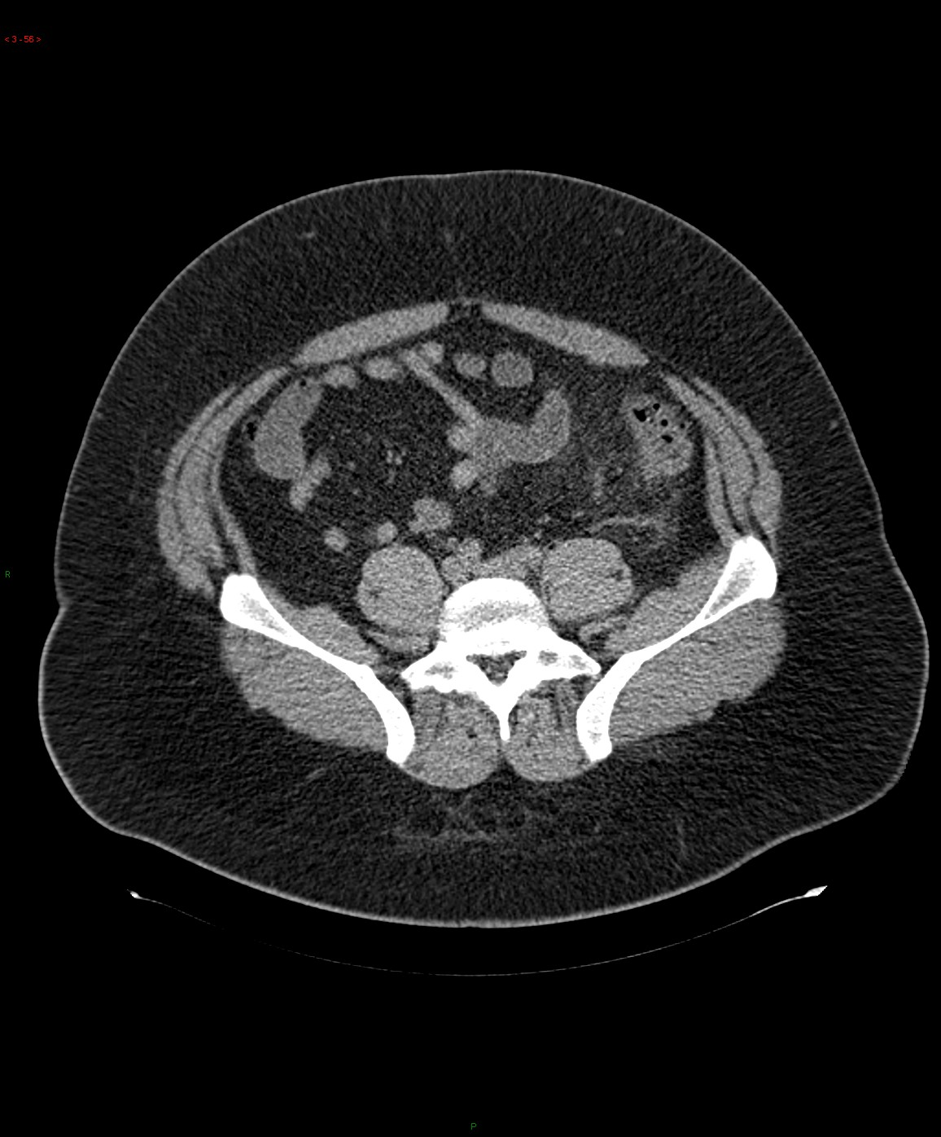
3D data
Andrew Ng
Notes:
6

Slide 7
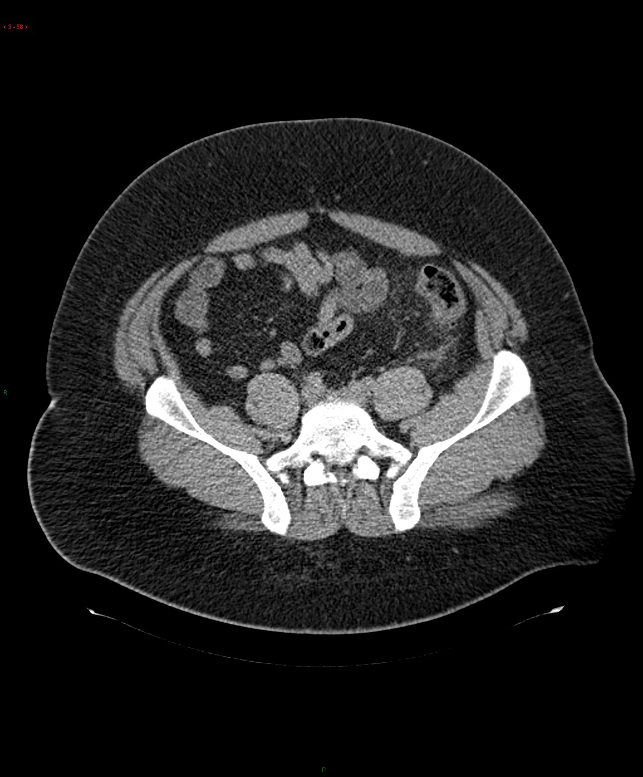
3D data
Andrew Ng
Notes:
7

Slide 8
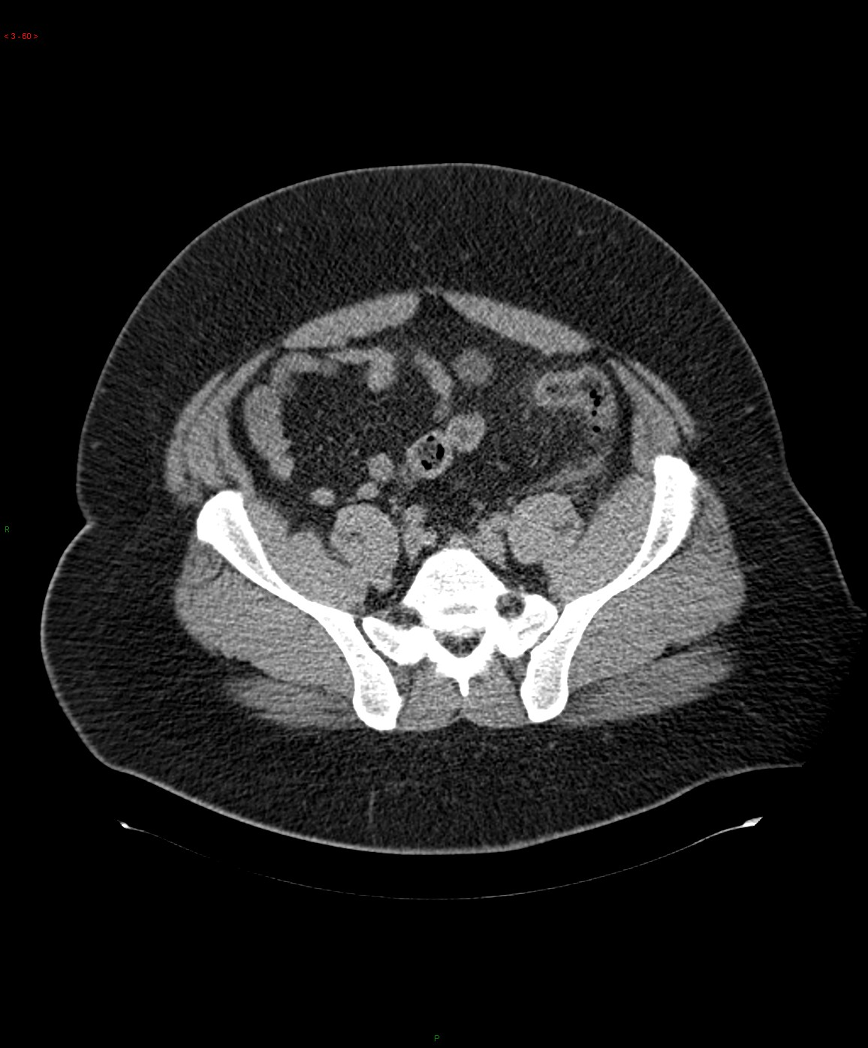
3D data
Andrew Ng
Notes:
8

Slide 9
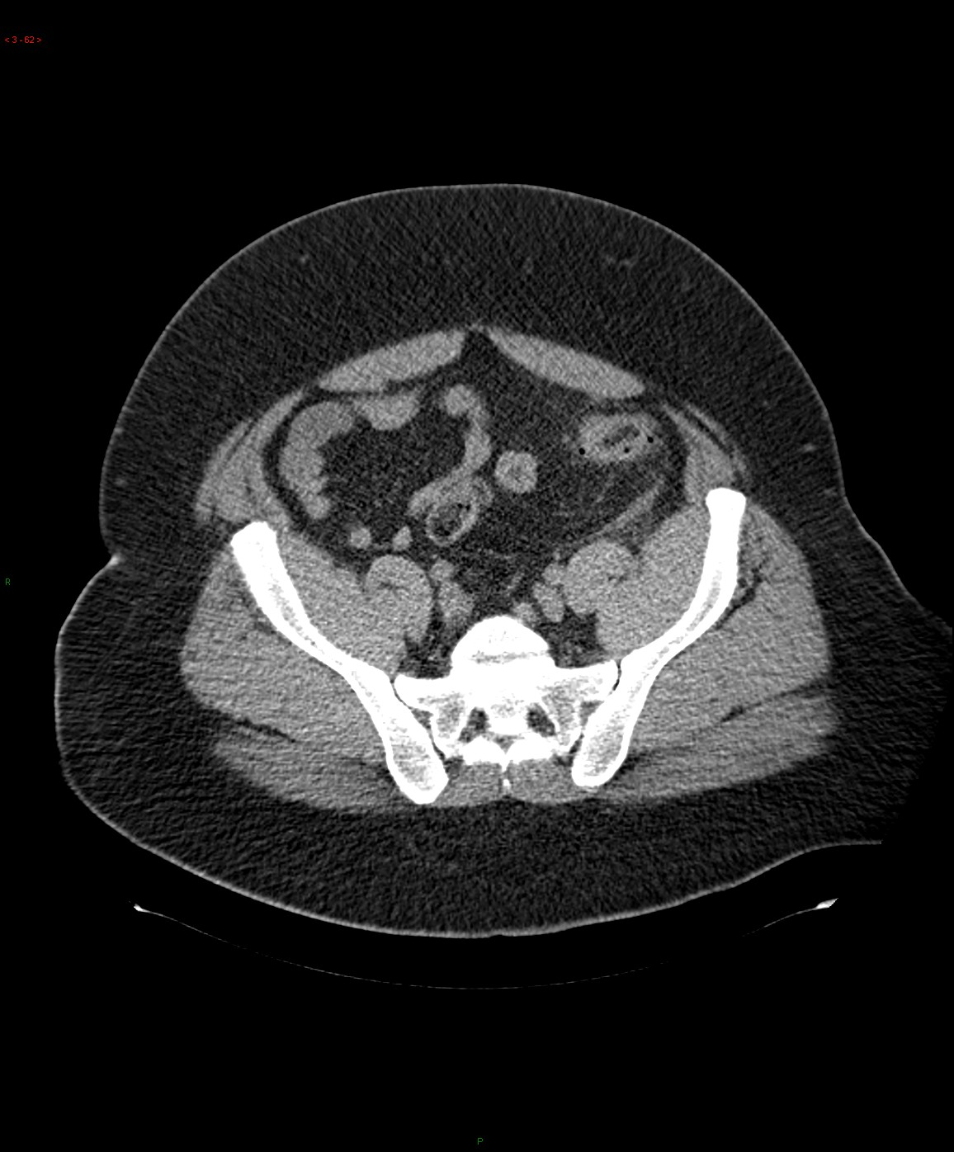
3D data
Andrew Ng
Notes:
9

Slide 10
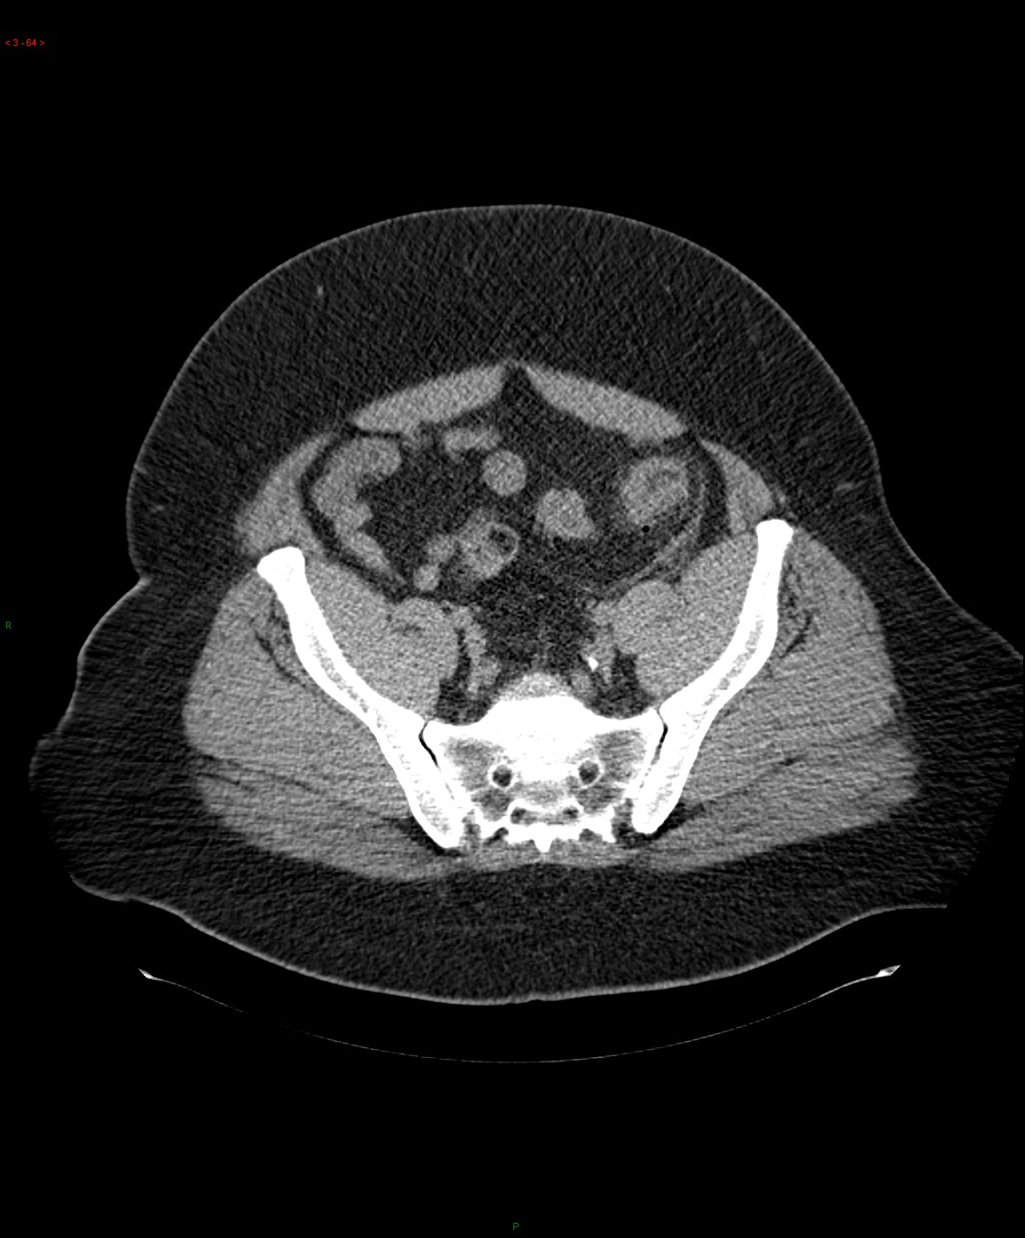
3D data
Andrew Ng
Notes:
10

Slide 11
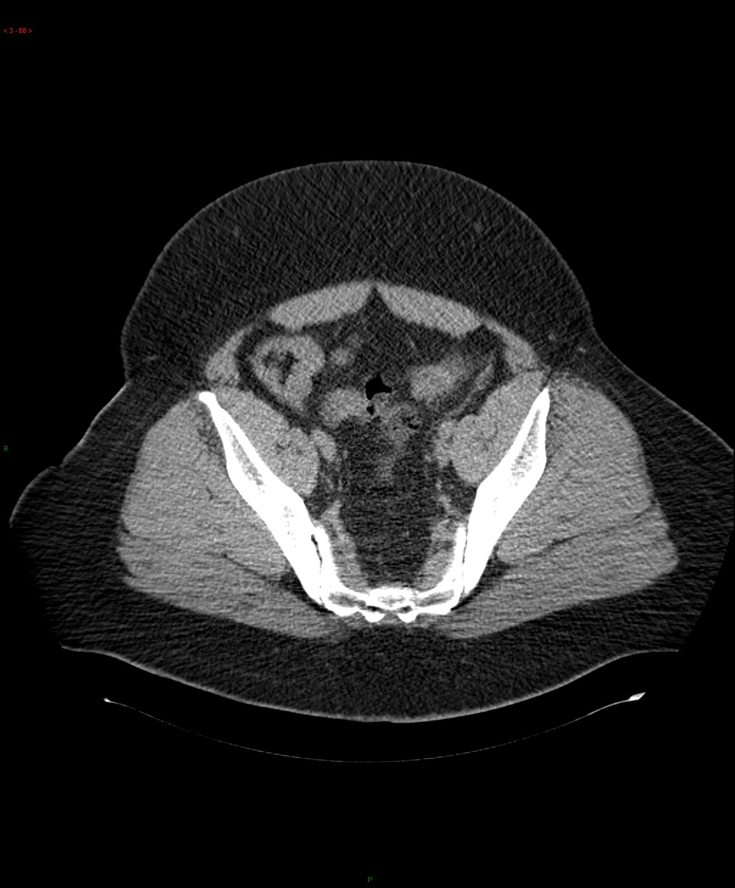
3D data
Andrew Ng
Notes:
11

Slide 12
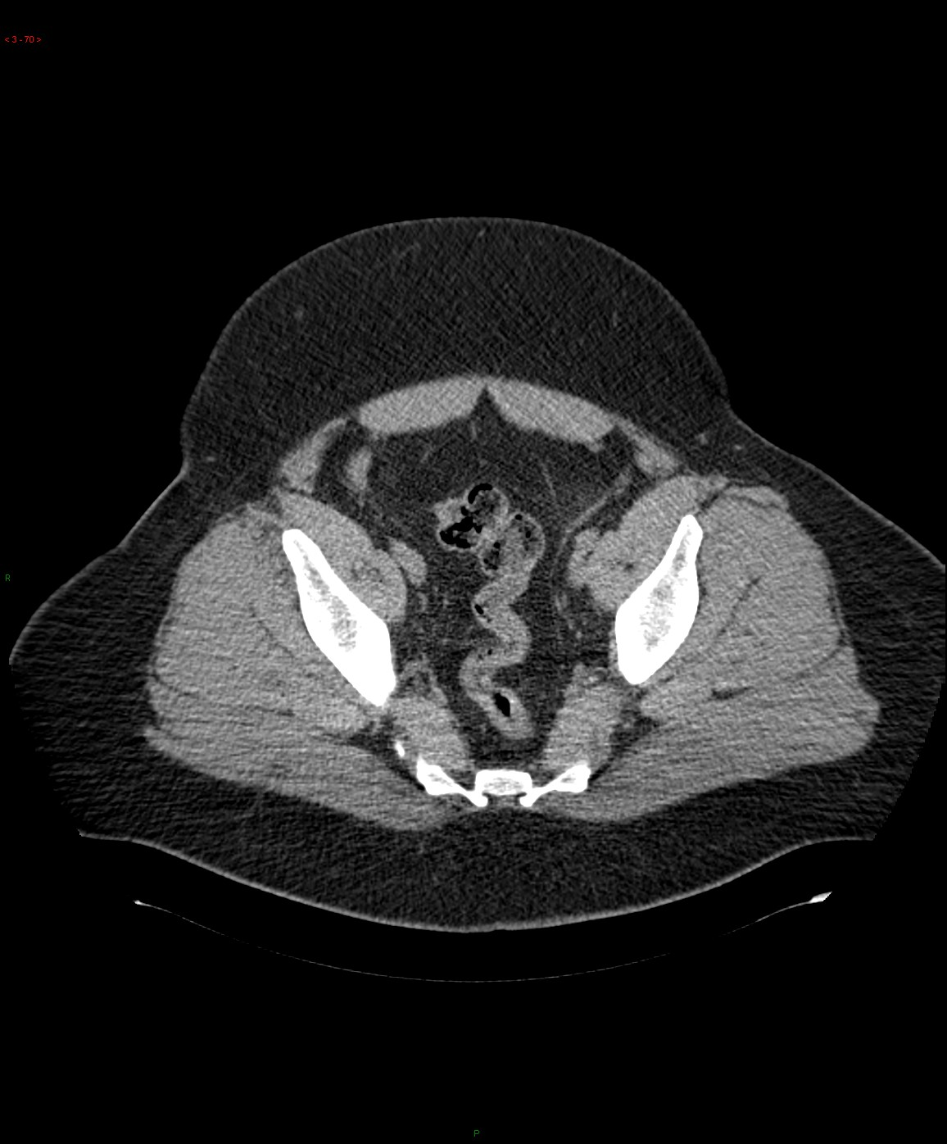
3D data
Andrew Ng
Notes:
12

Slide 13
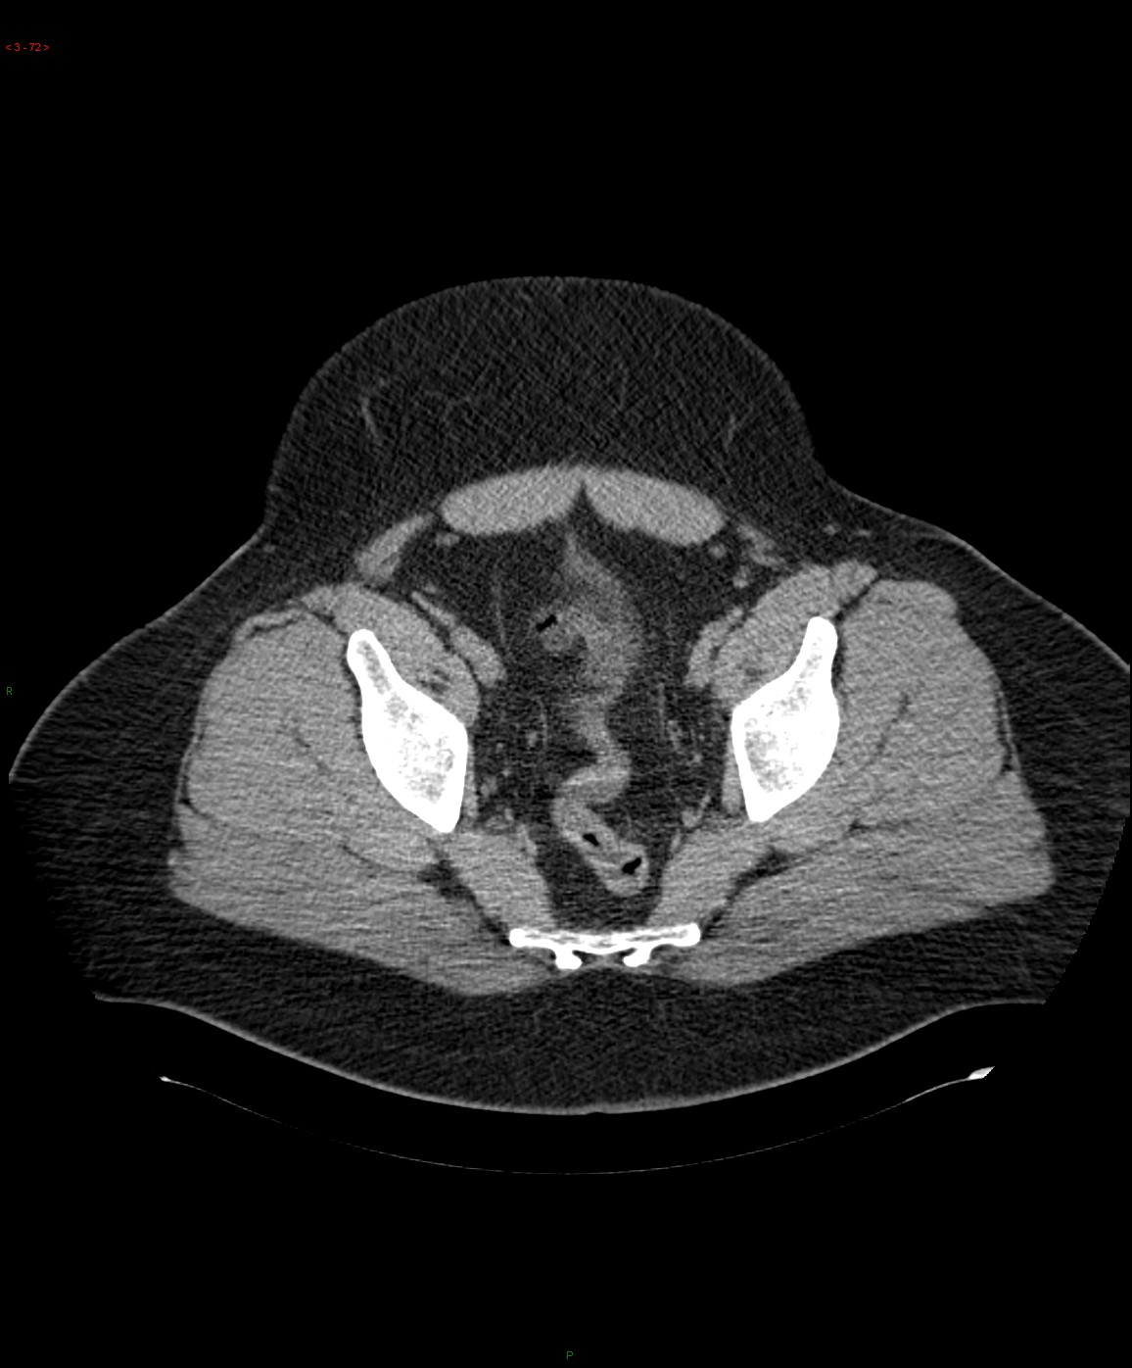
3D data
Andrew Ng
Notes:
13

Slide 14
3D convolution
3D filter
3D volume

