Slide 1

Neural Style Transfer
What are deep
ConvNets learning?
deeplearning.ai

Slide 2
Visualizing what a deep network is learning
Note: 3 by 3 max pool with stride 2:
FC
4096
FC
4096
Pick a unit in layer 1. Find the nine image patches that maximize the unit’s activation.
Repeat for other units.
[Zeiler and Fergus., 2013, Visualizing and understanding convolutional networks]

Slide 3
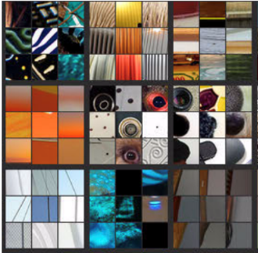
Visualizing deep layers
Layer 1
Layer 2
Layer 3
Layer 4
Layer 5

Slide 4
Visualizing deep layers: Layer 1
Layer 1
Layer 2
Layer 3
Layer 4
Layer 5

Slide 5
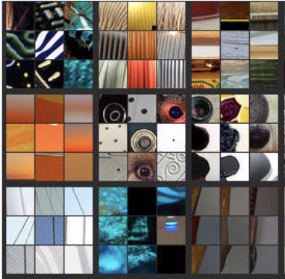
Visualizing deep layers: Layer 2
Layer 1
Layer 2
Layer 3
Layer 4
Layer 5

Slide 6
Visualizing deep layers: Layer 3
Layer 1
Layer 2
Layer 3
Layer 4
Layer 5

Slide 7
Visualizing deep layers: Layer 3
Layer 1
Layer 2
Layer 3
Layer 4
Layer 5

Slide 8
Visualizing deep layers: Layer 4
Layer 1
Layer 2
Layer 3
Layer 4
Layer 5

Slide 9
Visualizing deep layers: Layer 5
Layer 1
Layer 2
Layer 3
Layer 4
Layer 5

