Slide 1

Neural Style Transfer
Cost function
deeplearning.ai

Slide 2
Neural style transfer cost function
Content C
Style S
Generated image G
[Gatys et al., 2015. A neural algorithm of artistic style. Images on slide generated by Justin Johnson]

Slide 3
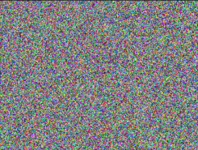
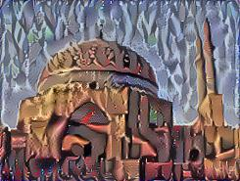
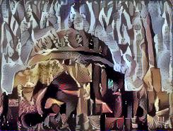
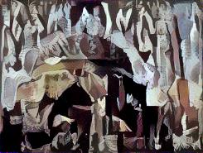

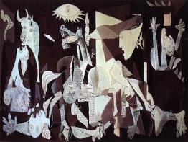
Find the generated image G
1. Initiate G randomly
G:
2. Use gradient descent to minimize
[Gatys et al., 2015. A neural algorithm of artistic style]

