Slide 1

Introduction to Deep Learning
What is a
Neural Network?
deeplearning.ai

Slide 2
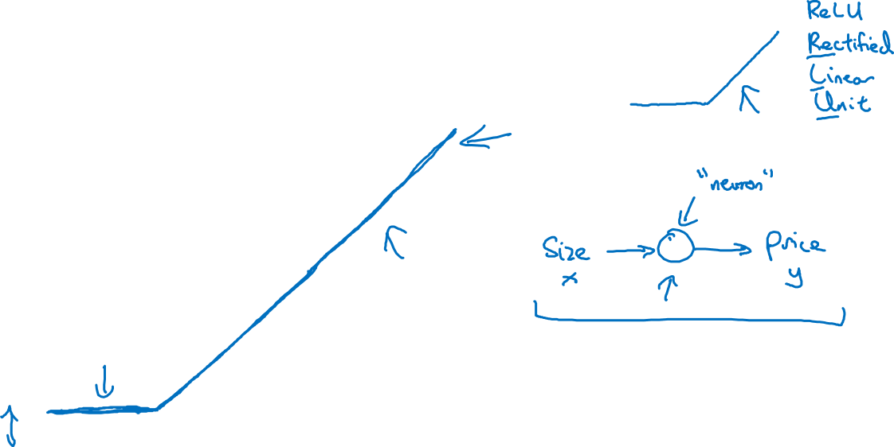
Housing Price Prediction
price
size of house

Slide 3
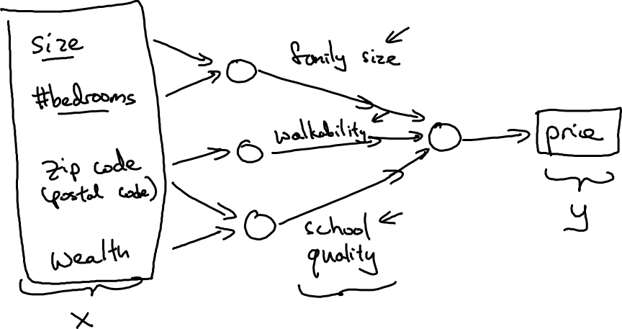
Housing Price Prediction

Slide 4

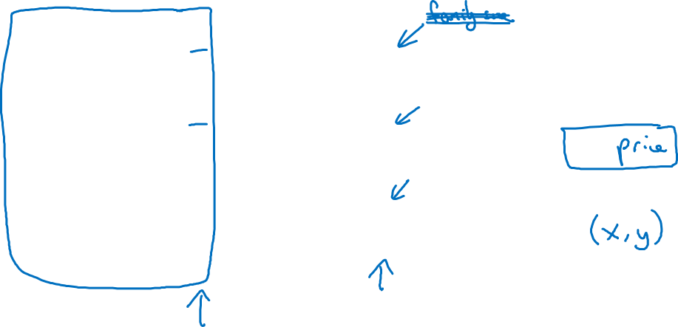




Housing Price Prediction
size
#bedrooms
y
zip code
wealth

